Slide 1
The influence of exercise on cardiovascular disease and metabolic disorders among people with HIV on HAART
Courtney Jensen | April 25, 2013

Slide 2
Objectives
1. Introduce the population I’ll be discussing
2. Justify why this population warrants public health concern
3. Illustrate the importance of exercise and habitual physical activity
4. Explain the qualities of a safe and effective ExR_{x}
5. Provide behavior change strategies so that
they may adhere to the prescription provided
Image source: http://www.9ap.net

Slide 3
Overview
1. Introduce the population and its public health importance
2. Outline the search strategy used to conduct this systematic review
3. Describe the relevant Pathophysiology
4. Explore the benefits of physical activity and exercise among this population
5. Define an appropriate pre-exercise evaluation
6. Identify unique considerations in exercise testing
7. Characterize the ACSM FITT recommendations
8. Evaluate special considerations in ExR_{x}
9. Discuss behavior change strategies to increase
exercise adherence
10. Provide a summary of the major points

Slide 4
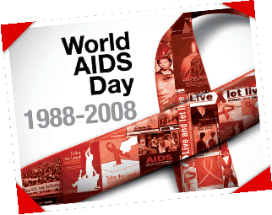
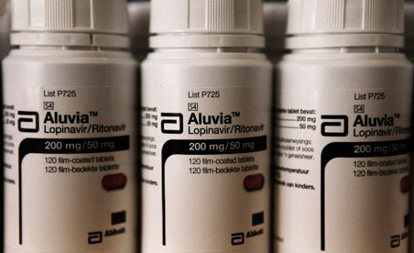
Special Population
People with HIV who take HAART
Image source: http://cylonsky.blogspot.com
Image source: http://www.guardian.co.uk/lifeandstyle/
Notes:
SUD is a multidimensional problem among a very heterogeneous group (McLellan et al., 2000). It includes both substance abuse and dependence and is diagnosable in DSM-IV as a type of brain and behavioral disorder (American Psychiatric Association, 2000).

Slide 5
Prevalence & Magnitude of HIV
1981: HIV is first recognized¹
Since 1981: Spread to every region of the world²
Today: 34 million people are living with HIV³
1.8 million people die of HIV/AIDS each year³
2.7 million new infections appear annually³
1. MMWR, 1981 2. Gottlieb et al., 1996; Faunci, 2006
3. Joint United Nations Program on HIV/AIDS, 2012

Slide 6
Prevalence & Magnitude of HIV
United States: ~1.2 million people infected (0.4%)¹
56,000 new infections appear annually²
24-27% unaware of their infection³
Annual financial cost in the U.S.: $30 billion⁴
More than $6 billion in direct medical expenses⁴
1. Joint United Nations Program on HIV/AIDS, 2012; Karim et al., 2007 2. Lansky et al., 2010
3. U.S. Centers for Disease Control and Prevention, 2006 4. Hutchinson et al., 2006

Slide 7
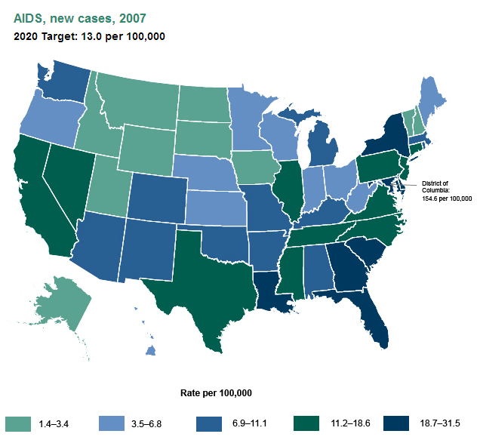
Prevalence & Magnitude of HIV
Rate of new AIDS cases varies by state
Lowest rates in 2007: Alaska, New Hampshire, Vermont, and several Midwestern and Mountain states
Highest rate: District of Columbia (154.6 new cases per 100,000 residents)
http://www.healthypeople.gov/2020/topicsobject
ives2020/nationalsnapshot.aspx?topicId=22 Retrieved 4 April 2013

Slide 8
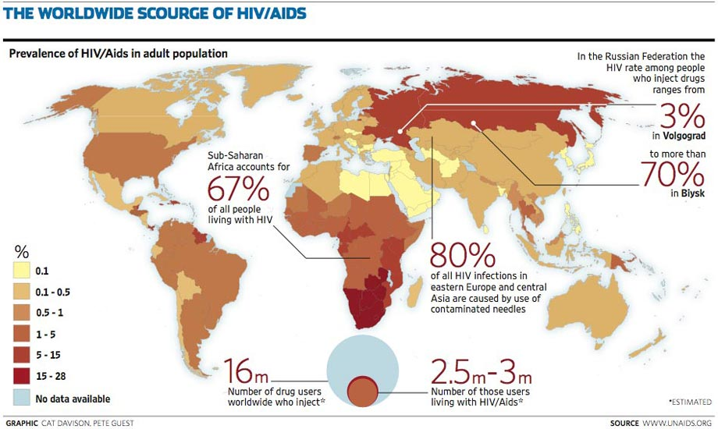

Slide 9
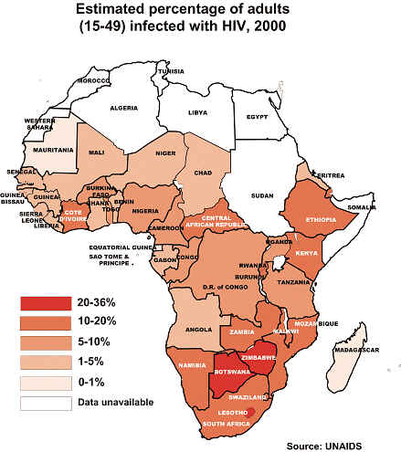
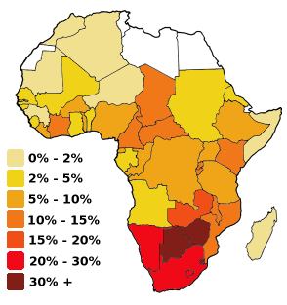
Not all maps are the same
Most estimated by UNAIDS
Different categorical distributions
Image source: http://sgugenetics.pbworks.com

Slide 10
Prevalence & Magnitude of HIV
Antiretroviral medication introduced in 1987¹
HAART introduced in 1996²
Mortality rate reduced by more than 70%³
Despite increases in the length of life,
the quality of life is not being improved
1. Fischl et al., 1987 2. Gulick et al., 1997; Hammer et al., 1997 3. Lugassy, 2010; Palella et al., 1998

Slide 11
Prevalence & Magnitude of HIV
The combination of HIV and HAART frequently results in:
Anthropometric abnormalities (e.g., lipodystrophy, lipoatrophy, and lipomegaly)
Compromised metabolic functioning (e.g., muscle wasting, altered insulin action, dyslipidemia, and hepatic lipogenesis)
Increased risk of cardiovascular events such as myocardial infarctions
Anuurad et al., 2009; Fichtenbaum et al., 2010; Grinspoon & Carr, 2005; Jain et al., 2001.

Slide 12
Prevalence & Magnitude of HIV
Exercise is a possible strategy to manage the metabolic impairments, improve the anthropometric abnormalities, and mitigate the cardiovascular risks associated with HIV and HAART
Despite these benefits, exercise has not become a standard component of therapeutic interventions for people living with HIV
Most interventions focus on awareness, diagnosis, and prevention
Fillipas et al., 2010; Spierer et al., 2007; Robinson et al., 2007; Henricksen, 2002; Jones et al., 2001; Thoni et al., 2002

Slide 13
On July 13th, 2010, the U.S. government presented a National HIV/AIDS Strategy, which outlines three primary goals to be accomplished by 2015
AIDS.gov, 2012

Slide 14
Reduce New HIV Infections: By 2015, the goal is to reduce the annual number of new cases by 25% while increasing percentage of people with HIV who know their serostatus to 90%
Increase Access to Care and Improve Health Outcomes for People Living with HIV: By 2015, the goal is to increase the proportion of HIV patients receiving clinical care from 65% to 85%
Reduce HIV-related health disparities: By 2015, the goal is to increase the proportion of people living with HIV who have an undetectable viral load by 20%
AIDS.gov, 2012

Slide 15
On December 2nd, 2010, the U.S. Department of Health and Human Services announced the Healthy People 2020 initiative
Eighteen specific HIV-related objectives were disclosed,
divided in four categories
U.S. Department of Health and Human Services, 2012a

Slide 16
Diagnosis of HIV Infection and AIDS: Achieve an annual rate of 12.4 new cases per 100,000 people, down from 13.0 new cases in 2010
Death, Survival, and Medical Healthcare After Diagnosis of HIV Infection and AIDS: Increase 3-year survival rate to 92.4% (from 84.0% in 2006) and reduce annual HIV-related deaths to 3.3 per 100,000 people
HIV Testing: Increase percentage of people who get tested from 17.2% in 2010 to 18.9% in 2020
HIV Prevention: Promote condom use (data are limited) and increase percentage of substance abuse treatment facilities with HIV/AIDS
U.S. Department of Health and Human Services, 2012a

Slide 17
Purpose
The public health importance of HIV/AIDS is illustrated by the simultaneous implementation of two federal initiatives concerning its treatment and prevention
Neither initiative mentions the therapeutic potential of exercise/PA
Therefore, the purpose of this systematic review is to establish a case for exercise and PA as a supplement to HIV/AIDS treatment interventions

Slide 18
Search Strategy
Electronic databases were searched for articles related to:
1) The cardiovascular and metabolic consequences of HIV and HAART
2) Modes by which exercise can improve cardiovascular and metabolic profiles among people with HIV who take HAART.
Image source: http://www.bcpiweb.com

Slide 19
Search Strategy
Databases were PubMed, Scopus, and the Cochrane Library
In PubMed, medical subject heading descriptors were used to facilitate a more comprehensive search result

Slide 20
Search Strategy
For articles related to the cardiovascular and metabolic consequences of HIV and HAART, the PubMed search term was:
("Anti-HIV Agents"[MAJR] OR haart[ti] OR "highly active antiretroviral therapy"[ti]) AND ("cardiovascular"[ti] OR hypertension[ti] OR hypertensive[ti] OR "blood pressure"[ti] OR smoking[ti] OR "tobacco use"[ti] OR diabetes[ti] OR "blood glucose"[ti] OR hyperglycemi*[ti] OR "cholesterol"[ti] OR metabolic[ti] OR metabolism[ti] OR obesity[ti] OR overweight[ti] OR "body mass"[ti] OR "body composition"[ti] OR "body morphology"[ti] OR bmi[ti] OR weight[ti] OR diabetes[ti] OR lipid[ti] OR lipids[ti] OR lipodystroph*[ti]) AND english[la] AND review[pt]
Image source: http://schaechter.asmblog.org

Slide 21
Search Strategy
For articles related to the cardiovascular and metabolic consequences of HIV and HAART, the PubMed search term was:
("Anti-HIV Agents"[MAJR] OR haart[ti] OR "highly active antiretroviral therapy"[ti]) AND ("cardiovascular"[ti] OR hypertension[ti] OR hypertensive[ti] OR "blood pressure"[ti] OR smoking[ti] OR "tobacco use"[ti] OR diabetes[ti] OR "blood glucose"[ti] OR hyperglycemi*[ti] OR "cholesterol"[ti] OR metabolic[ti] OR metabolism[ti] OR obesity[ti] OR overweight[ti] OR "body mass"[ti] OR "body composition"[ti] OR "body morphology"[ti] OR bmi[ti] OR weight[ti] OR diabetes[ti] OR lipid[ti] OR lipids[ti] OR lipodystroph*[ti]) AND english[la] AND review[pt]
156
Image source: http://schaechter.asmblog.org

Slide 22
Search Strategy
For articles related to modes by which exercise can improve cardiovascular and metabolic profiles among people with HIV who take HAART, the PubMed search term was:
("Anti-HIV Agents"[MAJR] OR haart[ti] OR "antiretroviral therapy"[ti] OR "antiretroviral therapies"[ti] OR "HIV"[ti]) AND ("cardiovascular" OR hypertension OR hypertensive OR "blood pressure" OR smoking OR "tobacco use" OR diabetes OR "blood glucose" OR hyperglycemi* OR "cholesterol" OR metabolic OR metabolism OR obesity OR overweight OR "body mass" OR "body composition" OR "body morphology" OR bmi OR weight OR diabetes OR lipid OR lipids OR lipodystroph*) AND (exercise[ti] OR exercises[ti] OR "jogging"[ti] OR running[ti] OR running[mesh] OR treadmill[ti] OR treadmills[ti] OR "strength training"[ti] OR "weight lifting"[ti] OR "resistance training"[ti] OR "endurance training"[ti] OR "cardiovascular training"[ti] OR "speed training"[ti] OR plyometric[ti] OR plyometrics[ti] OR "agility training"[ti] OR "physical activity"[ti] OR "physical activities"[ti]) AND english[la]

Slide 23
Search Strategy
For articles related to modes by which exercise can improve cardiovascular and metabolic profiles among people with HIV who take HAART, the PubMed search term was:
("Anti-HIV Agents"[MAJR] OR haart[ti] OR "antiretroviral therapy"[ti] OR "antiretroviral therapies"[ti] OR "HIV"[ti]) AND ("cardiovascular" OR hypertension OR hypertensive OR "blood pressure" OR smoking OR "tobacco use" OR diabetes OR "blood glucose" OR hyperglycemi* OR "cholesterol" OR metabolic OR metabolism OR obesity OR overweight OR "body mass" OR "body composition" OR "body morphology" OR bmi OR weight OR diabetes OR lipid OR lipids OR lipodystroph*) AND (exercise[ti] OR exercises[ti] OR "jogging"[ti] OR running[ti] OR running[mesh] OR treadmill[ti] OR treadmills[ti] OR "strength training"[ti] OR "weight lifting"[ti] OR "resistance training"[ti] OR "endurance training"[ti] OR "cardiovascular training"[ti] OR "speed training"[ti] OR plyometric[ti] OR plyometrics[ti] OR "agility training"[ti] OR "physical activity"[ti] OR "physical activities"[ti]) AND english[la]
85

Slide 24
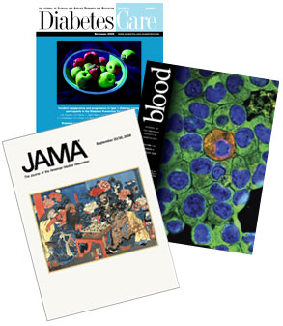
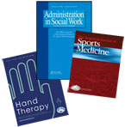
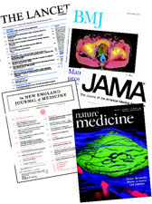
Search Strategy
All included studies:
Were written in English
Appeared in peer-reviewed journals

Slide 25
Search Strategy
Articles were excluded if:
They did not characterize cardiovascular, metabolic, or anthropometric consequences of HIV and HAART
Or:
They did not quantify the effects of exercise on adults with HIV taking HAART.

Slide 26
Search Strategy
Articles were excluded if:
The participants were children
Image source: http://www.nlm.nih.gov/medlineplus/magazine

Slide 27
Search Strategy
1) The cardiovascular and metabolic consequences of HIV and HAART
2) Modes by which exercise can improve cardiovascular and metabolic profiles among people with HIV who take HAART
32
29

Slide 28
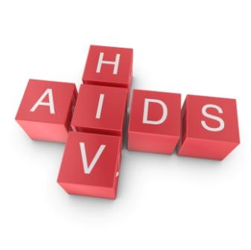
Pathophysiology of HIV
The International Committee on Taxonomy of Viruses classifies HIV as a Group VI RNA virus, or a retrovirus¹
Retroviruses do not contain DNA and thus replication must take place inside of a host cell²
1. King et al., 2012 2. Klatt, 2012

Slide 29
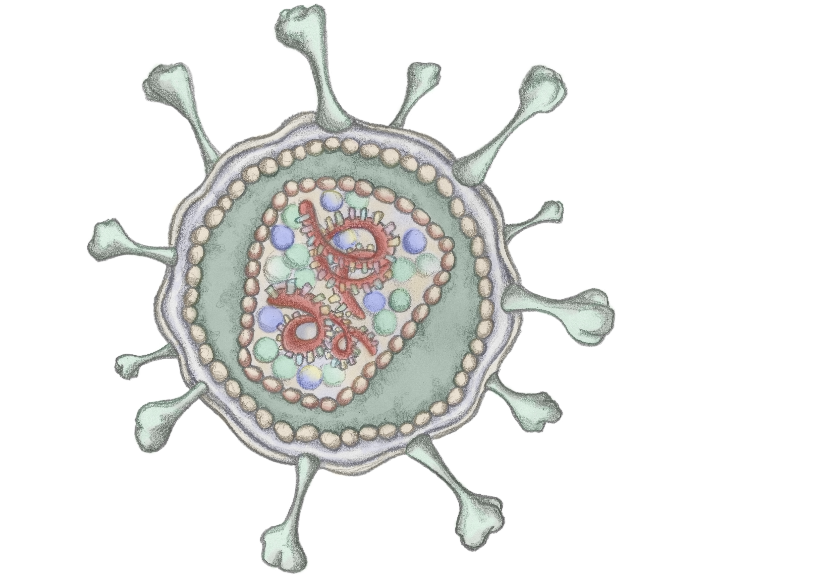

Slide 30
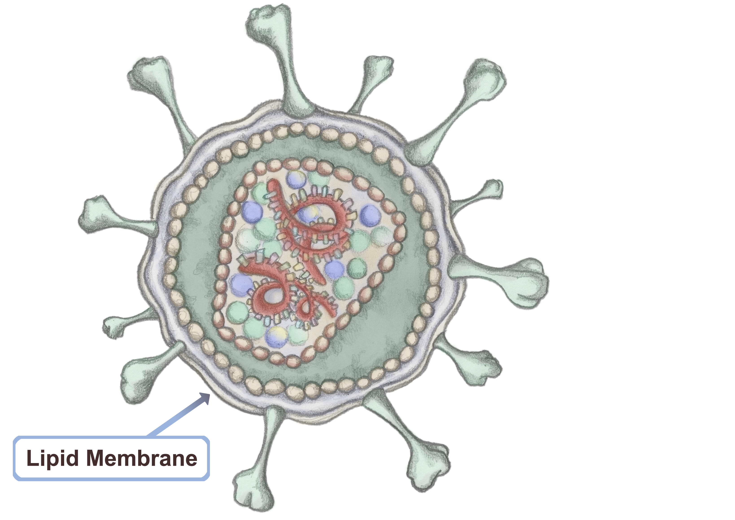

Slide 31
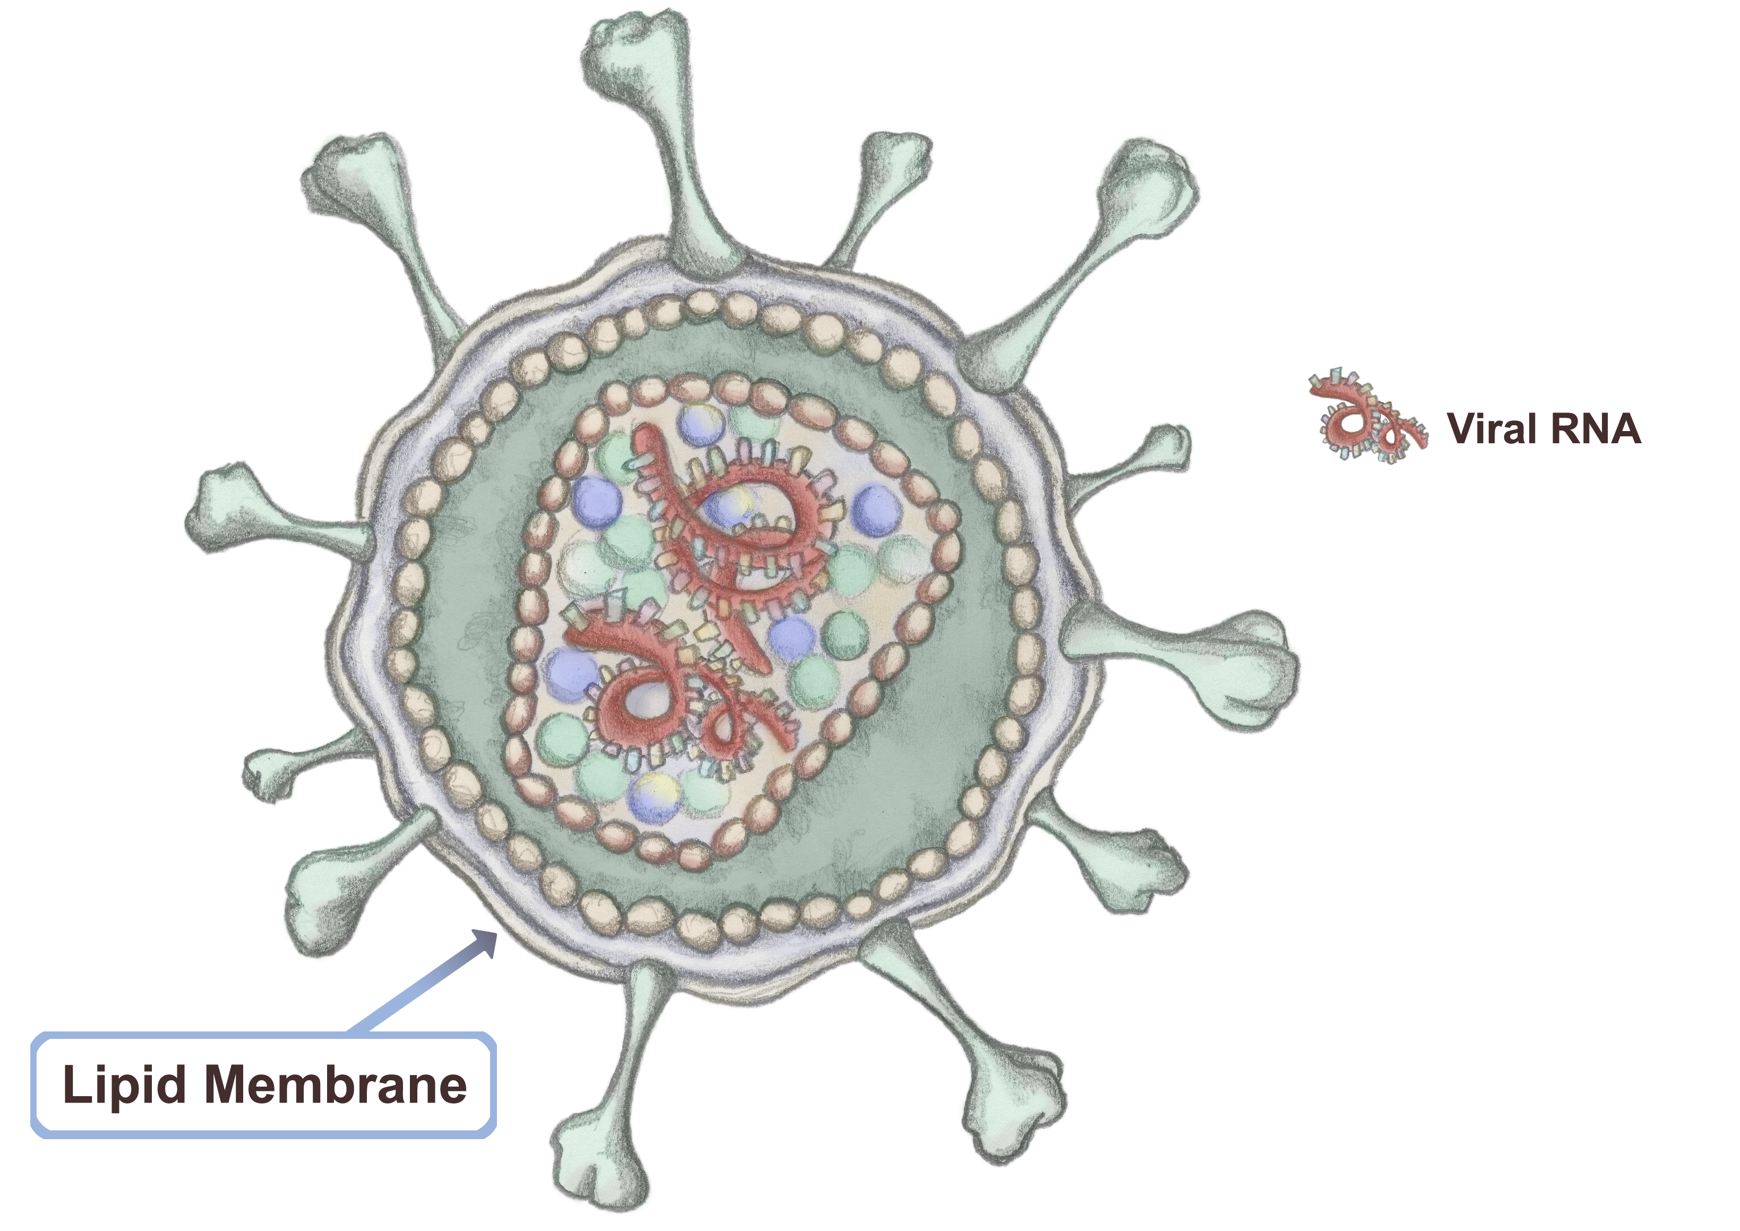

Slide 32
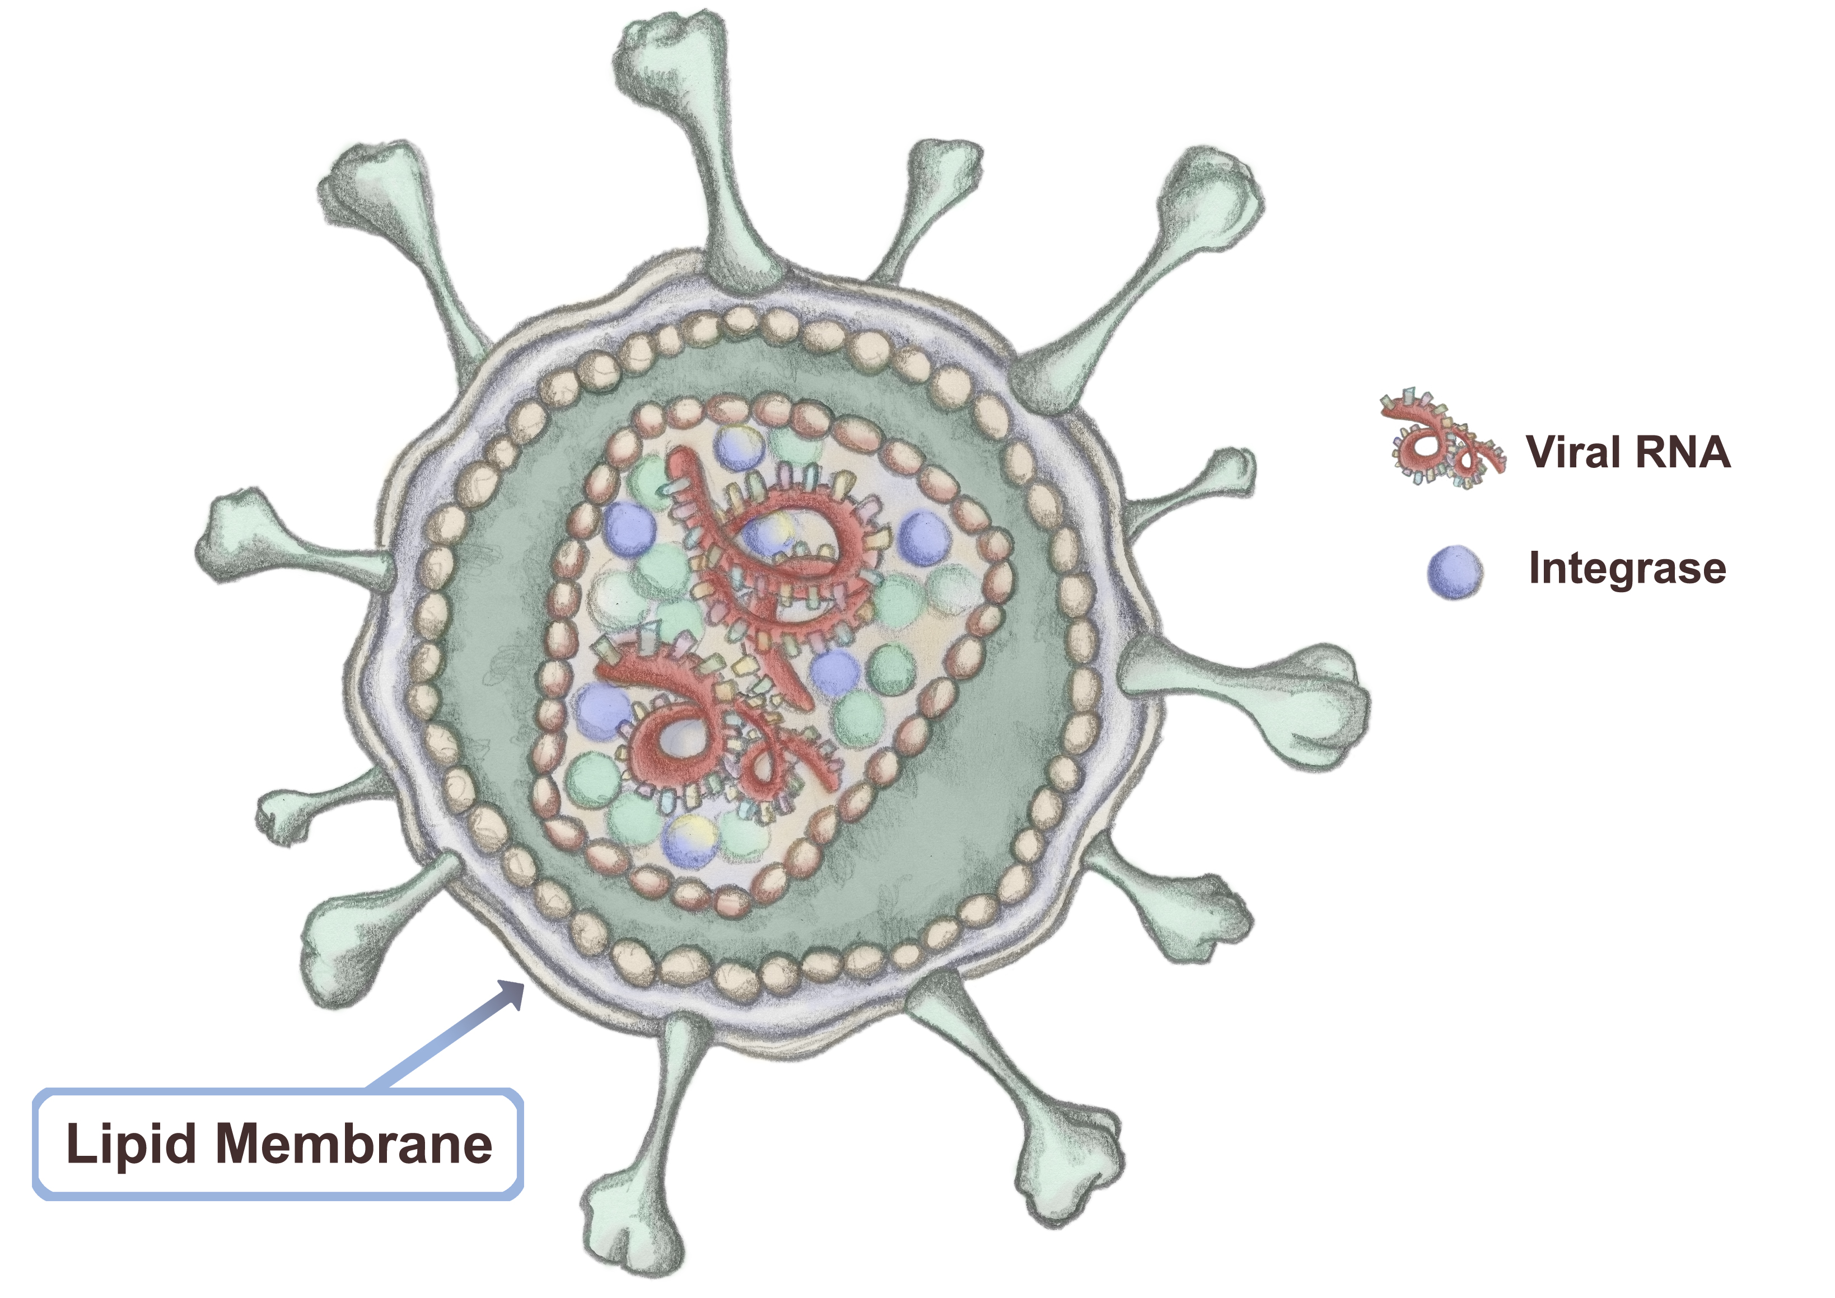

Slide 33
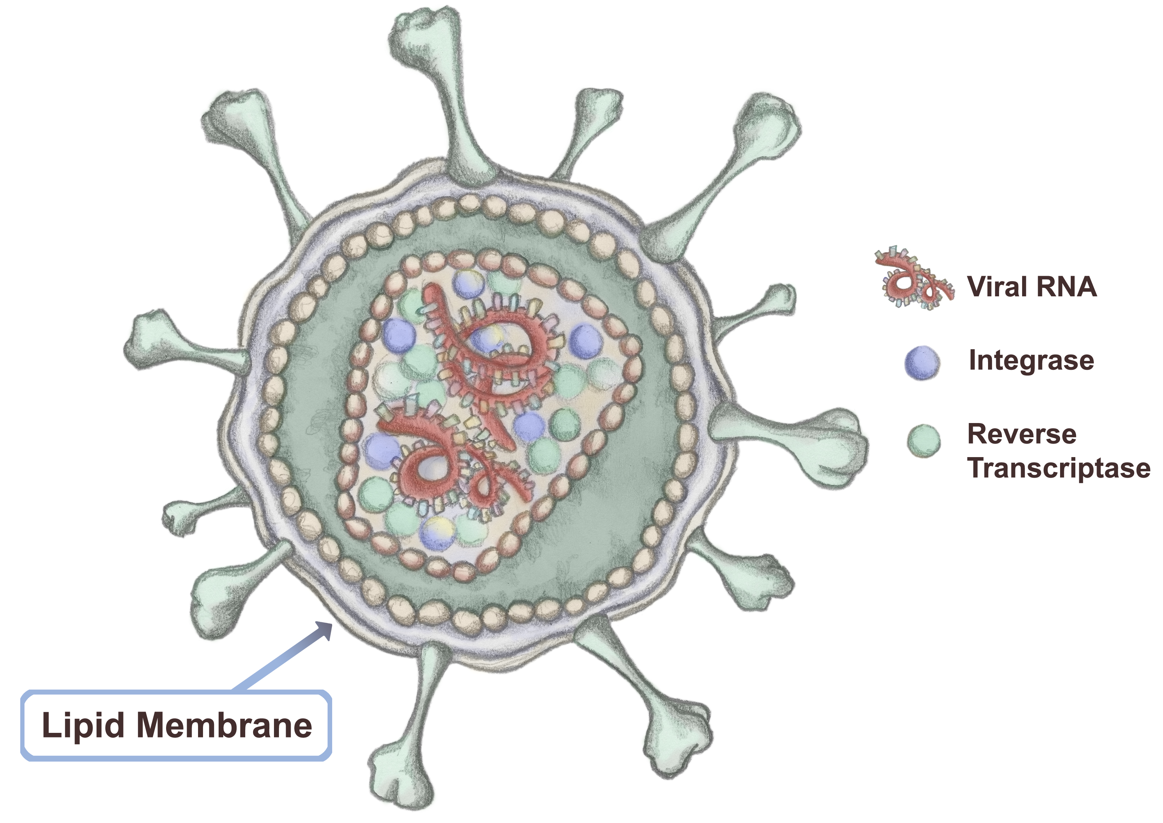

Slide 34
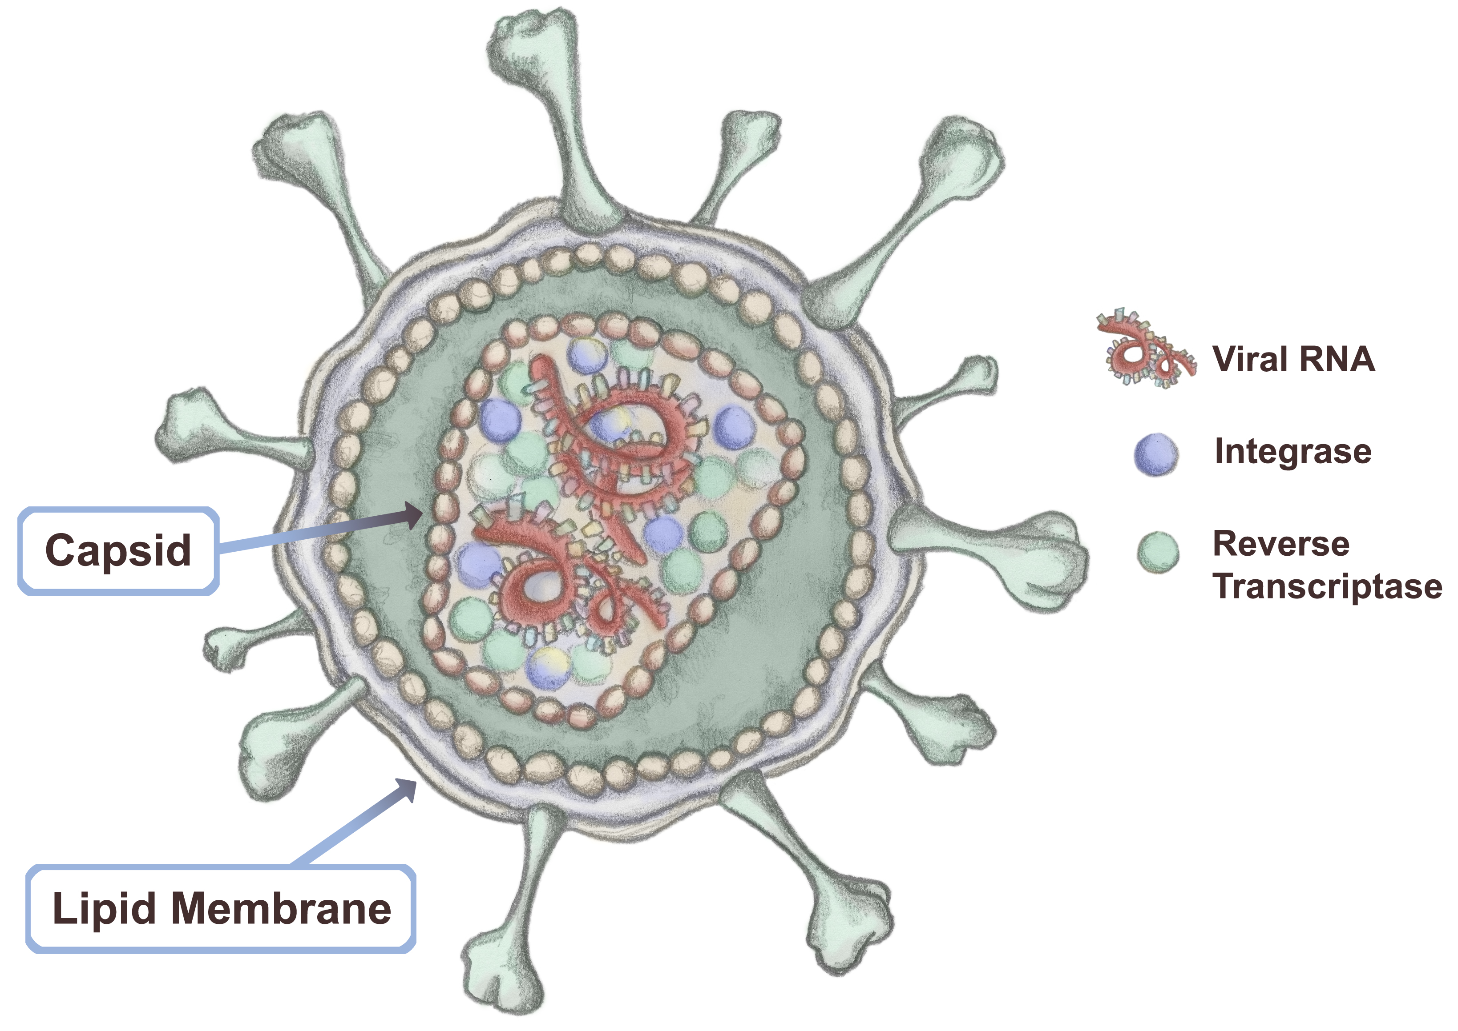

Slide 35
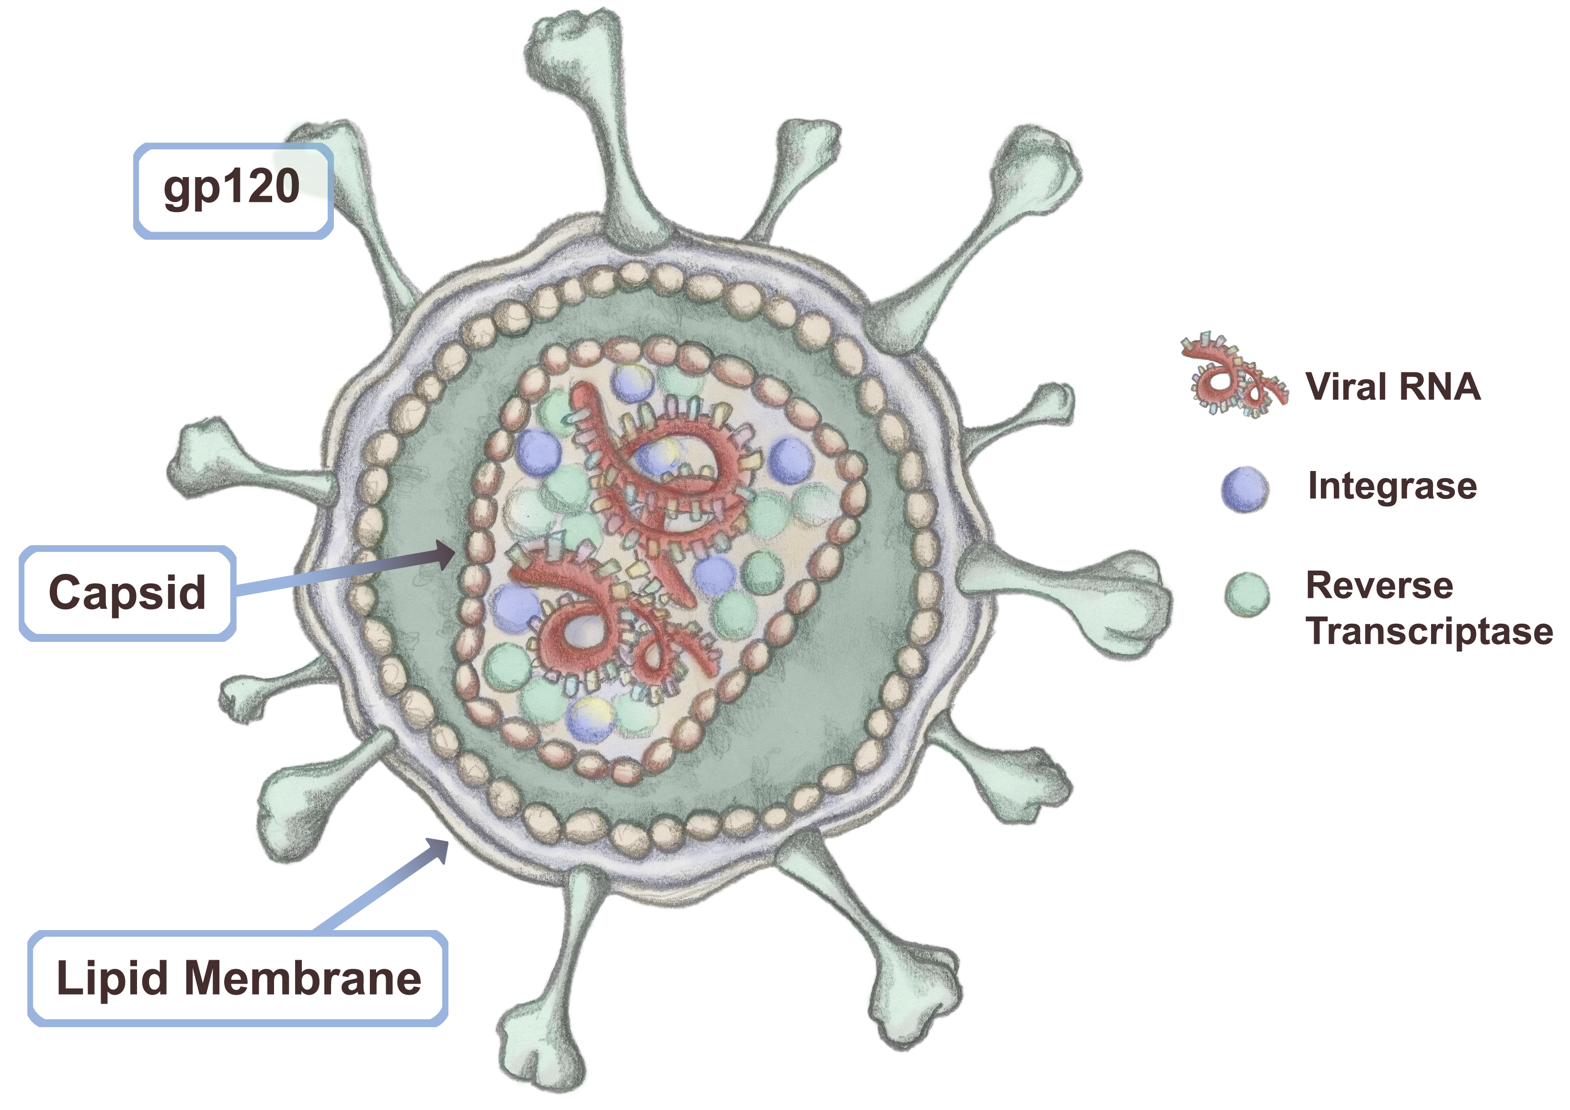

Slide 36
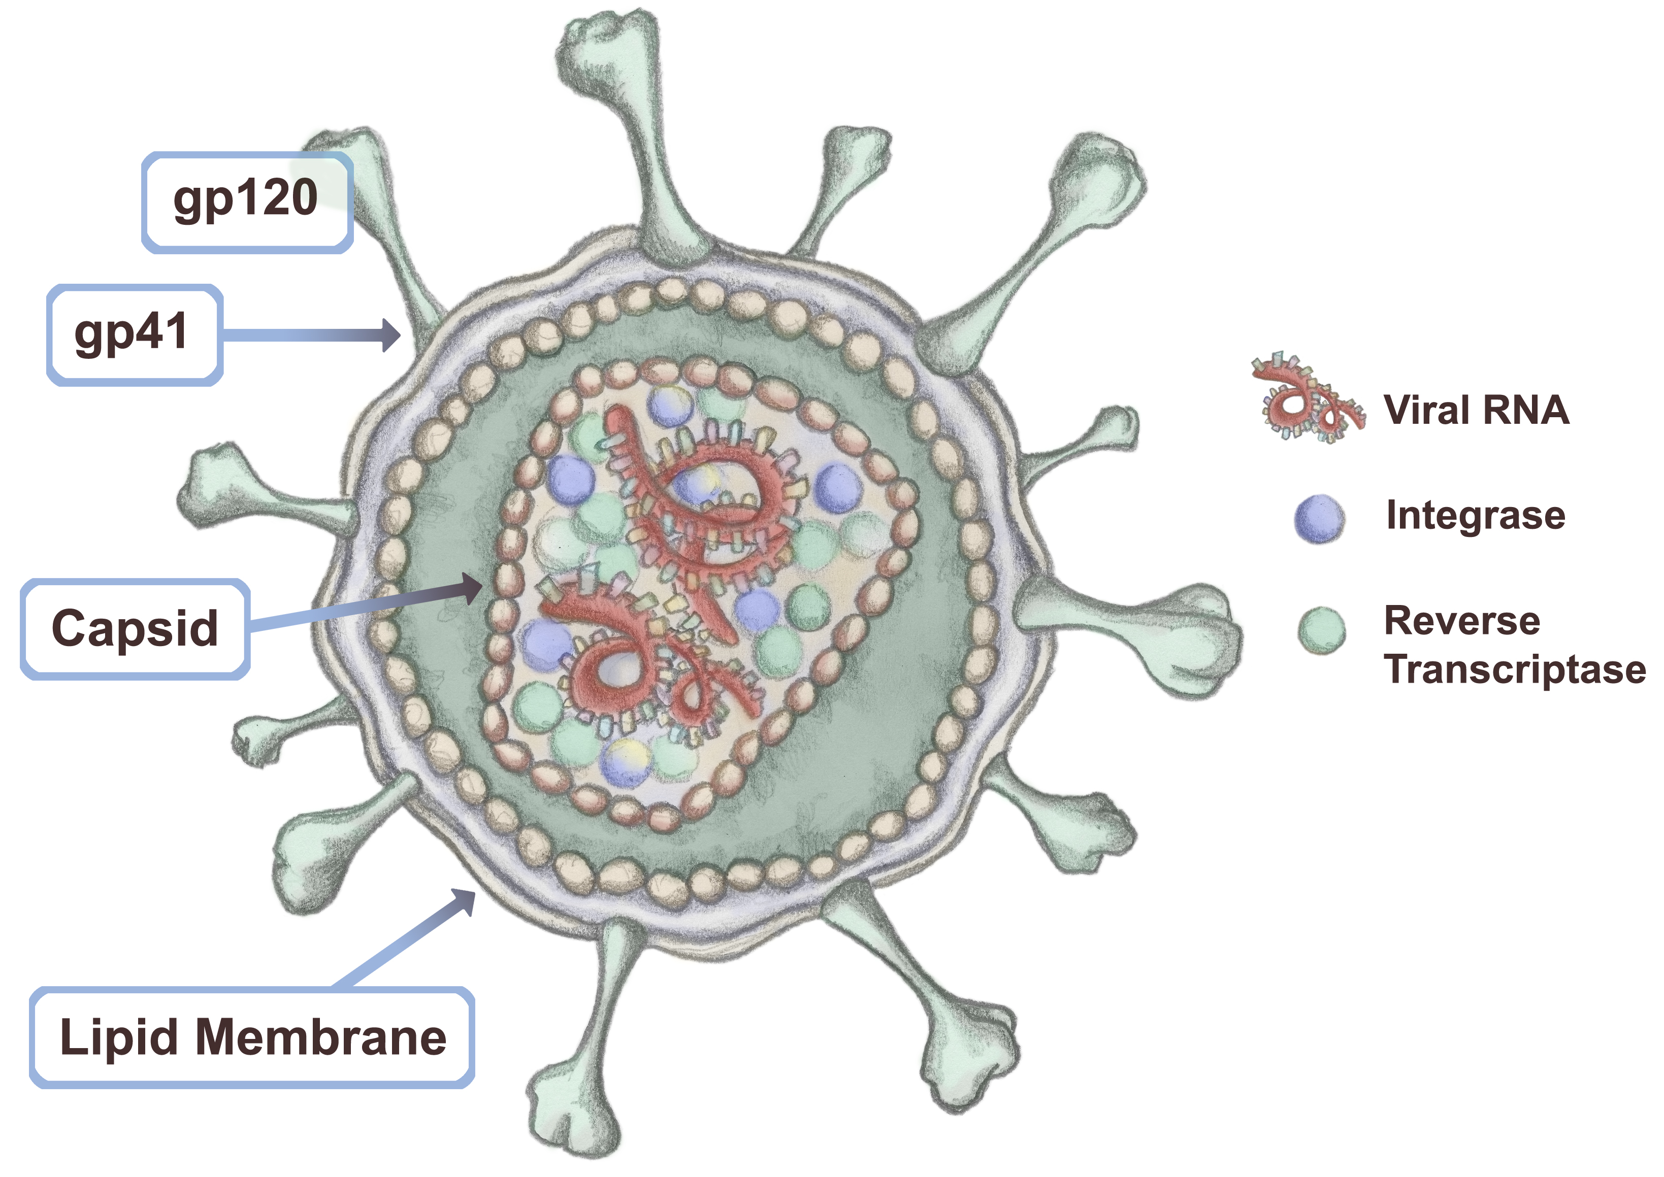

Slide 37
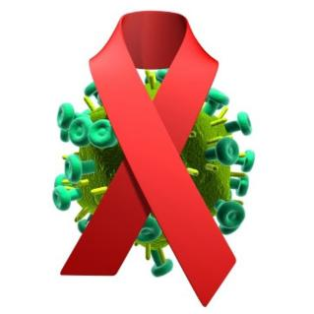
Pathophysiology of HIV
Once infected, there is a continuous replication of HIV
virions and a progressive destruction of CD4 cells¹
Eventually, despite hyperactive lymphocyte production,
the body is unable to produce new CD4 cells at the rate
of destruction¹
The consequence of this is failure of the immune system and the
appearance of AIDS¹
As HIV progresses toward AIDS, the infection elicits a variety of metabolic
and cardiovascular abnormalities²
The mechanisms resulting in these changes are not well understood
and likely to be from a multitude of influences (genetic predisposition,
HIV infection per se, the influence of environmental factors, etc.)²
1. Klatt, 2012 2. Guardiola et al., 2006; Grunfeld, 1995; Glover, 2010 Image source: Scientificamerican.com

Slide 38
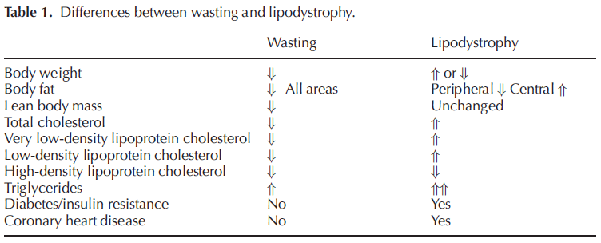
Scevola et al., 2003

Slide 39
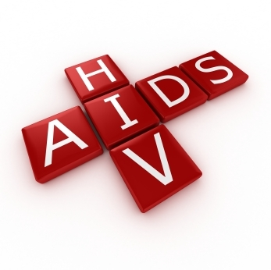
Pathophysiology of HIV
HIV associates with an excess proliferation of pro-inflammatory cytokines (e.g., interleukins 1, 2, and 6, interferon gamma, transforming growth factor-β, and tumor necrosis factor-α)
Gelato et al., 2007; Anuurad et al., 2009 Image source: Nation.com.pk

Slide 40
Pathophysiology of HIV
Initiate cell signaling cascades that compromise metabolic functioning both locally and systemically^{1,2}
When hyper-inflammation combines with accelerated adipose tissue lipolysis (via β-adrenergic stimulation), hepatic fatty acid levels can increase, stimulating the synthesis of triglycerides and the secretion of VLDL particles²
1. Gelato et al., 2007 2. Anuurad et al., 2009 Image source: Nation.com.pk

Slide 41
Pathophysiology of HIV
TNF-α and IL-1 upregulate LDL receptor activity while increasing serum triglyceride levels, contributing to the hypertriglyceridemia commonly seen in people with HIV
1. Gelato et al., 2007) 2. Anuurad et al., 2009 Image source: Nation.com.pk

Slide 42
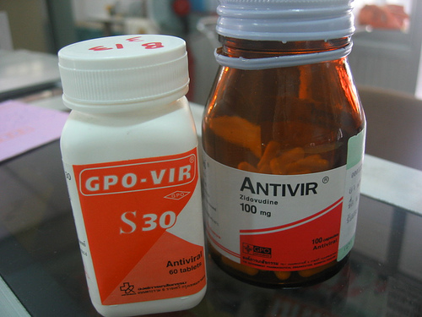
Pathophysiology of HIV
The addition of HAART commonly exacerbates:
Morphological changes (e.g., abdominal adiposity, wasting syndromes)¹
Cardiometabolic changes (e.g., robust increase in triglycerides, modest increase in LDL cholesterol, and a decrease in HDL cholesterol)²
Risk of CVD³ and the metabolic syndrome⁴
1. Hicks et al., 2003 2. Carpentier et al., 2005, Anuurad et al., 2009
3. Grinspoon & Carr, 2005 4. Samaras, 2007 Image source: Flickriver.com

Slide 43
Etiology
Injection drug use represents the primary mode of transmission
Typical transmission rates from sexual contact are 0.1% to 0.5%, although estimates can be as high as 1.7% per exposure based on other factors
1. Mathers et al., 2008; EMCDDA, 2009; UNAIDS, 2011 2. DeGruttola et al., 1989; Boily et al., 2009; Varghese et al., 2002 Image source: www.Chughtailab.com

Slide 44
Etiology
Intravenous drug use has a transmission probability of 0.7% per exposure, which translates to a 49% risk of infection after 100 exposures
Kaplan & Heimer, 1992; Kaplan & Heimer, 1995

Slide 45
Benefits of Exercise and
Habitual Physical Activity
PA and exercise interventions are a possible strategy to manage the metabolic impairments, improve the anthropometric abnormalities, and mitigate the cardiovascular risk associated with HIV and HAART
Fillipas et al., 2010; Spierer et al., 2007; Robinson et al., 2007; Henricksen, 2002; Thoni et al., 2002 Image source: glaucomacolombia.com

Slide 46
Benefits of Exercise and
Habitual Physical Activity
PA and exercise interventions are a possible strategy to manage the metabolic impairments, improve the anthropometric abnormalities, and mitigate the cardiovascular risk associated with HIV and HAART
Fillipas et al., 2010; Spierer et al., 2007; Robinson et al., 2007; Henricksen, 2002; Thoni et al., 2002 Image source: glaucomacolombia.com

Slide 47
Anthropometric measures

Slide 48
Anthropometric measures
Participants were
21–50 yr
Living in Rwanda
HIV+
On HAART for at least 6 months

Slide 49
Anthropometric measures
Inclusionary criteria
Body fat redistribution (lipomegaly or lipoatrophy) has occurred after initiation of HAART in the following areas: face, dorsocervical region, arms, breasts, abdomen, buttocks, and/or legs.
Changes were rated 1 – 4 according to severity:
1: Absent
2: Mild
3: Moderate
4: Severe
Scores for all body regions were combined and participants were eligible to enroll if their total score was ≥ 18 (moderate – severe)

Slide 50
Anthropometric measures
152 people were screened
21 did not have moderate – severe BFR
16 were not fit to exercise
11 declined to participate
4 anticipated pharmacological changes that contraindicated exercise
100 participants enrolled
Randomized to exercise group or non-exercising control group

Slide 51
Anthropometric measures
FITT of exercise program:
Frequency: 3x/week for 6 months
Intensity: progressive increase from 45% age-predicted max HR for the first 3 weeks, 60% for the next 6, and 75% for the remainder
Time: 1.5 hours/session
Type: supervised exercise session involving a warm-up, 15 min brisk walking, 45-60 min of jogging, running, stair climbing, low-back and abdominal stabilization exercises, and resistance training, 15 min cool-down, and stretching

Slide 52
Anthropometric measures
Anthropometric measures:
Height, weight, skinfolds, waist and hip circumferences were collected
Weight and height were measured to the nearest 0.1 kg and 0.1 cm
Waist circumference was measured at the narrowest circumference using a non-stretch cloth tape measure
Hip circumference was measured at the anterior superior iliac spine
Skinfolds were taken at the triceps, mid biceps, suprailiac and subscapular skin folds using Lange calipers, with % body fat calcuated by a formula validated in a black population

Slide 53
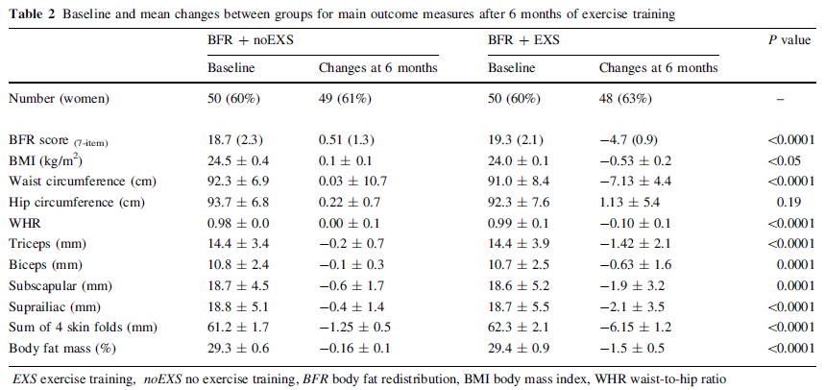

Slide 54
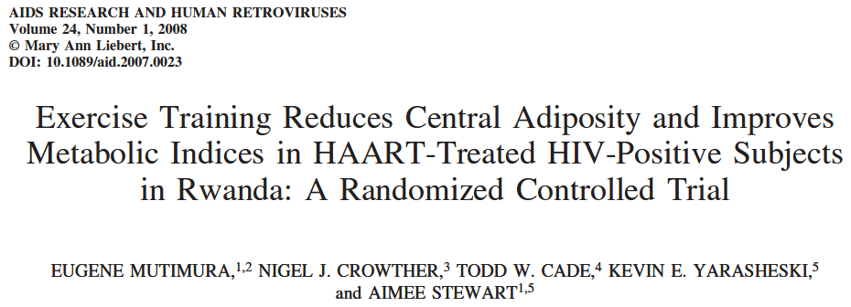
Cardiometabolic indices

Slide 55
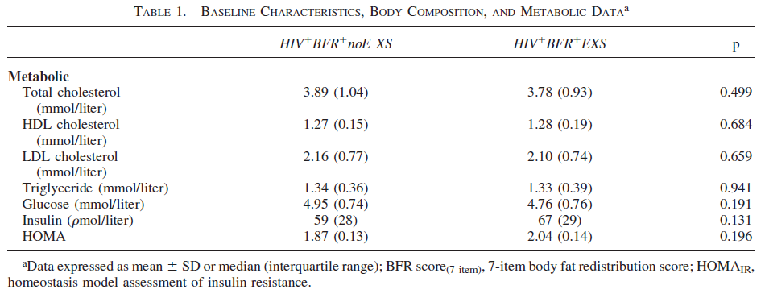

Slide 56
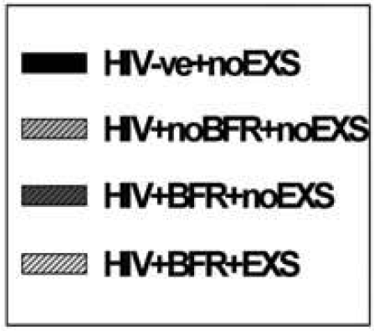
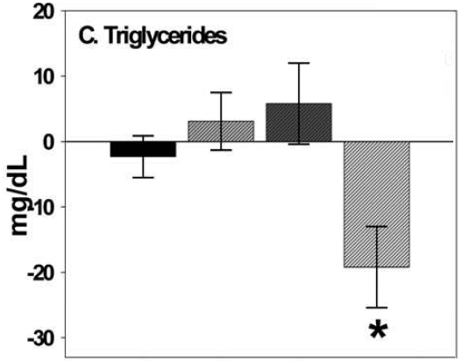

Slide 57
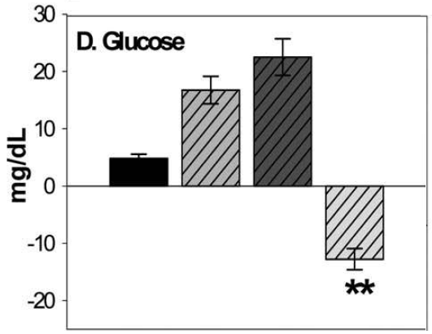

Slide 58
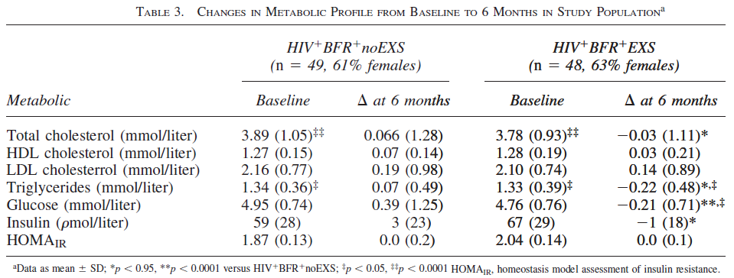
No significant changes were found in HDL cholesterol, LDL cholesterol, or HOMA values
Total cholesterol (p <0.05), blood glucose (p<0.0001), and insulin (p <0.05) levels declined more in the exercise group than the non-exercise group

Slide 59
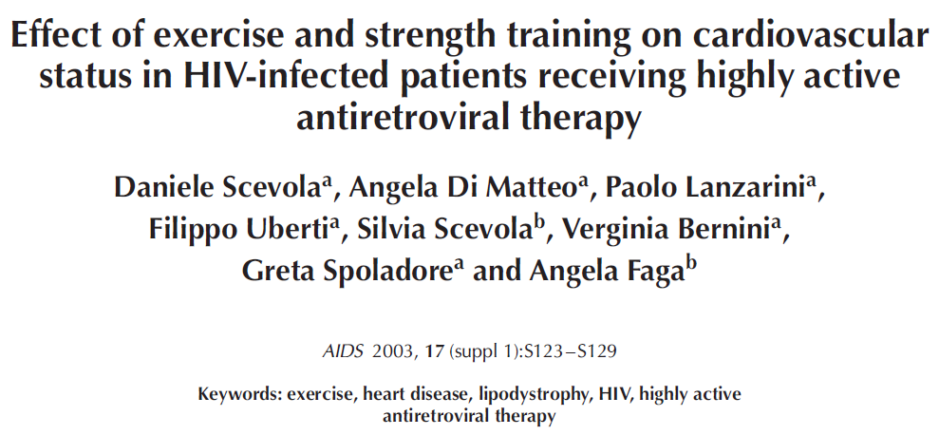
Cardiovascular risk

Slide 60
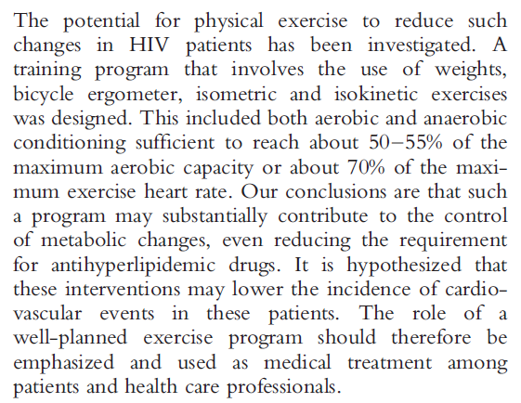

Slide 61
Benefits of Exercise and
Habitual Physical Activity
Aerobic and resistance exercise is safe for people with HIV
Baigis et al. 2002; Dolan et al., 1996; Grinspoon et al. 2000; McArthur et al., 1993; O’Brien et al., 2004; Perna et al., 1999; Rigsby et al., 1992; Smith et al., 2001; Stringer et al., 1998; Terry et al., 1999 Image source: http://www.trust2move.com

Slide 62
Pre-Exercise Evaluation
A variety of procedures can be used to assess
physical fitness among people with HIV
ACSM, GETP9, 2013

Slide 63
Pre-Exercise Evaluation
A variety of procedures can be used to assess
physical fitness among people with HIV
ACSM, GETP9, 2013
Cardiometabolic health
Resting BP
BMI
Waist circumference

Slide 64
Pre-Exercise Evaluation
A variety of procedures can be used to assess
physical fitness among people with HIV
ACSM, GETP9, 2013
Cardiometabolic health
Resting BP
BMI
Waist circumference
Graded exercise tests
Cycle ergometer
6-minute walk test
3-minute step test

Slide 65
Pre-Exercise Evaluation
A variety of procedures can be used to assess
physical fitness among people with HIV
ACSM, GETP9, 2013
Cardiometabolic health
Resting BP
BMI
Waist circumference
Graded exercise tests
Cycle ergometer
6-minute walk test
3-minute step test
Measures of strength
ACSM push-up test
ACSM curl-up test
Isometric handgrip dynamometry

Slide 66
Pre-Exercise Evaluation
A variety of procedures can be used to assess
physical fitness among people with HIV
ACSM, GETP9, 2013
Cardiometabolic health
Resting BP
BMI
Waist circumference
Graded exercise tests
Cycle ergometer
6-minute walk test
3-minute step test
Measures of strength
ACSM push-up test
ACSM curl-up test
Isometric handgrip dynamometry
Measures of mobility and physical functioning
Floor transfer test
5x sit-to-Stand tests

Slide 67
Pre-Exercise Evaluation
A variety of procedures can be used to assess
physical fitness among people with HIV
ACSM, GETP9, 2013
Cardiometabolic health
Resting BP
BMI
Waist circumference
Graded exercise tests
Cycle ergometer
6-minute walk test
3-minute step test
Measures of strength
ACSM push-up test
ACSM curl-up test
Isometric handgrip dynamometry
Measures of flexibility
Sit-and-reach
Measures of mobility and physical functioning
Floor transfer test
5x sit-to-Stand tests

Slide 68
Pre-Exercise Evaluation
A variety of procedures can be used to assess
physical fitness among people with HIV
ACSM, GETP9, 2013
Cardiometabolic health
Resting BP
BMI
Waist circumference
Graded exercise tests
Cycle ergometer
6-minute walk test
3-minute step test
Measures of strength
ACSM push-up test
ACSM curl-up test
Isometric handgrip dynamometry
Although GETP9 does not require people with HIV to undergo exercise testing prior to engaging in an ExR_{x}, Chapter 10 discusses how HIV and HAART associate health conditions that can predispose an individual to cardiac dysfunction and increase the risk of CVD.
Measures of flexibility
Sit-and-reach
Measures of mobility and physical functioning
Floor transfer test
5x sit-to-Stand tests

Slide 69
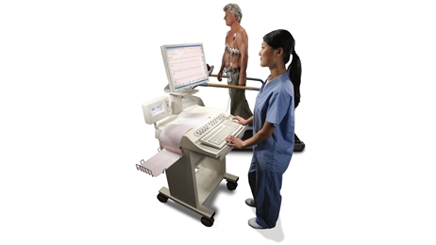
Special considerations in
Exercise Testing
More than 40% of people with HIV are sedentary
46% via Actigraph assessment¹
45.5% via lifestyle questionnaire²
42.3% via questionnaire³
66.7% via Actigaph³
CVD risk factors can be aggravated by acute exercise, especially when transitioning from a sedentary lifestyle⁴
In addition to gaining information about CVD risk, the examination may provide information relevant to the subsequent establishment of an exercise prescription⁵
1. Ramirez-Marrero et al., 2008 2. Eidam et al., 2006 3. Schuelter-Trevisol et al., 2010
4. Cobb & Weaver, 1986 5. ACSM, GETP9, 2013 Image source: www3.gehealthcare.com

Slide 70
Special considerations in
Exercise Testing
If the individual is to undergo exercise testing, GETP9 (2013) provides several considerations
Day-to-day health is more variable among people with HIV than among those without; normal testing battery may need adjustment
If the patient is symptomatic on the day of testing, reductions are expected in exercise time, peak oxygen consumption, and ventilatory threshold
If the patient is asymptomatic, a reduced exercise capacity is likely indicative of a sedentary lifestyle

Slide 71
Special considerations in
Exercise Testing
If the individual is to undergo exercise testing, GETP9 (2013) provides several considerations
The presence of AIDS reduces test performances dramatically; patients with AIDS are unlikely to achieve ventilatory threshold or peak oxygen consumption, and may experience abnormal endocrine and nervous system responses
In instances in which an acute infection is present, exercise testing should be postponed

Slide 72
Special considerations in
Exercise Testing
If the individual is to undergo exercise testing, GETP9 (2013) provides several considerations
When exercise testing is conducted, measures should be taken to limit transmission of infection (e.g., sterilization of reusable instruments)
Blood pressure and electrocardiogram should be evaluated periodically due to likelihood of cardiovascular impairments
High prevalence of peripheral neuropathies; tests should be adjusted to suit capacities in these situations

Slide 73
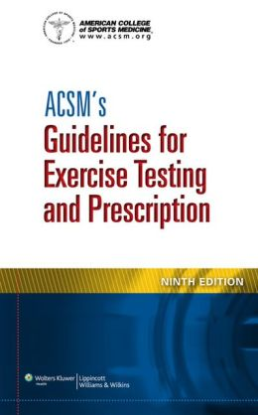
FITT Recommendations
Image source: http://www.todaysdietitian.com Article: Cannon, J. (2011). Keeping Fit With HIV — ACSM Guidelines Make Exercise Possible for Patients. Today’s Dietitian, 13(10): 86

Slide 74
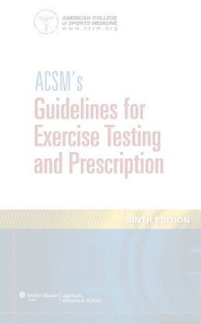
FITT Recommendations
ACSM’s FITT-VP recommendation for people with HIV
Frequency
Aerobic exercise should be performed 3-5 times a week and resistance exercise 2-3 times a week
Intensity
Aerobic exercise should be conducted at 40%–<60% oxygen consumption reserve or heart rate reserve
For resistance exercise, the patient should complete 8-10 repetitions in each set at a load of approximately 60% one repetition max (1-RM)

Slide 75
FITT Recommendations
ACSM’s FITT-VP recommendation for people with HIV
Time
The duration of AE should reflect capacity, beginning with 10 minute bouts and progressing to 30-60 minutes a day
For RT, the patient should spend 30 min completing 10-12 exercises, with 2-3 sets of each exercise, targeting all major muscle groups
Type
Mode must reflect interests and capacities, taking into consideration physical limitations (e.g., peripheral neuropathies)
Activities that promote flexibility should be incorporated 2-3 days a week for approximately 10 min

Slide 76
FITT Recommendations
ACSM’s FITT-VP recommendation for people with HIV
Volume
Initial volume (frequency, intensity, and time) may be met by more frequent bouts of moderate intensity exercise
As the patient becomes capable, increasing intensity can begin to account for a greater portion
Progression
Progression toward higher volume (especially in intensity) is likely to occur much more slowly than could be expected by healthy populations
Despite this, the ultimate goal is to progress asymptomatic patients toward the ACSM FITT prescription for healthy adults

Slide 77
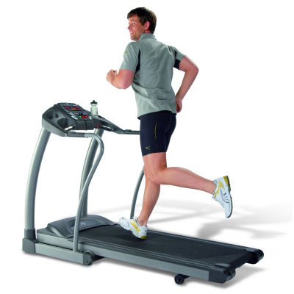
Special Considerations in ExR_{x}
GETP9 notes several considerations
regarding exercise prescription
If the patient is symptomatic, or has a diagnosis of one or more comorbidities, supervised exercise is recommended
Due to high day-to-day variability in health and exercise capacity, the components of the FITT principle should be adjusted based on acute state
Feelings of fatigue are expected and should not preclude exercise participation, but if accompanied by dizziness, nausea, or swollen joints, exercise should be delayed
Image source: http://epic-treadmills.com

Slide 78
Special Considerations in ExR_{x}
GETP9 notes several considerations
regarding exercise prescription
Contact or otherwise high-risk activities (e.g., skateboarding, rock climbing) should be avoided due to risk of bleeding
If osteopenia is present, weight-bearing activities should be a major focus
As HAART has elongated the expected lifespan of individuals with HIV, more than a quarter of all people in the U.S. who have HIV are 50 or older¹, so the age of the exerciser should be considered
1. Karpiak, Shippy, & Cantor, 2006

Slide 79
Behavioral Change Strategies
Contingency Management
Health belief model
Motivational Interviewing
Theory of planned behavior
Transtheoretical model

Slide 80
Behavioral Change Strategies
Contingency Management
Health belief model
Motivational Interviewing
Theory of planned behavior
Transtheoretical model

Slide 81
Behavioral Change Strategies
Provides tangible rewards (prizes, vouchers, etc.)
to motivate behavior change
Based on 3 basic behavioral principles
Frequently measure behavior targeted for change
Provide reinforcement when behavior occurs
Withhold reinforcement when behavior does not occur
Stalonas et al. (1978) found a primitive CM intervention to promote weight loss in obese adults
Higgins et al. (1994, 2000, 2003, 2007) and Rawson et al. (2002, 2006) found CM to promote drug abstinence in cocaine-dependent patients
Contingency Management
Health belief model
Motivational Interviewing
Theory of planned behavior
Transtheoretical model

Slide 82
Behavioral Change Strategies
Exercise adherence is susceptible to influence by reinforcement¹
CM reduces HIV risk behaviors relative to control conditions²
Epstein et al. 1980, 1994, 1995, 2001, 2004
Hanson et al., 2008
Contingency Management
Health belief model
Motivational Interviewing
Theory of planned behavior
Transtheoretical model

Slide 83
Conclusion
HIV with concurrent use of HAART is associated metabolic disturbances, anthropometric abnormalities, and an increased risk of CVD
Image sources: athleanx.com and
todaystheday7weekplan.wordpress.com

Slide 84
Conclusion
Each of these variables can potentially be managed with an appropriate ExR_{x}

Slide 85
Conclusion
Despite the therapeutic benefits of exercise, it is not commonly recommended as a component of HIV treatment interventions and it fails to be mentioned in the Healthy People 2020 initiative

Slide 86
Conclusion
Among adult men and women with HIV who take HAART, a combination of moderate intensity AE and RT, performed regularly, with modes that reflect the individual’s interests and capacity, appears to be a safe and effective way to mitigate metabolic impairment, manage morphological changes, and reduce the risk of CVD

Slide 87
Image source: http://themadcaplaughed.tumblr.com

Slide 88
Risk Stratification
People with HIV frequently experience comorbidities that may be contraindications to an exercise program^{1,2,3}
The CDC categorizes people with HIV into subgroups based on severity⁴
High viral load (≥1500 copies per milliliter)
Low viral load (<1500 copies per milliliter)
The WHO categorizes people with HIV based on stages of the illness⁵
Stage 1: Primary infection
Stage 2: Clinically asymptomatic stage
Stage 3: Symptomatic HIV infection
Stage 4: Progression from HIV to AIDS
Some physicians still caution people with HIV against any exercise program⁶
1. 4. CDC, 2005 5. WHO, 2005 6. Bopp et al., 2003

Slide 89
Injection drug use and HIV
UNODC/UNAIDS estimates there to be 15.9 injection drug users, of whom 3 million to be living with HIV¹
In Central Asia, Ukraine and the Russian Federation, opiate injection is linked to 60-70% of all HIV infections^{1,2}
1. Mathers et al., 2008 2. European Monitoring
Center for Drugs and Drug Addiction (EMCDDA), 2009

Slide 90
Injection drug use and HIV
HIV/AIDS is directly related to injection drug use in Russia^{1,2}
1.5 million heroin addicts
More than 250,000 registered cases of HIV
Suspected that the number of unregistered cases exceeds this
More than 80% of these cases are among intravenous drug users
HIV/AIDS is directly related to injection drug use in Central Asia³
Increasing prevalence of injection drugs parallel 19-fold increase
in HIV incidence between 2000 and 2008
HIV/AIDS is directly related to injection drug use in Pakistan⁴
HIV prevalence among drug users increased from 1% to 24% in 1 year
1. Mathers et al., 2008 2. European Monitoring Center for Drugs and Drug Addiction (EMCDDA), 2009 3. UNODC Regional Office for Central Asia, Compendium of Drug Related Statistics, 2009 4. Emmanuel et al., 2006

Slide 91
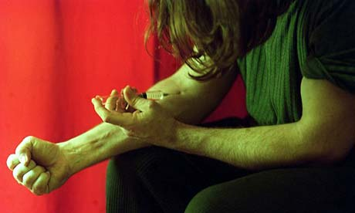
Injection drug use and HIV
HIV/AIDS is directly related to injection drug use in Ukraine¹
41.8% of injection drug users are HIV-positive
Intravenous drug use transmission rate: 0.7% per exposure²
Translates to a 49% risk of infection after 100 exposures
1. Mathers et al., 2008 2. Kaplan & Heimer, 1992; Kaplan & Heimer, 1995 Image source: http://www.guardian.co.uk

Slide 92
Special considerations in
Exercise Testing
Individuals with SUD and HIV express low functional capacities¹
Technicians should be cognizant of this and choose protocols accordingly
Because the majority of people with HIV are on medications³, and there may be cardiometabolic implications, ratings of perceived
exertion may be a more suitable mode of measuring one’s workload
1. Stein et al., 1998; Rudolf & Watts, 2002; Grinspoon & Carr, 2005; O’Brien et al., 2004
2. Lima et al., 2009 3. Kitahata et al., 2009; U.S. Department of Health and Human Services, 2011

