Slide 1
Exercise and Physical Activity among People with HIV and Substance Use Disorder
Courtney Jensen | April 26, 2012

Slide 2
Objectives
1. Establish a clear definition of the populations I’ll be discussing
2. Justify why these populations warrant public health concern
3. Illustrate why exercise and habitual physical activity is
important to this population
4. Explain how such a program will benefit them
5. Provide behavior change strategies so that
they may adhere to the prescription provided
Image source: http://www.9ap.net

Slide 3
Overview
1. Introduce the populations
2. Outline the search strategy used to conduct this systematic review
3. Explore the relevant background information
Prevalence & Magnitude, Pathophysiology
4. Note the benefits of physical activity and exercise among these populations
5. Define an appropriate pre-exercise evaluation
6. Identify unique considerations in exercise testing
7. Characterize the ACSM FITT recommendations
8. Evaluate special considerations in ExR_{x}
9. Discuss behavior change strategies to increase
exercise adherence
10. Provide a summary of the major points
Image source: http://howcanisucceedinlife.com

Slide 4
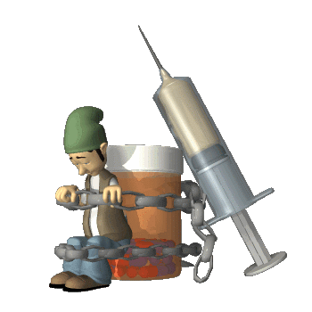
Two Special Populations
People with HIV People with SUD
Image source: http://cylonsky.blogspot.com
Image source: http://www.saudipsych.org
Notes:
SUD is a multidimensional problem among a very heterogeneous group (McLellan et al., 2000). It includes both substance abuse and dependence and is diagnosable in DSM-IV as a type of brain and behavioral disorder (American Psychiatric Association, 2000).

Slide 5
Methods
Electronic databases were searched for studies relevant to exercise
or physical activity (PA) and SUD or HIV.
Databases were: PubMed, CINAHL, Sport Discuss, PsycInfo, Academic Search Premier, Rehabilitation and Physical Medicine, Scopus, and Cochrane Library.
PubMed medical subject heading (MeSH) descriptors were used to facilitate a more comprehensive search result.
Image source: http://www.bcpiweb.com

Slide 6
Methods
MeSH descriptors for exercise and PA: “Exercise therapy/methods”, “exercise”, “motor activity”, “resistance training”, “weight lifting”, “running” and “walking.”
MeSH descriptors for SUD: “Substance-related disorders”, “street drugs”, “cocaine”, “heroin”, “dextroamphetamine”, “ethanol”, “cannabis”, and “smoking.”
MeSH descriptors for HIV: “HIV”, “HIV infections”, “HIV wasting syndrome”, “immunologic deficiency syndromes”, “acquired immunodeficiency syndrome”, and “antiretroviral therapy, highly active.”

Slide 7
Methods
In addition to the MeSH descriptors, the search included
exercise modalities appearing in the title (e.g., “jogging”,
“bicycl*”, “treadmil*”, “strength train*”, “endurance train*”,
“cardiovascular train*”, “speed train*”, “plyometric*”, “agility”) as well as terms
describing exercise characteristics
(“training duration”, “training frequency”,
“training intensity”, “training mode”)
In databases other than PubMed, the MeSH descriptors were included in the search terms
Image source: http://schaechter.asmblog.org

Slide 8
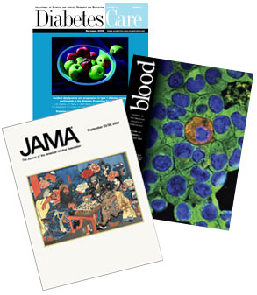
Methods
All included studies:
Were written in English
Appeared in peer-reviewed journals
Quantified the effects of exercise and/or PA
among people with SUD and/or HIV

Slide 9
Methods
All included studies:
Were written in English
Appeared in peer-reviewed journals
Quantified the effects of exercise and/or PA
among people with SUD and/or HIV
Studies were excluded if:

Slide 10
Methods
All included studies:
Were written in English
Appeared in peer-reviewed journals
Quantified the effects of exercise and/or PA
among people with SUD and/or HIV
Studies were excluded if:
The subjects were children
Image sou
Image source: http://www.nlm.nih.gov/medlineplus/magazine

Slide 11
Methods
All included studies:
Were written in English
Appeared in peer-reviewed journals
Quantified the effects of exercise and/or PA
among people with SUD and/or HIV
Studies were excluded if:
The drug investigated was a hallucinogen
Image source: http://mario.wikia.com

Slide 12
Methods
All included studies:
Were written in English
Appeared in peer-reviewed journals
Quantified the effects of exercise and/or PA
among people with SUD and/or HIV
Studies were excluded if:
The drug was an anabolic steroid
Image source: http://www.roidsstock.com

Slide 13
Methods
All included studies:
Were written in English
Appeared in peer-reviewed journals
Quantified the effects of exercise and/or PA
among people with SUD and/or HIV
Studies were excluded if:
The drug was phencyclidine

Slide 14
Two Special Populations
People with HIV
People with SUD
Image source: http://cylonsky.blogspot.com
Image source: http://www.saudipsych.org
Notes:
SUD is a multidimensional problem among a very heterogeneous group (McLellan et al., 2000). It includes both substance abuse and dependence and is diagnosable in DSM-IV as a type of brain and behavioral disorder (American Psychiatric Association, 2000).

Slide 15
Two Special Populations
People with SUD
Notes:
SUD is a multidimensional problem among a very heterogeneous group (McLellan et al., 2000). It includes both substance abuse and dependence and is diagnosable in DSM-IV as a type of brain and behavioral disorder (American Psychiatric Association, 2000).

Slide 16
Prevalence & Magnitude
People with SUD
Notes:
SUD is a multidimensional problem among a very heterogeneous group (McLellan et al., 2000). It includes both substance abuse and dependence and is diagnosable in DSM-IV as a type of brain and behavioral disorder (American Psychiatric Association, 2000).

Slide 17
Prevalence & Magnitude

Slide 18
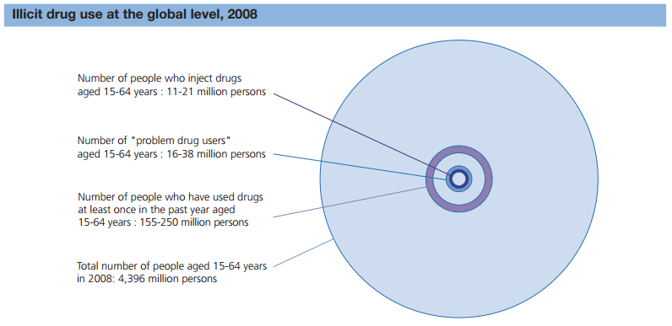
Prevalence & Magnitude
UNODC, World Drug Report, 2010

Slide 19
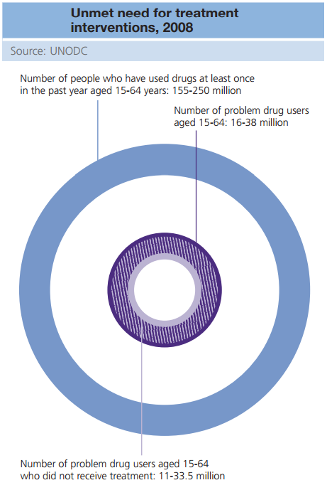
UNODC, World Drug Report, 2010

Slide 20
Worldwide Prevalence
Between 155 and 250 million people between the ages of 15 and 64 (3.5 to 5.7% of the population) used illicit substances at least once in 2008.
Between 16 and 38 million of them (10 – 15%) are “problem drug users” (only counting cannabis, opiates, cocaine and amphetamines)
Between 11 and 33.5 million problem drug users (70 – 88%)
did not receive treatment in 2008
UNODC, World Drug Report, 2010

Slide 21
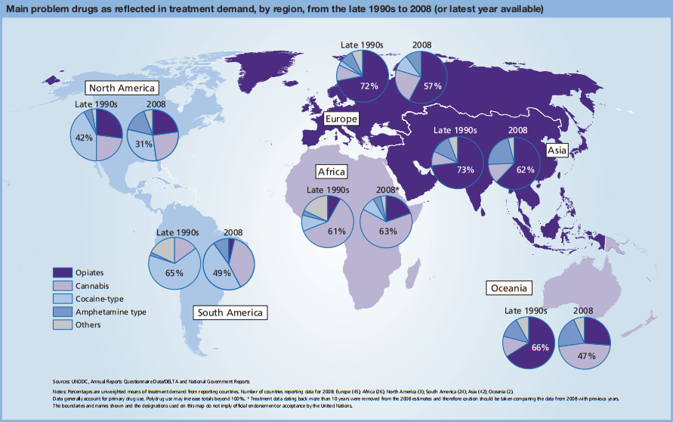
UNODC, World Drug Report, 2010

Slide 22
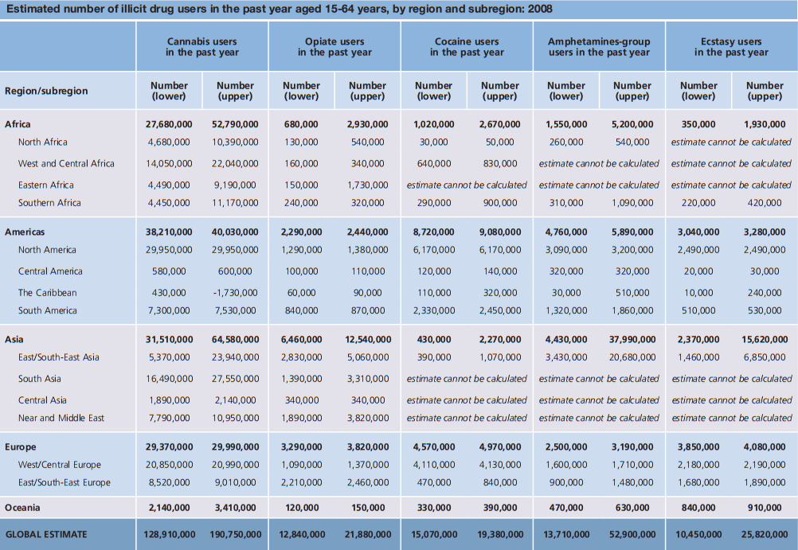
UNODC, World Drug Report, 2010

Slide 23
Prevalence & Magnitude in the United States
19.9 million (8.0% of the population) are current users of illicit drugs¹
7 million (2.8%) were dependent on one or more of those drugs²
126.8 million (51.1%) are current users of alcohol¹
17.6 million meet the criteria to be diagnosed
with alcohol abuse or dependence³
Alcohol abuse/dependence affects 18%
at some point during each person’s lifetime⁴
1. The National Survey on Drug Use and Health (2007)
2. UNODC, World Drug Report, 2010 3. Grant et al. (2004).
4. Kessler, et al. (2005) Image source: http://www.mydallasmommy.com
Image source: http://sgugenetics.pbworks.com

Slide 24
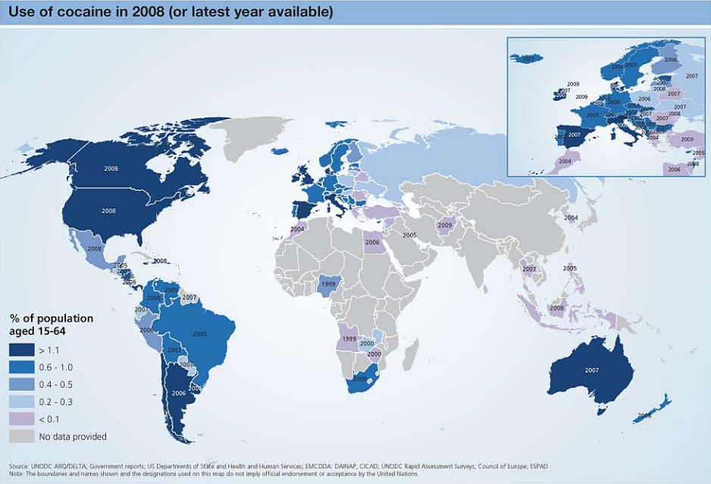
UNODC, World Drug Report, 2010

Slide 25
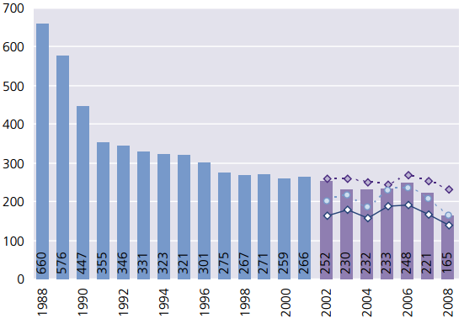
Cocaine
Although annual prevalence rates
are declining, North America still has
the largest cocaine market:
Global cocaine market: $80-100 billion
North American cocaine market: $38 billion
Within North America, U.S. market is largest
5.3 million cocaine users in the U.S.
18% are considered dependent
Cocaine was involved nearly 40% of all drug-related deaths in the U.S. in 2008
Estimated cost of these deaths: $13 billion
UNODC, World Drug Report, 2010

Slide 26
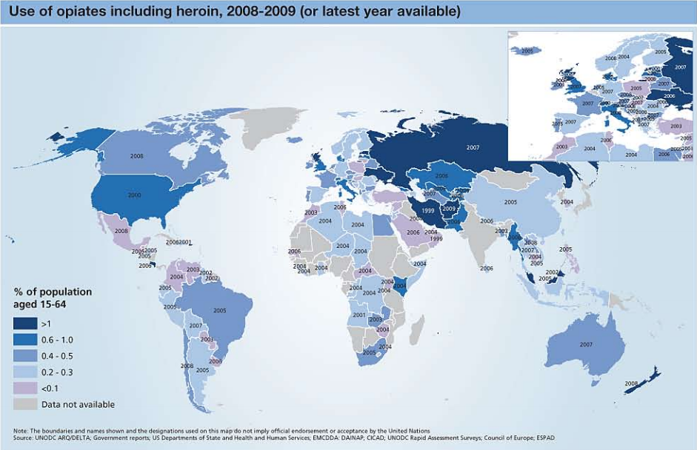
UNODC, World Drug Report, 2010

Slide 27
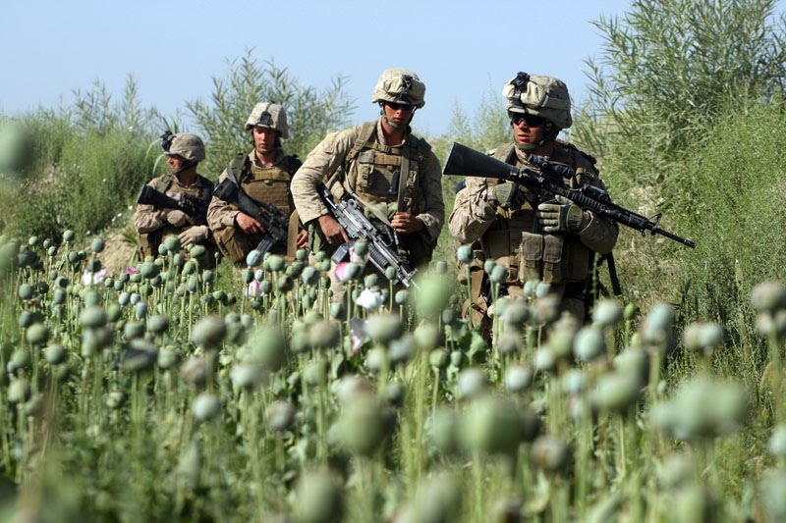
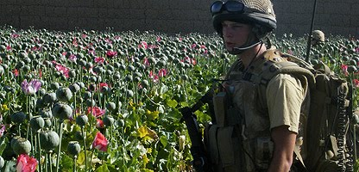
Heroin and other opiates
Annual global opiate market: $65 billion ($55 billion from heroin)
United states and Canadian market: $8 billion¹
Global Consumption: 15 million heroin users and 4 million users of other opiates¹
U.S. has the highest prevalence of
heroin use in North America (0.58%
Of the population aged 15-64; about
1.2 million people)²
1. UNODC, World Drug Report, 2010 2. US ONDCP, 2000. Image source: http://remixxworld.blogspot.com

Slide 28
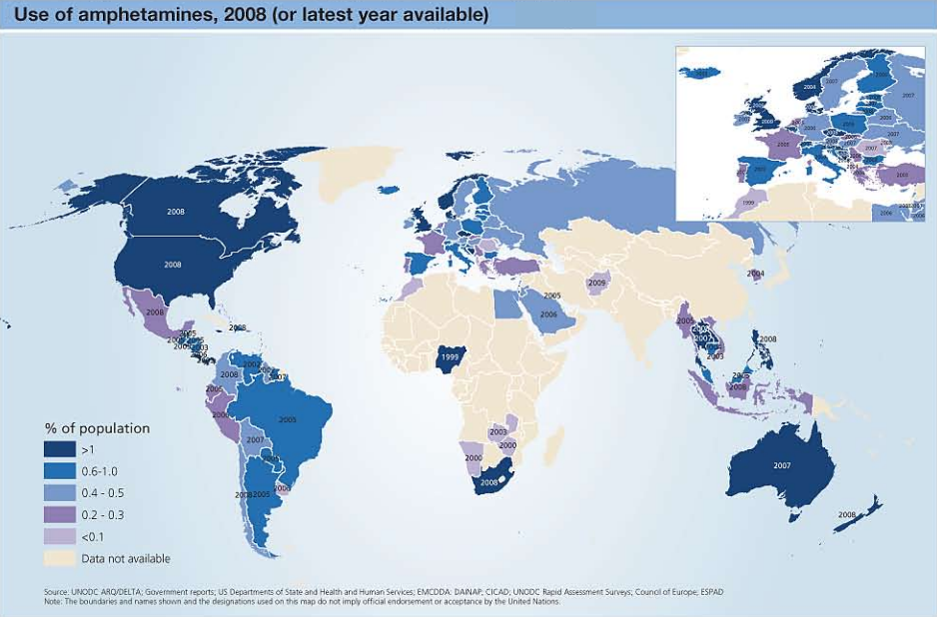
UNODC, World Drug Report, 2010

Slide 29
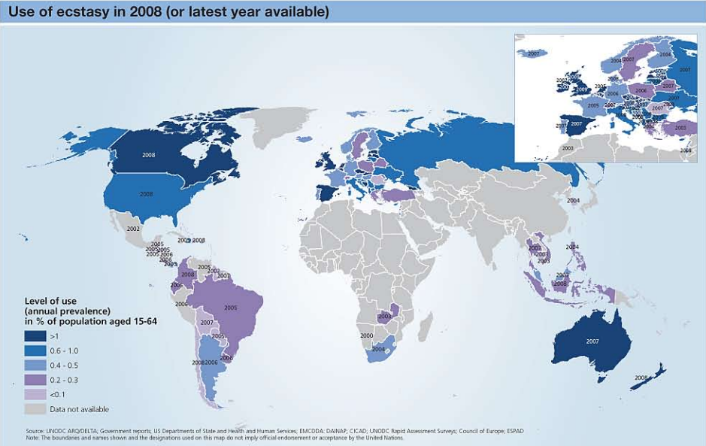
UNODC, World Drug Report, 2010

Slide 30
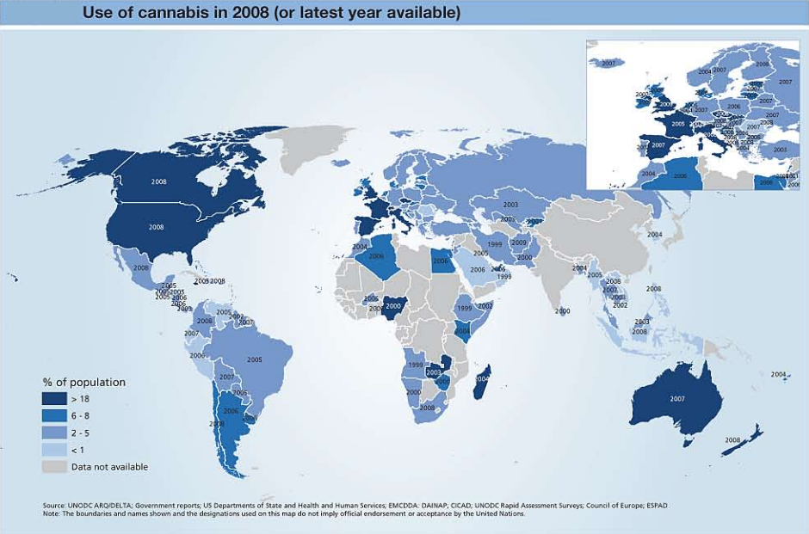
UNODC, World Drug Report, 2010

Slide 31
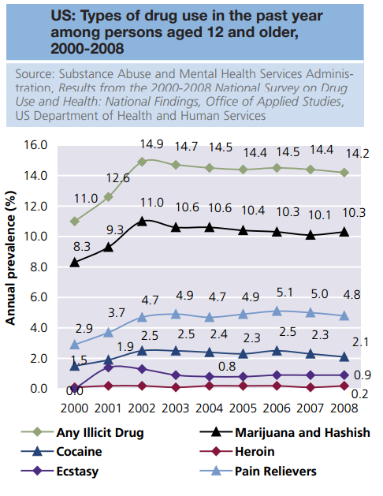
Marijuana
Largest number of illicit drug users:
129-191 million people¹
In the U.S., nearly 30 million people (12.5% of population aged 15 – 64)
Used marijuana in 2008²
75.7% of U.S. drug users consume it¹
Typically thought of as harmless, but shows strong correlation with cardiovascular disease³
1/Graph: UNODC, World Drug Report, 2010
2. SAMSHA, 2008
3. Hall W., and Degenhardt, L., 2009.

Slide 32
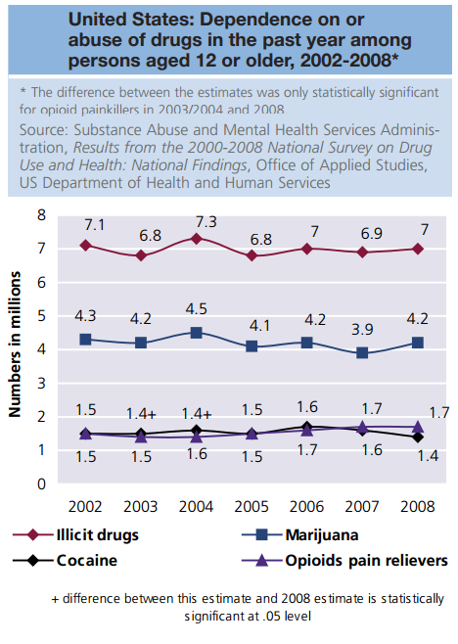
Other drugs…
Amphetamine-group substances: Between 13.7 and 52.9 million people used at least once in 2008¹
3.2 million from North America
2.7 million from the U.S. (1.3%)²
Ecstacy: 10.5 and 25.8 million people worldwide¹, 2.4 million people from the U.S. (1%)²
1/Graph: UNODC, World Drug Report, 2010
2. SAMSHA, 2008

Slide 33
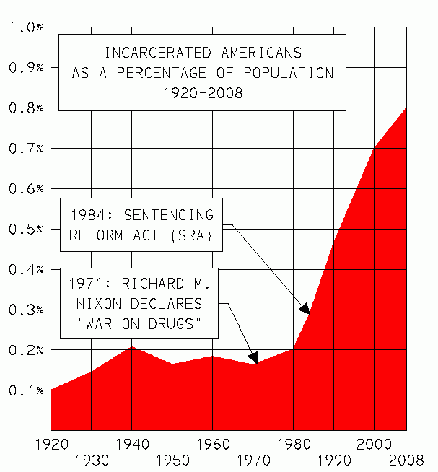
Prevalence & Magnitude continued…
People with SUD are more likely to engage in criminal activity¹
37.2% of adults on parole had abused illicit substances or were dependent on them, compared to 8.9% who had not been on parole in the past year²
37.4% of adults on probation were drug abusers or dependent on drugs compared to 8.5% of adults not on parole in the past year²
1. Hser et al., 1993
2. The National Survey on Drug Use and Health, 2007
Image source: http://sgugenetics.pbworks.com
U.S. Incarceration Rate Timeline Source: http://en.wikipedia.org/

Slide 34
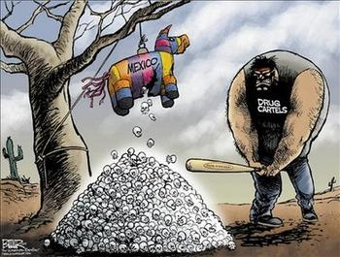
Current Mexican drug cartels:
The Sinaloa Federation: Led by Mexico’s “most wanted” billionaire, Joaquin Guzman
Gulf Cartel: Once, but no longer the most powerful criminal organization in Mexico
Los Zetas: The only current trafficking organization founded by special forces soldiers
The Juarez Cartel: Floundering cartel located in one of the most violent cities, Ciudad Juarez
The Tijuana Cartel: Occupies Tijuana; also known as the Arellano Felix Organization
The Beltran Leyva Organization: Led by five Beltran
Levya brothers who split off from the Sinaloa cartel; three
were killed.
La Familia Michoacana: Split from Los Zetas, moved
business to Michoacan, known for methamphetamine,
beheadings, and religious ideology
UNODC, World Drug Report, 2010 Image: http://www.offshorenet.com

Slide 35
Washington is a popular state to assess…
Beckett, Katherine, Kris Nyrop, Lori Pfingst and Melissa Bowen. (2005). Drug Use, Drug
Arrests, and the Question of Race: Lessons from Seattle. Social Problems 52(3): 419-41.
Washington State Department of Health and Human Services Report. (2004). Tobacco, Alcohol, and Other Drug Abuse Trends in Washington State. (Olympia, Washington).
Washington State Department of Health and Human Services, n.d. (2003). County Profile of Substance Use and Need for Treatment Services: King County: http://www1.dshs.wa.gov/pdf/hrsa/dasa/2003WANAHSCoProfiles/King.pdf
Washington State Institute For Public Policy. (2006). Evidence-Based Public Policy Options To Reduce Future Prison Construction, Criminal Justice Costs, And Crime Rates: http://www.wsipp.wa.gov/rptfiles/06-10-1201.pdf.
Image source: http://sgugenetics.pbworks.com

Slide 36
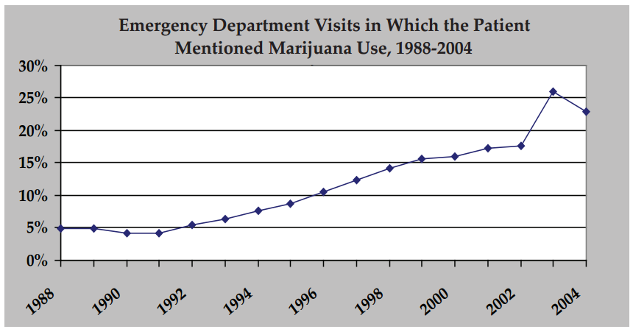
Source: Drug Abuse Warning Network, National Estimates of Drug-Related Emergency Department Visits: https://dawninfo.samhsa.gov/pubs/edpubs/default.asp)
Image source: http://sgugenetics.pbworks.com

Slide 37
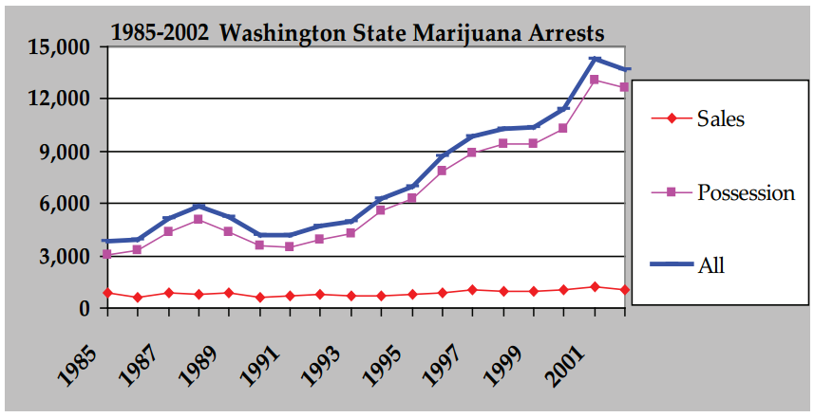
Image source: http://sgugenetics.pbworks.com
Source: FBI, Uniform Crime Reporting program

Slide 38
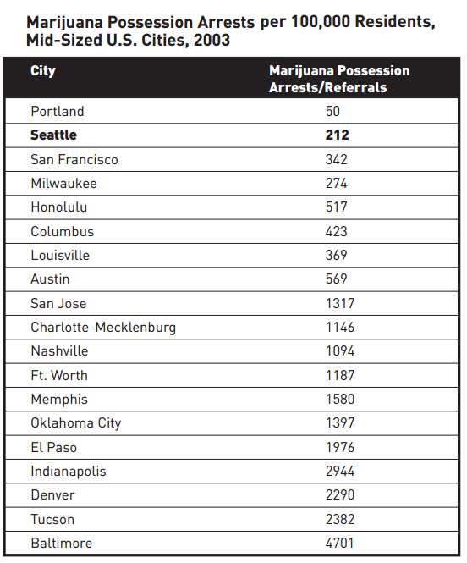
There are cities worse
than Seattle…
Data sources: FBI, Uniform Crime Reporting program and Final Report of the Marijuana Policy Review Panel on the Implementation
of Initiative 75.
Image source: http://www.topfansgear.com
Image source: http://sgugenetics.pbworks.com

Slide 39
A lot of people have attempted to quantify the cost of SUD…
Benson, B.L., Leburnand, I.S. & Rasmussen, D.W. (2001). The Impact of Drug Enforcement on Crime: An Investigation of the Opportunity Costs of Police Resources. Journal of Drug Issues, 31(4): 989-1006.
Benson, B.L., Rasmussen, D.W., & Kim, I. (1998). Deterrence and Public Policy: Trade Offs in the Allocation of Police Resources. International Review of Law and Economics 18: 77-100.
Debusmann, B. (2008). Einstein, insanity and the war on drugs. Reuters, December 3.
Harwood, H., Fountain, D., & Livermore, G. (1998). The Economic Costs of Alcohol and Drug Abuse in the United States. Report prepared for the National Institute on Drug Abuse and the National Institute on Alcohol Abuse and Alcoholism, National Institutes of Health, Department of Health and Human Services. Rockville, MD.
Jensen, E.L. & Gerber, J. (1996). The Civil Forfeiture of Assets and the War on Drugs.
Crime and Delinquency, 42: 412-34.
Minron, J. (2005). The Budgetary Implications of Marijuana Prohibition: http://www.prohibitioncosts.org/MironReport.pdf
Rodricks, D. (2008). Legalizing drugs: The money argument. Baltimore Sun, December 2.
Office of National Drug Control Policy. (2005). Disrupting the Market: Attacking the Economic Basis of the Drug Trade: http://www.whitehousedrugpolicy.gov/publications/policy/ndcs05/disrupt_mkt.html

Slide 40
2008: 1,702,537
2007: 1,841,182
2006: 1,889,810
2005: 1,846,351
2004: 1,745,712
2003: 1,678,192
2002: 1,538,813
2001: 1,586,902
2000: 1,579,566
1999: 1,532,200
1998: 1,559,100
1997: 1,583,600
1996: 1,506,200
1995: 1,476,100
1994: 1,351,400
1993: 1,126,300
1992: 1,066,400
1991: 1,010,000
1990: 1,089,500
1989: 1,361,700
1988: 1,155,200
1987: 937,400
1986: 824,100
1985: 811,400
1984: 708,400
1983: 661,400
1982: 676,000
The Economic Costs of Drug Abuse by The Office of National Drug Control Policy (2003) reports $180.8 billion
$128.9 billion (71.3%) attributed to lost productivity (illness, incarceration, premature death, etc)
$36.4 billion (20.1%) attributed to criminal justice expenses, $14.2 billion for state and local corrections facilities, $9.8 billion for drug-related law enforcement expenses, and $6.2 billion for federal policies.
$15.8 billion (8.7%) attributed to health care costs,
$3.7 billion of this for HIV/AIDS related to drug abuse
Annual U.S. arrests for illicit drug sales and possession
Image source: http://sgugenetics.pbworks.com

Slide 41
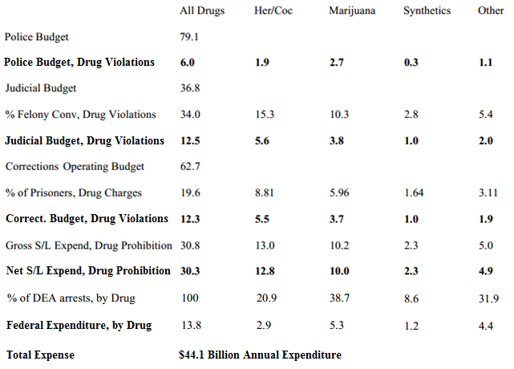
2008: 1,702,537
2007: 1,841,182
2006: 1,889,810
2005: 1,846,351
2004: 1,745,712
2003: 1,678,192
2002: 1,538,813
2001: 1,586,902
2000: 1,579,566
1999: 1,532,200
1998: 1,559,100
1997: 1,583,600
1996: 1,506,200
1995: 1,476,100
1994: 1,351,400
1993: 1,126,300
1992: 1,066,400
1991: 1,010,000
1990: 1,089,500
1989: 1,361,700
1988: 1,155,200
1987: 937,400
1986: 824,100
1985: 811,400
1984: 708,400
1983: 661,400
1982: 676,000
Three years later (in billions):
Annual U.S. arrests for illicit drug sales and possession
Budgetary data: http://www.census.gov/govs/estimate/0600ussl_1.html
And DEA arrest data: http://www.albany.edu/sourcebook/pdf/t440.pdf.
Image source: http://sgugenetics.pbworks.com
Notes:
Police funding up 7 and a half billion in three years… it’s about 20%. That first measurement, the 130 billion in lost productivity tally is mostly from incarceration, so obviously this would impact that as well. Maybe not to the tone of 20%, but it doesn’t seem unreasonable – and in fact almost conservative – to assume that in the last nine years, that total number has probably breached 200 billion per year.

Slide 42
2008: 1,702,537
2007: 1,841,182
2006: 1,889,810
2005: 1,846,351
2004: 1,745,712
2003: 1,678,192
2002: 1,538,813
2001: 1,586,902
2000: 1,579,566
1999: 1,532,200
1998: 1,559,100
1997: 1,583,600
1996: 1,506,200
1995: 1,476,100
1994: 1,351,400
1993: 1,126,300
1992: 1,066,400
1991: 1,010,000
1990: 1,089,500
1989: 1,361,700
1988: 1,155,200
1987: 937,400
1986: 824,100
1985: 811,400
1984: 708,400
1983: 661,400
1982: 676,000
Factor in cigarettes and alcohol:
Annual cost on society: $484 billion
Annual U.S. arrests for illicit drug sales and possession
Image source: http://www.lose-weight-with-us.com
NSDUH, 2007
Notes:
Police funding up 7 and a half billion in three years… it’s about 20%. That first measurement, the 130 billion in lost productivity tally is mostly from incarceration, so obviously this would impact that as well. Maybe not to the tone of 20%, but it doesn’t seem unreasonable – and in fact almost conservative – to assume that in the last nine years, that total number has probably breached 200 billion per year.

Slide 43
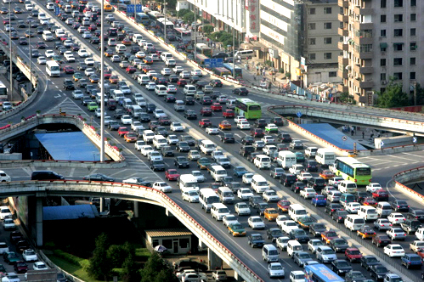
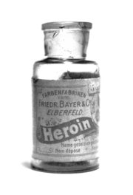
In total:
The United Nations values the illicit drug market
at a steady $400 billion a year. This is 8% of the
total fiscal exchange of all forms of international
commerce combined.^{1,2}
The entire automotive industry accounts for 5.3%.²
Total cost of the first ten years of war in Afghanistan
and Iraq combined: $60 billion (liberal estimate).³
1. Drug Policy Alliance: http://www.drugpolicy.org/ 2. Harris, S. (2004). The End
of Faith: Religion, Terror, and the Future of Reason, W.W. Norton & Company.
3. Huffington Post, August 30, 2011: Military Spending Waste: Up To $60 Billion...
Image 1 source: http://tubulocity.com Image 2 source: http://en.wikipedia.org
Image source: http://sgugenetics.pbworks.com

Slide 44
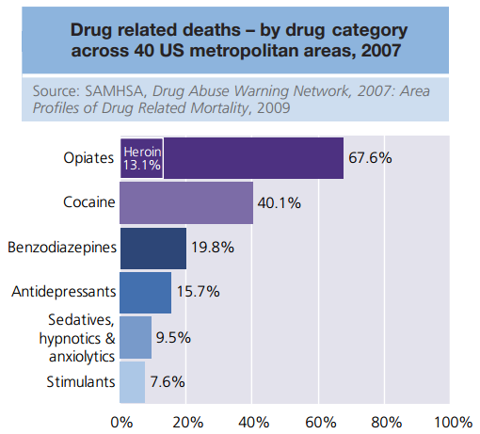
Pathophysiology of SUD
Variety of environmental and biological factors lead to SUD¹
Chronic illness conditions are endemic in this population¹
SUD compromises:
Physical health²
Mental health³
Quality of life⁴
Problems are interrelated and symptoms worsen with age^{1,5,6}
1. Roe et al., 2010 2. Stein et al., 1998 3. Lima et al., 2009 4. Daeppen et al., 1998 5. Levy & Anderson, 2005 6. Rudolf & Watts, 2002

Slide 45
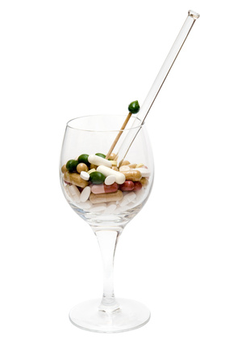
Pathophysiology of SUD
Nearly 75% have at least one medical problem¹
Over 60% have psychiatric diagnoses¹
More than 80% are taking medications¹
Commonly for depression or bipolar disorder
30,000 + annual deaths from drug-related causes²
Twice the annual national murder rate
1. Lima et al., 2009 2. National Vital Statistics Reports,
58(1), 2009. Deaths: 31,800 Image source: http://teenmentalhealth.org

Slide 46
Connecting SUD to HIV
People with SUD who go untreated are
more likely to spread infections
Injection drug use (typically heroin) is a
common mode of disease transmission,
including HIV/AIDS
Batki, 1988
Broome et al., 1999
Crosby et al., 2000
Des Jarlais & Hubbard, 1999
Magura et al., 2000
Mathers et al., 2008
Metzger et al., 1993

Slide 47
Connecting SUD to HIV
UNODC/UNAIDS estimates there to be 15.9 injection drug users, of whom 3 million to be living with HIV¹
In Central Asia, Ukraine and the Russian Federation, opiate injection is linked to 60-70% of all HIV infections^{1,2}
1. Mathers et al., 2008 2. European Monitoring
Center for Drugs and Drug Addiction (EMCDDA), 2009

Slide 48
Connecting SUD to HIV
HIV/AIDS is directly related to injection drug use in Russia^{1,2}
1.5 million heroin addicts
More than 250,000 registered cases of HIV
Suspected that the number of unregistered cases exceeds this
More than 80% of these cases are among intravenous drug users
HIV/AIDS is directly related to injection drug use in Central Asia³
Increasing prevalence of injection drugs parallel 19-fold increase
in HIV incidence between 2000 and 2008
HIV/AIDS is directly related to injection drug use in Pakistan⁴
HIV prevalence among drug users increased from 1% to 24% in 1 year
1. Mathers et al., 2008 2. European Monitoring Center for Drugs and Drug Addiction (EMCDDA), 2009 3. UNODC Regional Office for Central Asia, Compendium of Drug Related Statistics, 2009 4. Emmanuel et al., 2006

Slide 49
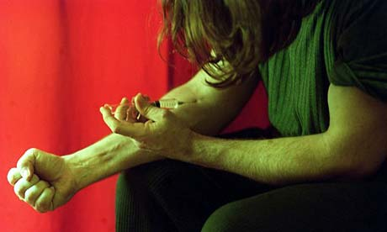
Connecting SUD to HIV
HIV/AIDS is directly related to injection drug use in Ukraine¹
41.8% of injection drug users are HIV-positive
Intravenous drug use transmission rate: 0.7% per exposure²
Translates to a 49% risk of infection after 100 exposures
1. Mathers et al., 2008 2. Kaplan & Heimer, 1992; Kaplan & Heimer, 1995 Image source: http://www.guardian.co.uk

Slide 50
Prevalence & Magnitude of HIV
Global: 34 million people are living with HIV¹
1.8 million people die of HIV/AIDS each year¹
2.7 million new infections appear annually¹
United States: 1.2 million people infected (0.4%)²
56,000 new infections appear annually³
24-27% unaware of their infection⁴
1. Joint United Nations Program on HIV/AIDS, 2012 2. Karim et al., 2007
3. Lansky et al., 2010 4. U.S. Centers for Disease Control and Prevention, 2006

Slide 51
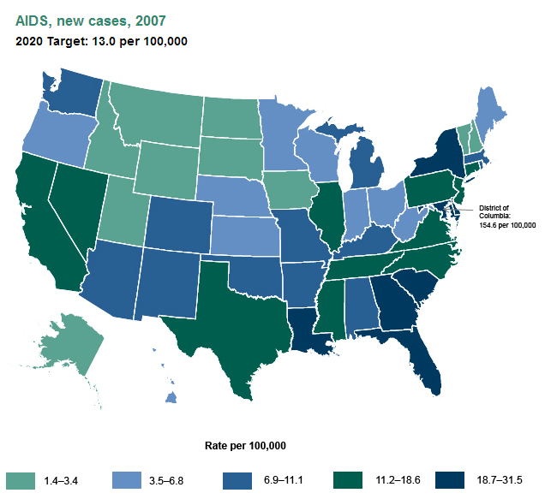
Prevalence & Magnitude of HIV
The rate of new AIDS cases varies by state
Alaska, New Hampshire, Vermont, and several Midwestern and Mountain states had the lowest rates in 2007
District of Columbia had a higher rate than any state in 2007 (154.6 new cases per 100,000 residents)
http://www.healthypeople.gov/2020/topicsobjectives2020/nationalsnapshot.aspx?topicId=22
Retrieved 4 April 2013

Slide 52
Prevalence & Magnitude of HIV
Annual financial cost in the U.S.: $30 billion¹
More than $6 billion in direct medical expenses¹
Since the first recognized cases of HIV in 1981 (known then as pneumocystis carinii pneumonia), it has spread to every region of the world²
1. Hutchinson et al., 2006 2. Gottlieb et al., 1996; Faunci, 2006

Slide 53
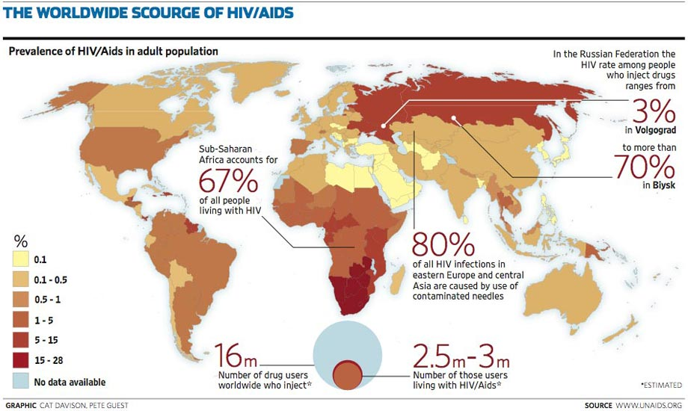
Image source: http://sgugenetics.pbworks.com

Slide 54
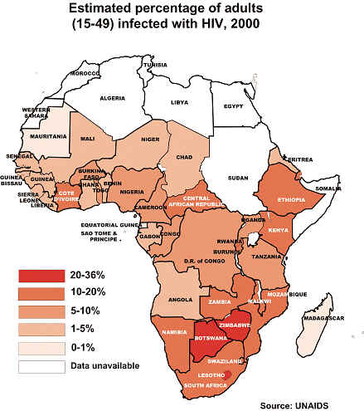
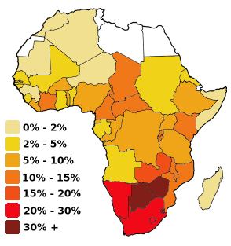
Not all maps are the same
Most estimated by UNAIDS
Different categorical distributions
Image source: http://sgugenetics.pbworks.com

Slide 55
Pathophysiology of HIV
The contraction and progression of HIV compounds
the impairments suffered by the individual as well as
the individual’s burden on society
Bing et al., 2001
Cress et al., 2003
Dudgeon et al., 2004
French et al., 2000
Nelson et al., 2002

Slide 56
Pathophysiology of HIV
Once infected, people with HIV experience a variety
of symptoms, which are presented in stages based
on the amount of the virus present in the blood¹
Acute infection phase^{1,2}
Mouth and esophageal sores
Lymphadenopathy
Pharyngitis
Fever
Malaise
Myalgia
Rash
As HIV progresses, metabolic disturbances, ulcerations,
and parasitic and fungal infections commonly manifest^{1,2}
1. Kah, & Walker, 1998 2. World Health Organization, 1990

Slide 57
Pathophysiology of HIV
Beginning highly active antiretroviral therapy (HAART) while
early in the infection stage enhances long-term survival¹
HAART has reduced mortality rates by more than 70%²
The combination of HIV and HAART commonly elicits
Morphological changes (e.g., abdominal adiposity and wasting syndromes)³
Cardiometabolic changes (e.g., dyslipidemia and insulin resistance)³
A high prevalence of developing cardiovascular disease⁴
A high prevalence of developing the metabolic syndrome⁵
People with HIV also routinely experience major depression,
generalized anxiety disorder, and a reduce quality of life⁶
1. Kitahata et al., 2009 2. Palella et al., 1998; Crum et al., 2006
3. Hicks et al., 2003 4. Grinspoon & Carr, 2005 5. Samaras, 2007 6. Bing et al., 2001

Slide 58
Benefits of Exercise and
Habitual Physical Activity
PA & exercise interventions are possible strategies to manage
both physical and mental health of populations with HIV/SUD
Physical benefits¹
Increase strength and lean body mass
Decrease fat mass and improve body composition
Reduce abdominal fat distribution and waist circumference
Enhance metabolic functioning
Insulin action and glucose homeostasis
Improve cardiovascular markers
Blood pressure and blood lipid profile
People with HIV may experience improved immune funcitoning²
Improvements to CD4+ counts and viral load
1. Corcoran & Grinspoon, 1999; Henricksen, 2002; Jones et al., 2001; Macarthur et al., 1993; Thoni et al., 2002; Pate et al., 1995: Pescatello, 1998, 1999, 2000; Anderson et al., 1999; Blair et al., 1992; Dunn et al., 1999; Hakim et al., 1999; USDHHA, 1996 2. O’Brien et al., 2004

Slide 59
Benefits of Exercise and
Habitual Physical Activity
Mental health outcomes improve with exercise and PA
Quality of life markers
Overall psychological distress
Mood and anxiety disorders
Depression
Bock et al., 1999
Byrne & Byrne, 1993
Penedo & Dahn, 2005
DiLorenzo et al., 1999
Doyne et al., 1983, 1987
Frankel & Murphy, 1974
Hughes, 1984
Martin & Dubbert, 1982
Palmer et al., 1995
Penedo & Dahn, 2005
Salguero et al., 2010
Taylor et al., 1985
Image source: http://www.bic.mni.mcgill.ca

Slide 60
Benefits of Exercise and
Habitual Physical Activity
Improved drug abstinence through various mechanisms
Physiological moderation of cravings
Altering of environmental triggers (social, etc)
Improved coping skills
Exercise as a substitute behavior
Changing of one’s life goals
Brown, 2008; Correia et al., 200; Hobson & Rejeski, 1993; Keller, 1980; Marlatt, 1985; Murphy et al., 1986; Rejeski et al., 1991; Read & Brown, 2003; Sinyor et al., 1982; Taylor et al., 1985; Tkachuk & Martin, 1999
Image source: http://wesmantoddshaw.hubpages.com

Slide 61
Benefits of Exercise and
Habitual Physical Activity
Aerobic and resistance exercise is safe for people with SUD and HIV
Baigis et al. 2002; Grinspoon et al. 2000, Laperriere et al., 1991; Lox et al. 1995, 1996; McArthur et al., 1993; O’Brien et al., 2004; Perna et al., 1999; Rigsby et al., 1992; Stringer et al., 1998; Terry et al., 1999 Image source: http://www.trust2move.com

Slide 62
Pre-Exercise Evaluation
A variety of procedures can be used to assess
physical fitness among people with SUD and HIV
ACSM, GETP8, 2009

Slide 63
Pre-Exercise Evaluation
A variety of procedures can be used to assess
physical fitness among people with SUD and HIV
ACSM, GETP8, 2009
Cardiometabolic health
Resting BP
BMI
Waist circumference

Slide 64
Pre-Exercise Evaluation
A variety of procedures can be used to assess
physical fitness among people with SUD and HIV
ACSM, GETP8, 2009
Cardiometabolic health
Resting BP
BMI
Waist circumference
Graded exercise tests
Cycle ergometer
6-minute walk test
3-minute step test

Slide 65
Pre-Exercise Evaluation
A variety of procedures can be used to assess
physical fitness among people with SUD and HIV
ACSM, GETP8, 2009
Cardiometabolic health
Resting BP
BMI
Waist circumference
Graded exercise tests
Cycle ergometer
6-minute walk test
3-minute step test
Measures of strength
ACSM push-up test
ACSM curl-up test
Isometric handgrip dynamometry

Slide 66
Pre-Exercise Evaluation
A variety of procedures can be used to assess
physical fitness among people with SUD and HIV
ACSM, GETP8, 2009
Cardiometabolic health
Resting BP
BMI
Waist circumference
Graded exercise tests
Cycle ergometer
6-minute walk test
3-minute step test
Measures of strength
ACSM push-up test
ACSM curl-up test
Isometric handgrip dynamometry
Measures of flexibility
Sit-and-reach

Slide 67
Pre-Exercise Evaluation
A variety of procedures can be used to assess
physical fitness among people with SUD and HIV
ACSM, GETP8, 2009
Cardiometabolic health
Resting BP
BMI
Waist circumference
Graded exercise tests
Cycle ergometer
6-minute walk test
3-minute step test
Measures of strength
ACSM push-up test
ACSM curl-up test
Isometric handgrip dynamometry
Measures of flexibility
Sit-and-reach
Measures of mobility and physical functioning
Floor transfer test
5x sit-to-Stand tests

Slide 68
Pre-Exercise Evaluation
A variety of procedures can be used to assess
physical fitness among people with SUD and HIV
ACSM, GETP8, 2009
Cardiometabolic health
Resting BP
BMI
Waist circumference
Graded exercise tests
Cycle ergometer
6-minute walk test
3-minute step test
Measures of strength
ACSM push-up test
ACSM curl-up test
Isometric handgrip dynamometry
Follow standard testing procedures for all exercise tests
Measures of flexibility
Sit-and-reach
Measures of mobility and physical functioning
Floor transfer test
5x sit-to-Stand tests

Slide 69
Pre-Exercise Evaluation
A variety of procedures can be used to assess
physical fitness among people with SUD and HIV
ACSM, GETP8, 2009
Cardiometabolic health
Resting BP
BMI
Waist circumference
Graded exercise tests
Cycle ergometer
6-minute walk test
3-minute step test
Measures of strength
ACSM push-up test
ACSM curl-up test
Isometric handgrip dynamometry
Technicians should allow subjects a proper warm-up period prior to (and cool-down following) any GXT
Measures of flexibility
Sit-and-reach
Measures of mobility and physical functioning
Floor transfer test
5x sit-to-Stand tests

Slide 70
Risk Stratification
People with SUD and HIV frequently experience comorbidities that may be contraindications to an exercise program^{1,2,3}
The CDC categorizes people with HIV into subgroups based on severity⁴
High viral load (≥1500 copies per milliliter)
Low viral load (<1500 copies per milliliter)
The WHO categorizes people with HIV based on stages of the illness⁵
Stage 1: Primary infection
Stage 2: Clinically asymptomatic stage
Stage 3: Symptomatic HIV infection
Stage 4: Progression from HIV to AIDS
Some physicians still caution people with HIV against any exercise program⁶
1. Obel et al., 2007 2. Lima et al., 2009 3. Roe et al., 2010 4. CDC, 2005 5. WHO, 2005 6. Bopp et al., 2003

Slide 71
Pre-Exercise Evaluation
ACSM, GETP8, 2009

Slide 72
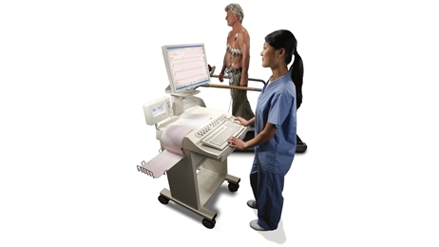
Pre-Exercise Evaluation
Prior to conducting any exercise testing
subjects should obtain medical clearance
All testing following approval should be
conducted by a trained technician
Thompson et al., 2009 Image source: http://www3.gehealthcare.com

Slide 73
Unique Considerations in
Exercise Testing
Individuals with SUD and HIV express low functional capacities¹
Technicians should be cognizant of this and choose protocols accordingly
Because the majority of people with SUD² and HIV³ are on medications
(HAART, methadone, BP lowering medication, etc.), ratings of perceived
exertion may be a more suitable mode of measuring one’s workload
1. Stein et al., 1998; Rudolf & Watts, 2002; Grinspoon & Carr, 2005; O’Brien et al., 2004
2. Lima et al., 2009 3. Kitahata et al., 2009; U.S. Department of Health and Human Services, 2011

Slide 74
FITT Recommendations
An ideal FITT recommendation (Frequency (F), Intensity (I), Time or duration (T), and Type (T) of exercise) for people with SUD and/or HIV is not yet developed
Ex R_{x} should adhere to general recommendations for apparently healthy adults¹
Modify to meet needs of the individual to safely maximize desired benefits
Exercise intensity
Progression
3-5 days per week for 30-60 minutes per day, including aerobic, resistance, and flexibility components^{1,2}
Image source: http://www.todaysdietitian.com Article: Cannon, J. (2011). Keeping Fit With HIV — ACSM Guidelines Make Exercise Possible for Patients. Today’s Dietitian, 13(10): 86
1. Thompson et al., 2009
2. US Department of Health
and Human Services, 2008

Slide 75
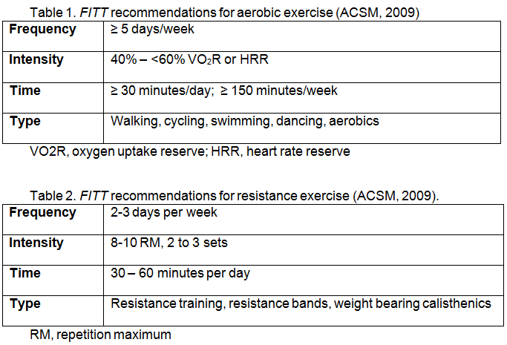
FITT Recommendations

Slide 76
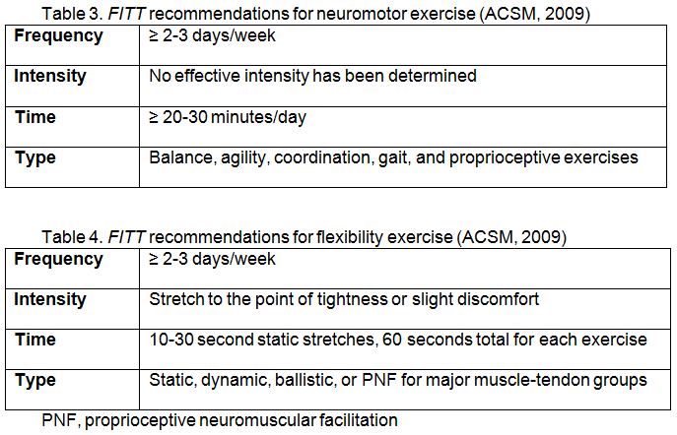
FITT Recommendations

Slide 77
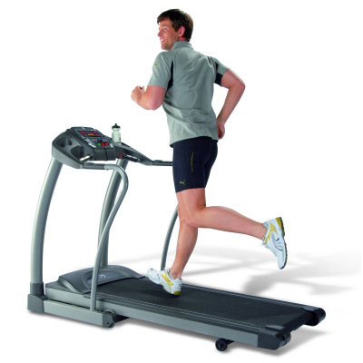
Unique Considerations in Ex R
X
All subjects with SUD and/or HIV should receive medical clearance
prior to any participation in exercise
Due to extremely sedentary behavior, subjects are encouraged to
increase exercise and PA levels gradually with the goal of ultimately
meeting ACSM guidelines for healthy adults
Reasons why subjects do not engage in exercise
should be considered
Often a lack of resources
Transportation
Insurance/financial
Familial barriers (e.g., childcare)
Woodhouse, 1990 Image source: http://epic-treadmills.com

Slide 78
Unique Considerations in Ex R
X
Some subjects with HIV experience wasting syndromes
while others experience weight gain with lipodystrophy¹
More extreme comorbidities will require further
manipulation of FITT principle; particularly intensity²
Asymptomatic patients may be permitted to
participate in more vigorous intensity exercise
than those with noted health issues and/or risks
who should be restricted to low or moderate
intensity workouts²
1. Balog, 1998; Carr, 2003 2. ACSM, GETP8, 2009

Slide 79
Behavioral Change Strategies
Contingency management
Health belief model
Motivational Interviewing
Theory of planned behavior
Transtheoretical model

Slide 80
Behavioral Change Strategies
Contingency management
Health belief model
Motivational Interviewing
Theory of planned behavior
Transtheoretical model

Slide 81
Behavioral Change Strategies
Provides tangible rewards (prizes, vouchers, etc)
to motivate behavior change
Based on 3 basic behavioral principles
Frequently measure behavior targeted for change
Provide reinforcement when behavior occurs
Withhold reinforcement when behavior does not
Stalonas et al. (1978) found a primitive CM intervention to promote weight loss in obese adults
Higgins et al. (1994, 2000, 2003, 2007) and Rawson et al. (2002, 2006) found CM to promote drug abstinence in cocaine-dependent patients
Contingency management
Health belief model
Motivational Interviewing
Theory of planned behavior
Transtheoretical model

Slide 82
Behavioral Change Strategies
Exercise adherence is susceptible to influence by reinforcement¹
People with SUD benefit from exercise programs²
CM reduces HIV risk behaviors relative to control conditions³
Epstein et al. 1980, 1994, 1995, 2001, 2004
Brown et al., 2009, 2010; Marcus et al., 1999, 2005
Hanson et al., 2008
Contingency management
Health belief model
Motivational Interviewing
Theory of planned behavior
Transtheoretical model

Slide 83
Take-Home Messages
Physical activity and exercise can be safe lifestyle interventions for people with SUD and HIV
Before engaging in any Ex R_{x} medical clearance should be granted from a physician
Once cleared for exercise testing, the battery should be conducted by a trained technician
Following testing, the person should slowly work toward the ACSM guidelines for healthy adults
Several strategies exist to motivate exercise adherence
One strategy is Contingency Management
Image sources: http://blogs.babble.com, http://www.superstock.com

Slide 84
Image source: http://themadcaplaughed.tumblr.com

Slide 85
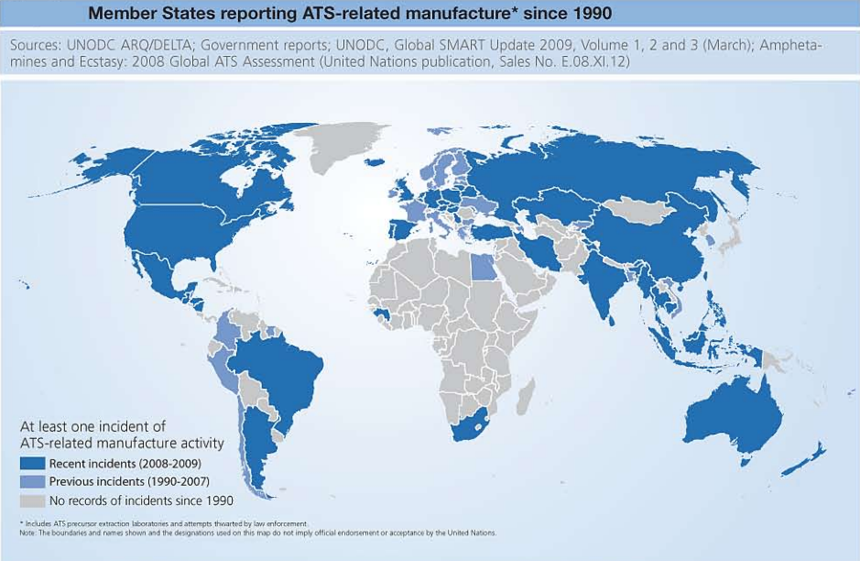
UNODC, World Drug Report, 2010

Slide 86
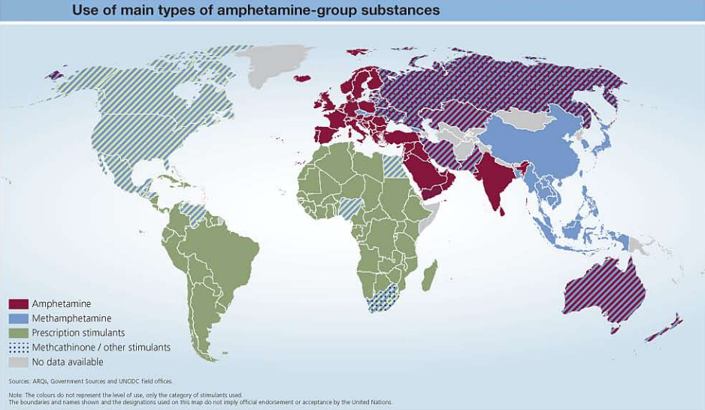
UNODC, World Drug Report, 2010

Slide 87
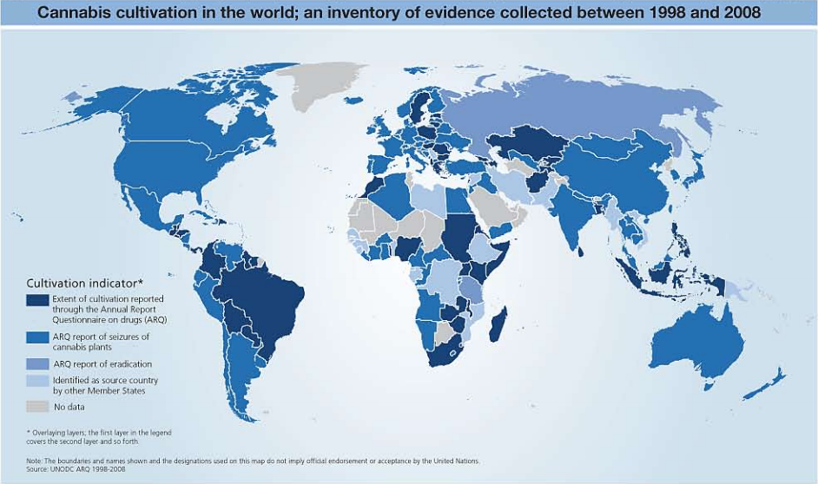
UNODC, World Drug Report, 2010

Slide 88
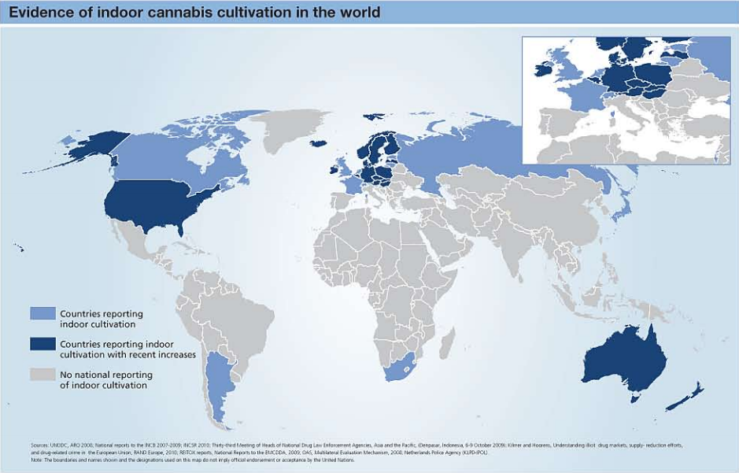
UNODC, World Drug Report, 2010

