Slide 1
The Influence of the
Blood Lipid-Lipoprotein Profile
on Psychological Wellbeing
C.D. Jensen, K.L. Darragh, B.A. Parker,
J.A. Capizzi, C.M. White, P.M. Clarkson,
P.D. Thompson, & L.S. Pescatello, FACSM
The Effects of Statins on Muscle Performance: NIH R01HL081893-01A2

Slide 2
Baseline Values (Men vs. Women)
Beck Depression Inventory
Psychological General Well Being Index

Slide 3
Baseline Values (Men vs. Women)
Beck Depression Inventory
Psychological General Well Being Index

Slide 4
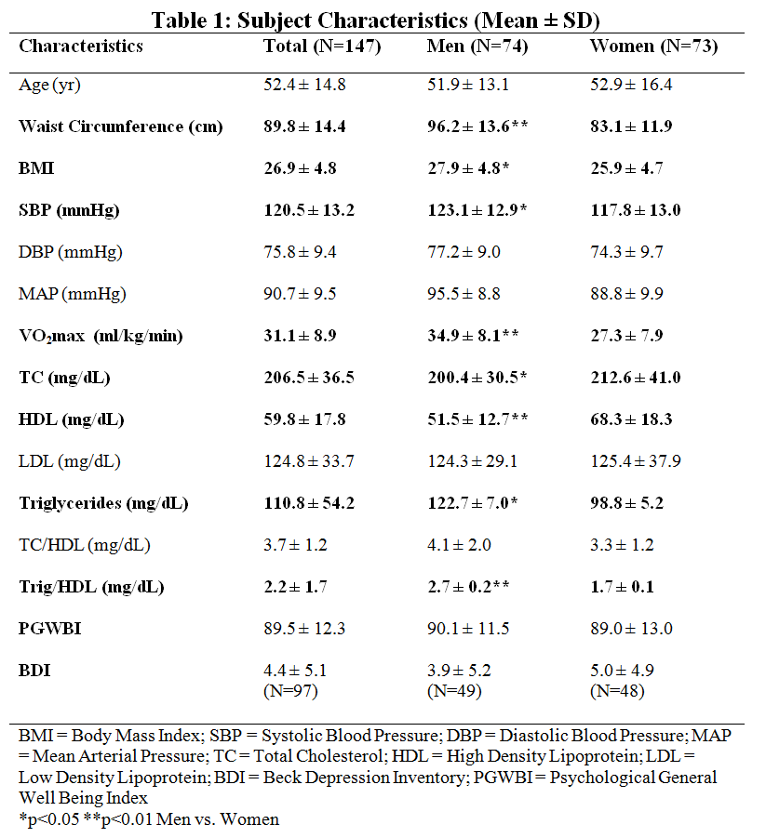

Slide 6
Baseline Values (Men vs. Women)
Beck Depression Inventory
Psychological General Well Being Index

Slide 7
Beck Depression Inventory (BDI)
1. Beck et al., 1961; Beck et al., 1979 2. Beck et al., 1988 3. Kramek et al., 2010

Slide 8
Beck Depression Inventory (BDI)
21-question multiple choice assessment of the severity of depression¹
1. Beck et al., 1961; Beck et al., 1979 2. Beck et al., 1988 3. Kramek et al., 2010

Slide 9
Beck Depression Inventory (BDI)
21-question multiple choice assessment of the severity of depression¹
Each question receives a score of 0-3
1. Beck et al., 1961; Beck et al., 1979 2. Beck et al., 1988 3. Kramek et al., 2010

Slide 10
Beck Depression Inventory (BDI)
21-question multiple choice assessment of the severity of depression¹
Each question receives a score of 0-3
Scores summed to form a composite score of 0-63
1. Beck et al., 1961; Beck et al., 1979 2. Beck et al., 1988 3. Kramek et al., 2010

Slide 11
Beck Depression Inventory (BDI)
21-question multiple choice assessment of the severity of depression¹
Each question receives a score of 0-3
Scores summed to form a composite score of 0-63
0-9: Minimal depression
10-18: Mild depression
19-29: Moderate depression
30-63: Severe depression
1. Beck et al., 1961; Beck et al., 1979 2. Beck et al., 1988 3. Kramek et al., 2010

Slide 12
Beck Depression Inventory (BDI)
21-question multiple choice assessment of the severity of depression¹
Each question receives a score of 0-3
Scores summed to form a composite score of 0-63
0-9: Minimal depression
10-18: Mild depression
19-29: Moderate depression
30-63: Severe depression
Others have used different cutoff points³, but they appear to be selected arbitrarily while those published by Beck et al. (1988) are based on clinical reports by the Center for Cognitive Therapy
1. Beck et al., 1961; Beck et al., 1979 2. Beck et al., 1988 3. Kramek et al., 2010

Slide 13
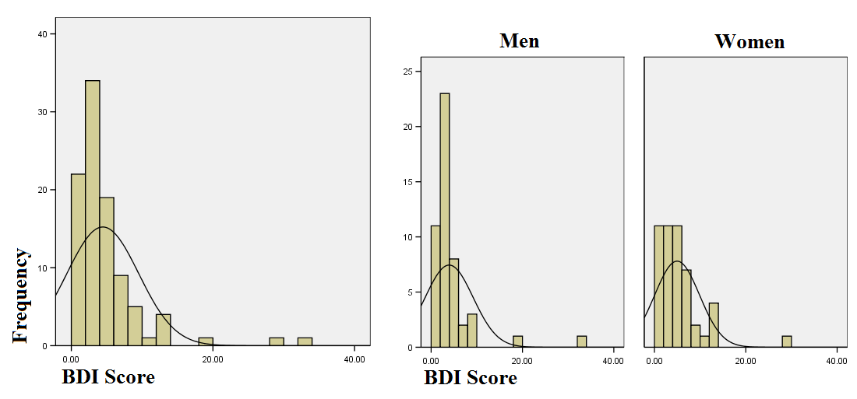
BDI data collected on 97 subjects

Slide 14
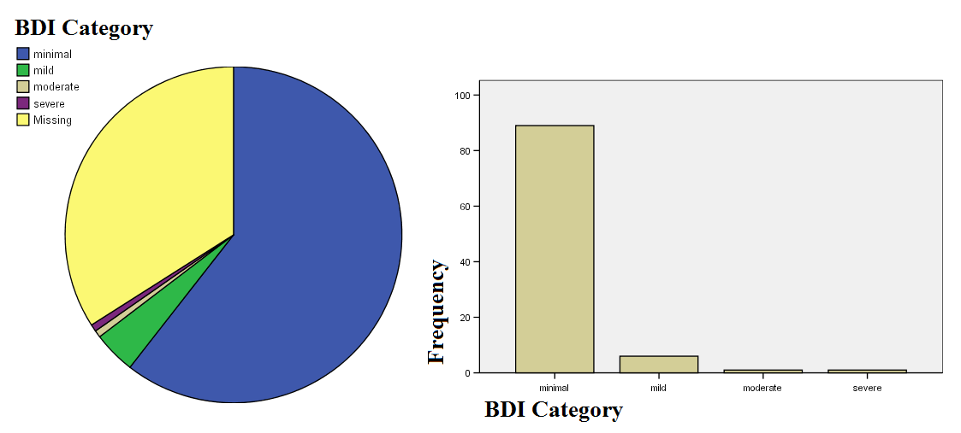
89 subjects had minimal depression (92%)
6 were mildly depressed
1 was moderately depressed
1 had severe depression

Slide 15
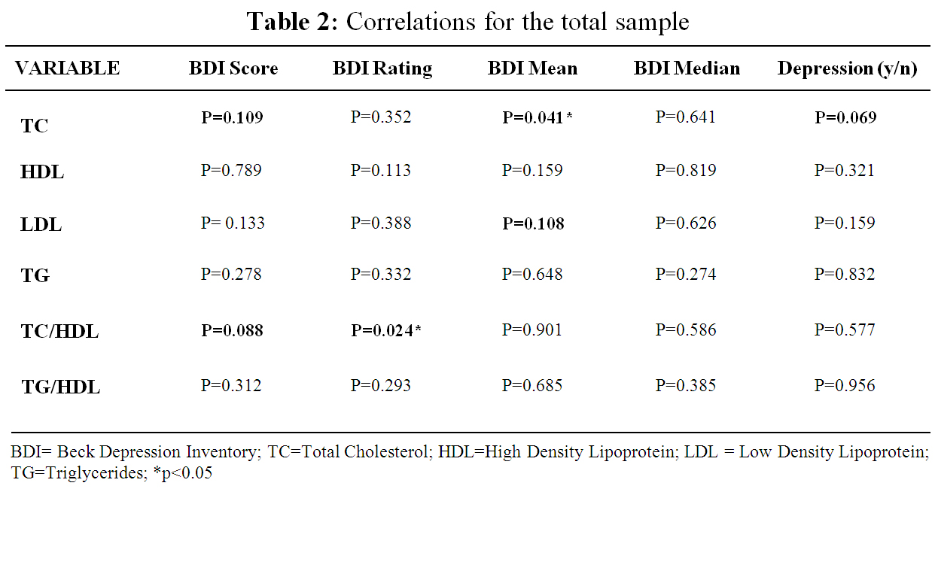

Slide 16
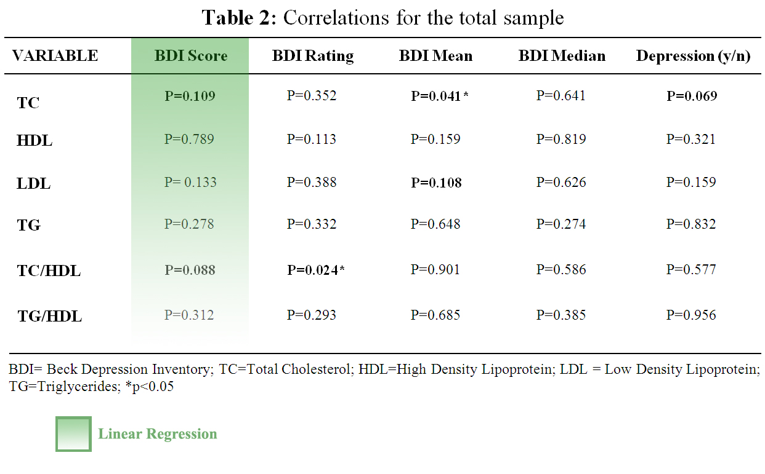

Slide 17
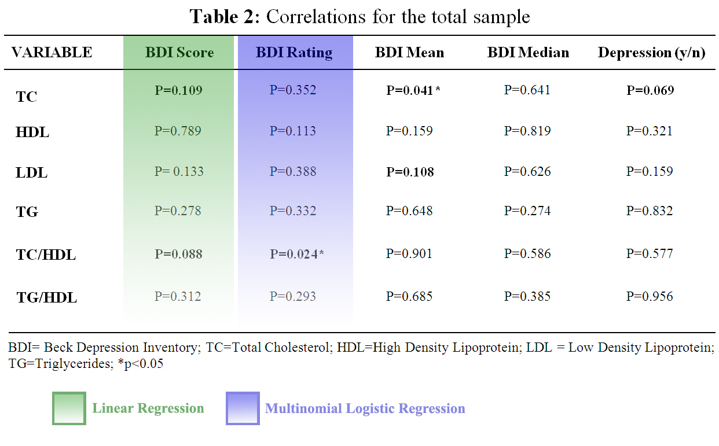

Slide 18
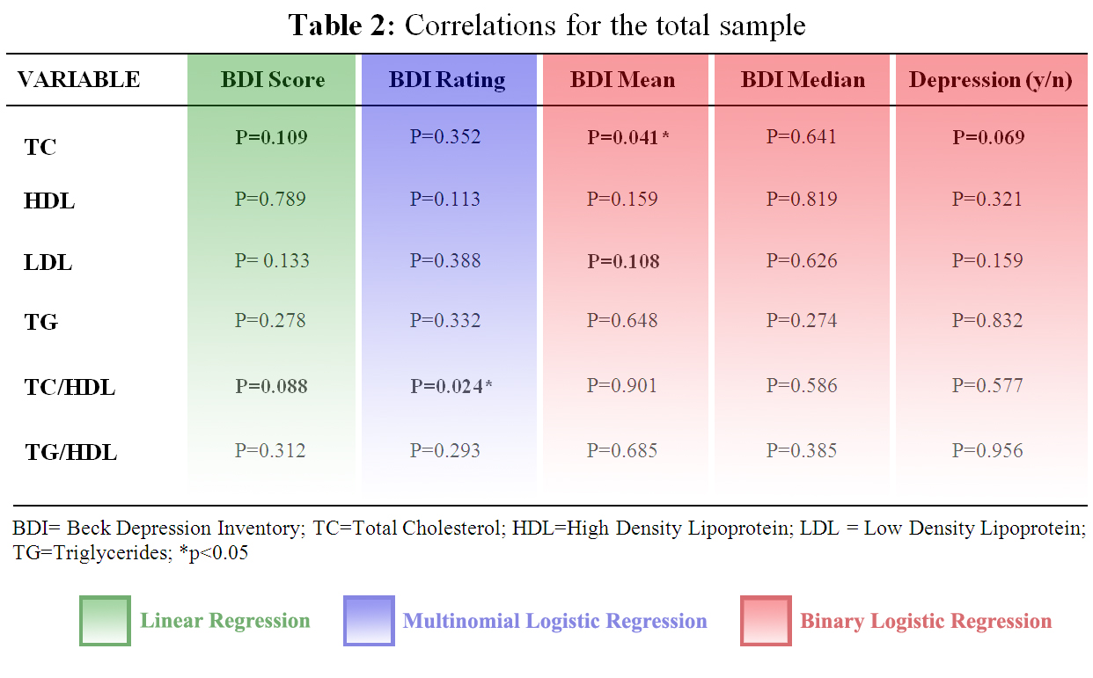

Slide 20
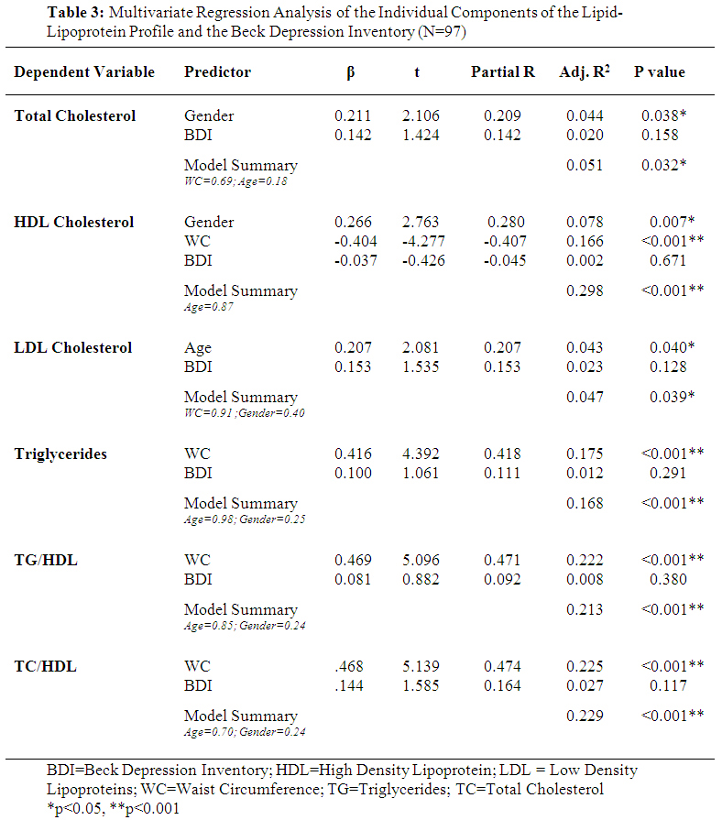

Slide 21
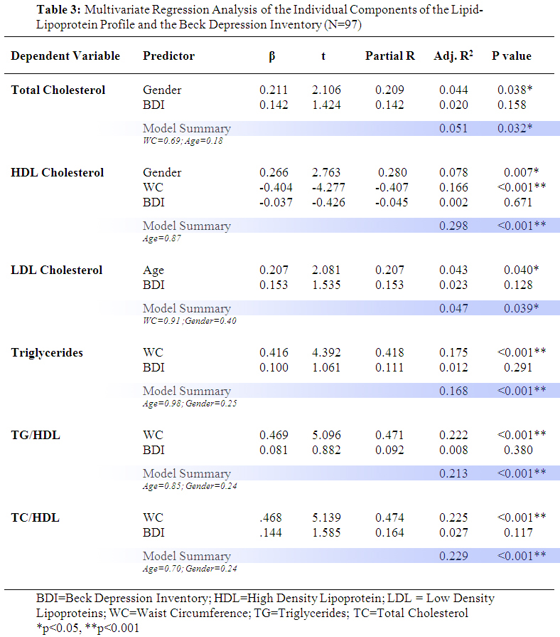

Slide 22
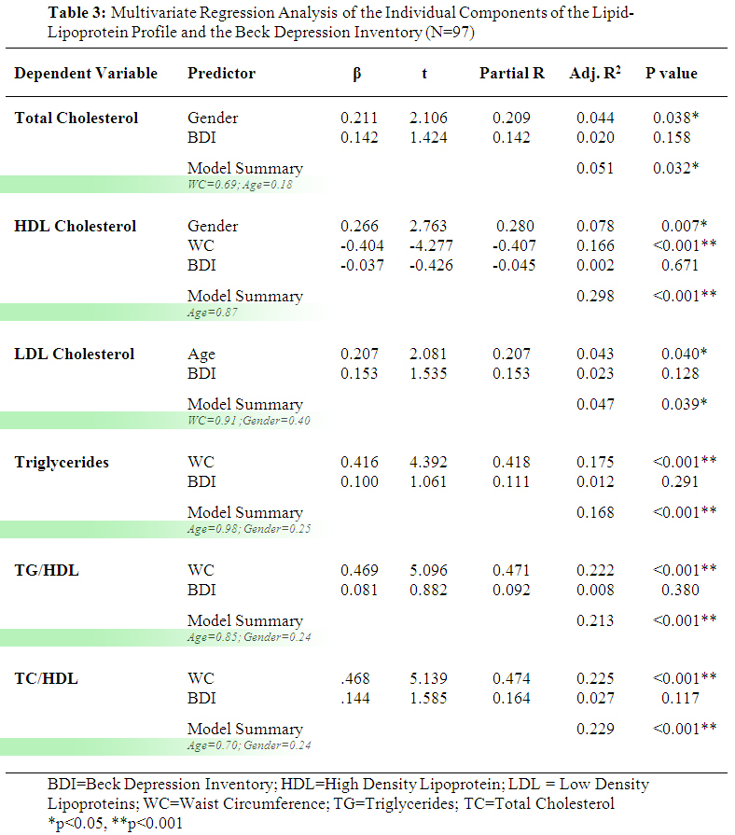

Slide 23
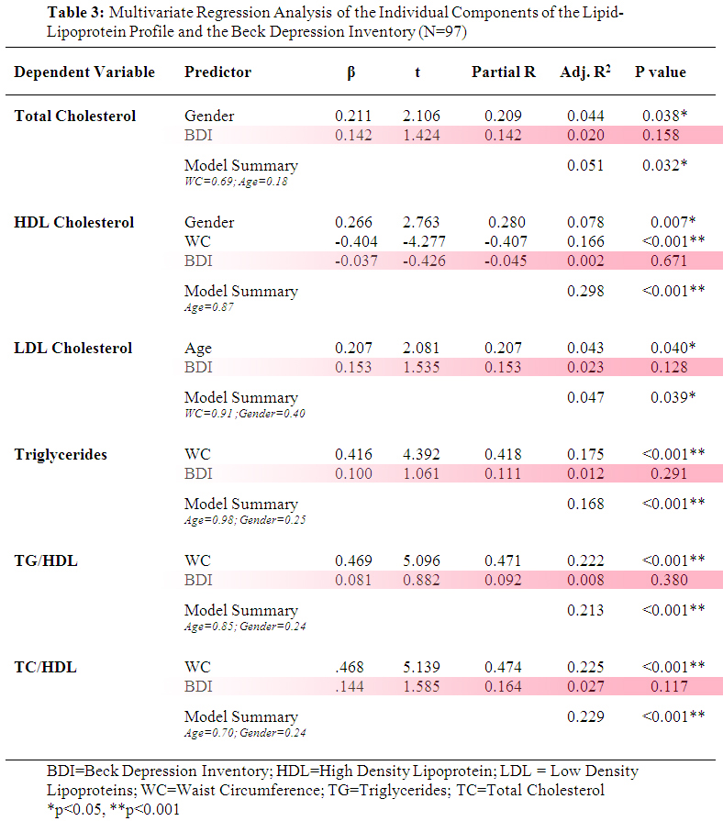

Slide 25
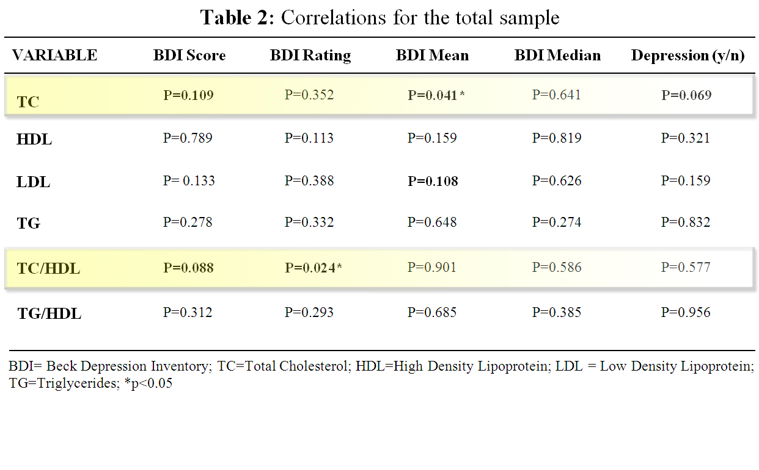

Slide 26
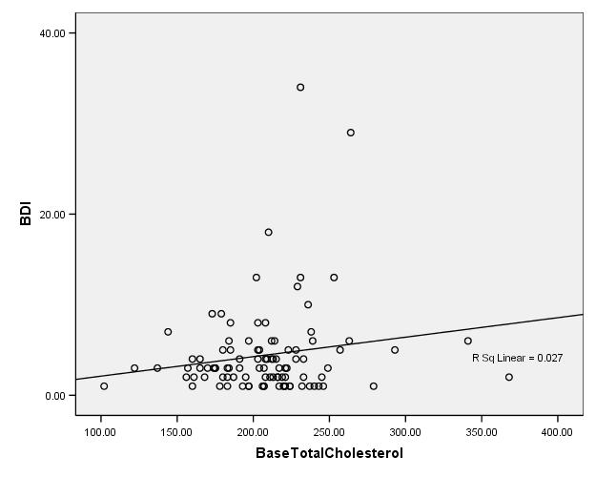

Slide 27
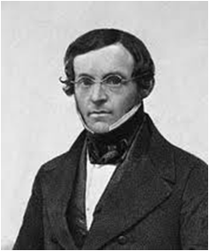
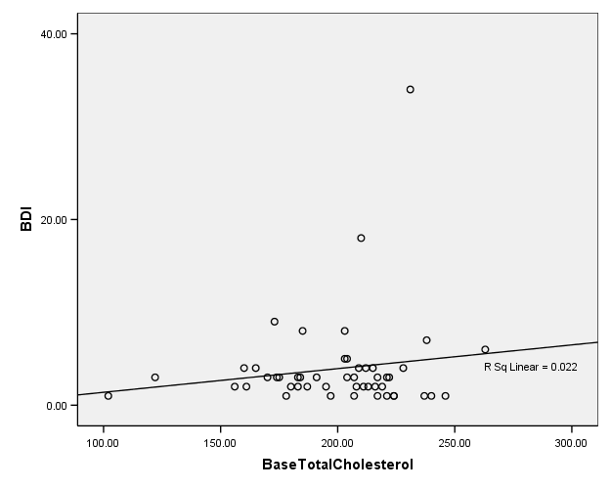
Image sources:
http://en.wikipedia.org
& http://www.thesilentrooster.com
Image sources:
http://fn.bmj.com
& http://www.dobhran.com

Slide 28
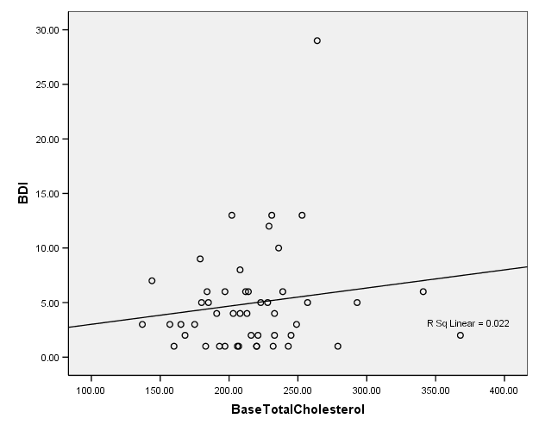
Image sources:
http://en.wikipedia.org
& http://www.thesilentrooster.com
Image sources:
http://fn.bmj.com
& http://www.dobhran.com

Slide 31
Multinomial Logistic Regression
Dependent: BDI Rating
Factor: Gender
Covariates: TC and WC

Slide 32
Multinomial Logistic Regression
Dependent: BDI Rating
Factor: Gender
Covariates: TC and WC
Intercept Only is the “null model”
Final is the “full model”
For model fitting criteria, when the “-2 Log Likelihood” for the Final is lower than the Intercept Only, that is indicative of better fit
The significance of the Chi-Square test also indicates goodness of fit

Slide 33
Multinomial Logistic Regression
Dependent: BDI Rating
Factor: Gender
Covariates: TC and WC
Lack of significance in the Pearson and Deviance statistics indicates goodness of fit
Metrics in the Pseudo R-Square table are surrogate values for the R² of a multiple regression analysis
They DON’T represent variance in the dependent variable however; they represent better fit
Better fit is indicated by higher values

Slide 34
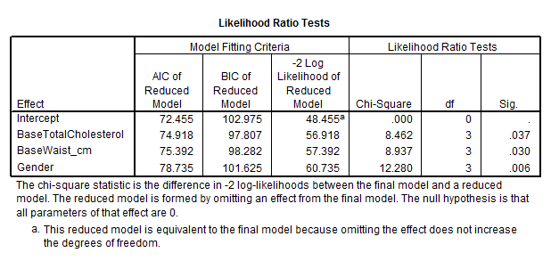
Multinomial Logistic Regression
Dependent: BDI Rating
Factor: Gender
Covariates: TC and WC
Each variable in the model is compared to the full model to determine if they should be included
Each predictor here contributes to the full effect

Slide 35
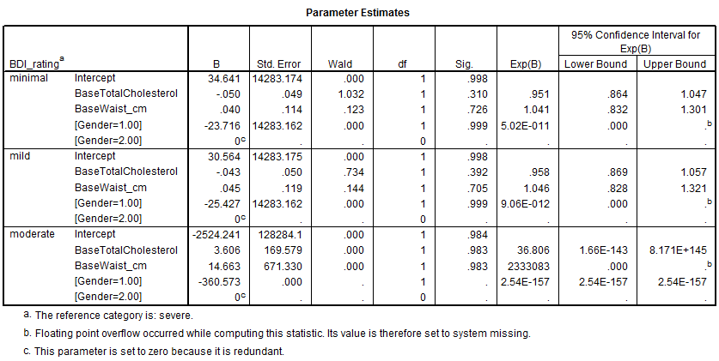
Multinomial Logistic Regression
Dependent: BDI Rating
Factor: Gender
Covariates: TC and WC
With a reference category of severe, this is estimating models of minimal, mild, and moderate depression relative to severe
The logistic coefficient (B) is shown for each predictor variable. What’s being predicted here are the odds of membership in the category of depression

Slide 36
Multinomial Logistic Regression
Dependent: BDI Rating
Factor: Gender
Covariates: TC and WC
Gender: The male score of -23.716 suggests men are less likely than women to be categorized in minimal rather than severe. This makes sense: the only severe score belongs to men.

Slide 37
Multinomial Logistic Regression
Dependent: BDI Rating
Factor: Gender
Covariates: TC and WC
The Wald chi-square test (and its p-value) tests the null hypothesis
For minimal relative to severe, TC has a Wald of 1.032 with a p-value of 0.31
Do not reject the null hypothesis - for minimal depression relative to severe, the regression coefficient for TC is not statistically different from zero given gender and WC are in the model

Slide 38
Multinomial Logistic Regression
Dependent: BDI Rating
Factor: Gender
Covariates: TC and WC
Exp(B) is the odds or relative risk that an outcome will fall in the comparison group rather than the referent group.
Predictors which increase the odds of falling in the comparison group are >1.0
Predictors which do not have an effect are =1.0
Predictors which decease the odds of falling into the comparison group are <1.0

Slide 39
Multinomial Logistic Regression
Dependent: BDI Rating
Factor: Gender
Covariates: TC and WC
In minimal, TC has an Exp(B) of 0.951. If a subject were to increase her cholesterol by one unit, the relative risk of being categorized in minimal rather than severe depression would be expected to decrease by a factor of 0.951 given that the other variables in the model were held constant. So with a one unit increase in TC, the relative risk of being in the minimal depression group would be 0.951 times more likely. As TC goes up, we would expect more severe depression.

Slide 40
Multinomial Logistic Regression
Dependent: BDI Rating
Factor: Gender
Covariates: TC and WC
In moderate, TC has an Exp(B) of 36.806. If a subject were to increase her TC by one unit, the relative risk for moderate depression would increase by a factor of 36.806. As a subject increases cholesterol, they’re more likely to be moderately depressed.

Slide 41
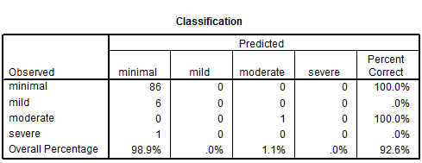
Multinomial Logistic Regression
Dependent: BDI Rating
Factor: Gender
Covariates: TC and WC
How well the full model correctly classifies cases
It does not predict severe or mild depression at all but the overall percentage is 92.6%

Slide 42
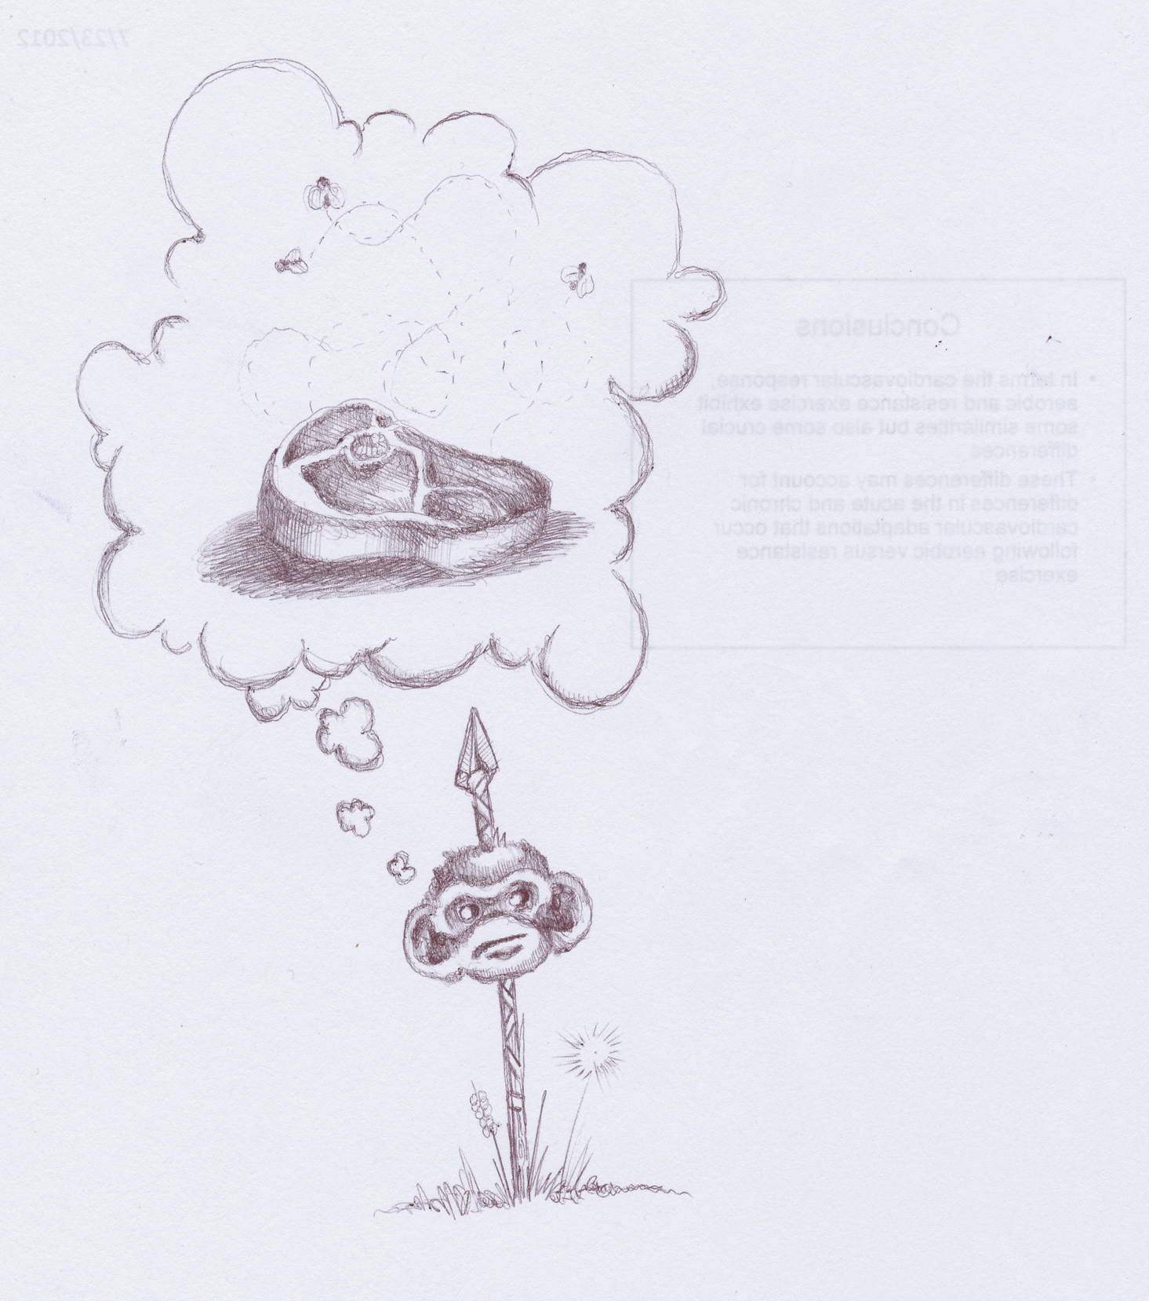
That’s all for Total Cholesterol
Moving onto TC to HDL ratio…

Slide 43
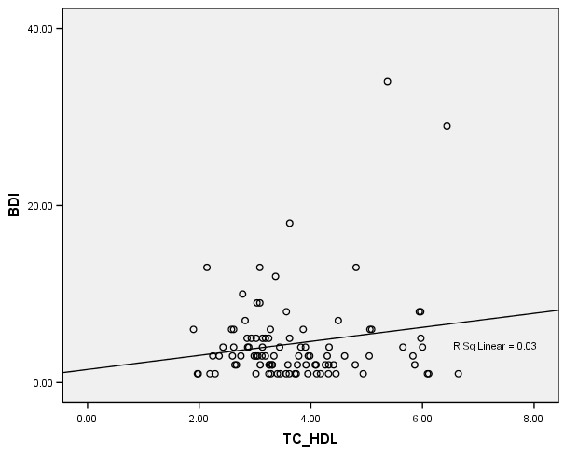

Slide 44
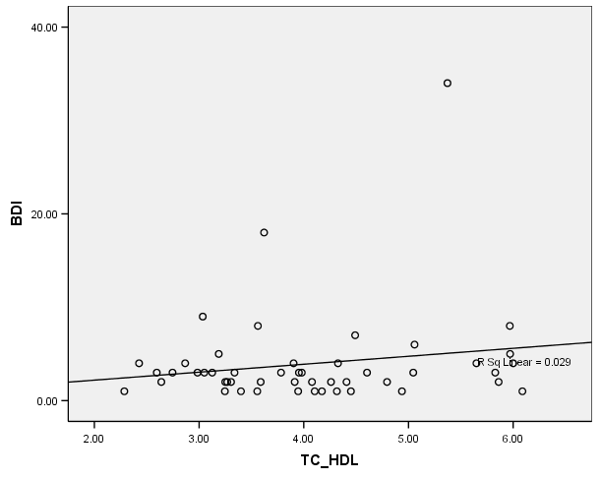

Slide 45
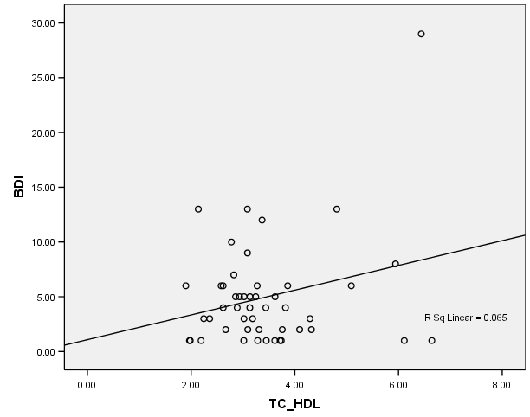

Slide 48
Multinomial Logistic Regression
Dependent: BDI Rating
Covariates: TC/HDL and BMI

Slide 49
Multinomial Logistic Regression
Dependent: BDI Rating
Covariates: TC/HDL and BMI
When the “-2 Log Likelihood” for the Final is lower than the Intercept Only, that is indicative of better fit
The significance of the Chi-Square test also indicates goodness of fit

Slide 50
Multinomial Logistic Regression
Dependent: BDI Rating
Covariates: TC/HDL and BMI
Lack of significance in the Pearson and Deviance statistics indicates goodness of fit
Metrics in the Pseudo R-Square table are surrogate values for the R² of a multiple regression analysis
Better fit is indicated by higher values

Slide 51
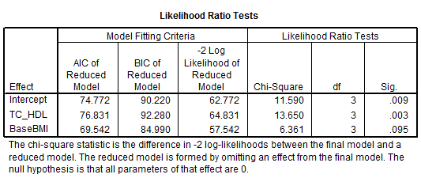
Multinomial Logistic Regression
Dependent: BDI Rating
Covariates: TC/HDL and BMI
Each variable in the model is compared to the full model to determine if they should be included
Each predictor here contributes to the full effect

Slide 52
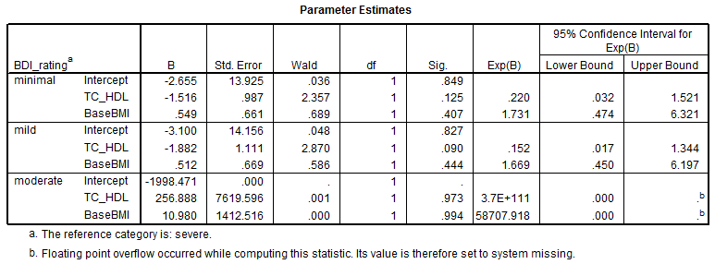
Multinomial Logistic Regression
Dependent: BDI Rating
Covariates: TC/HDL and BMI
As TC/HDL ratio increases, categorization migrates toward moderate, but this isn’t significant

Slide 53
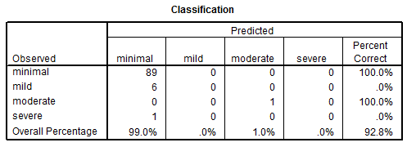
Multinomial Logistic Regression
Dependent: BDI Rating
Covariates: TC/HDL and BMI
How well the full model correctly classifies cases
It does not predict severe or mild depression at all but the overall percentage is 92.8%

Slide 54
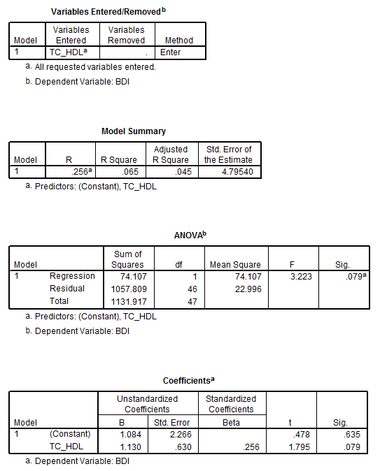
Linear Regression | Women Only
Dependent: BDI Score
Covariates: TC/HDL (no other variable sig)
6.5% of BDI score can be predicted from TC/HDL ratio
Close to significant
For every point a subject goes up on TC/HDL, she increases 1.13 points on BDI

Slide 55
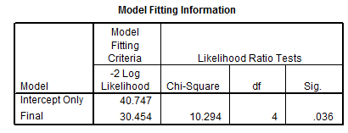
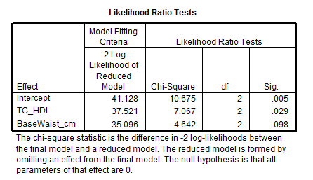
Multinomial Logistic Regression | Women Only
Dependent: BDI Rating
Covariates: TC/HDL and WC

Slide 56
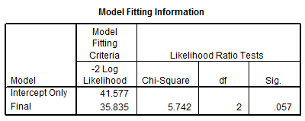
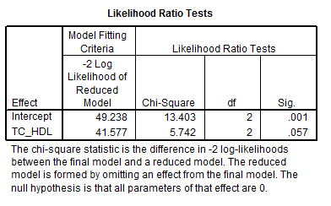
Multinomial Logistic Regression | Women Only
Dependent: BDI Rating
Covariates: TC/HDL
As TC/HDL ratio increases, the likelihood that subjects would go from minimal to mild depression decreases slightly, but goes way up that they would go from minimal to moderate (neither significantly)

Slide 57
Beck Depression Inventory in Summary…
Summary of all significant and trending variables in:
1. Multivariate Regressions
2. Linear Regressions
3. Binary Logistic Regressions
4. Multinomial Logistic Regressions

Slide 58
Beck Depression Inventory in Summary…
Multivariate Regressions
Model summaries are significant for
all dependent variables (TC, HDL,
LDL, TG, TG/HDL, TC/HDL)
BDI is not significant in any model
Significance driven by covariates
(gender, waist circumference, age)

Slide 59
Beck Depression Inventory in Summary…
Multivariate Regressions
Model summaries are significant for
all dependent variables (TC, HDL,
LDL, TG, TG/HDL, TC/HDL)
BDI is not significant in any model
Significance driven by covariates
(gender, waist circumference, age)

Slide 60
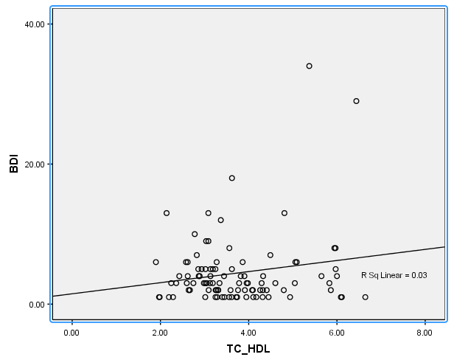
Beck Depression Inventory in Summary…
Linear Regressions
The closest model to significance is
TC/HDL predicting BDI score (p=0.09)
As TC/HDL increases, BDI score worsens
No covariate is close to significance
R² = 0.03 Adjusted R² = 0.02

Slide 61
Beck Depression Inventory in Summary…
Linear Regressions
The closest model to significance is
TC/HDL predicting BDI score (p=0.09)
As TC/HDL increases, BDI score worsens
No covariate is close to significance
R² = 0.03 Adjusted R² = 0.02

Slide 62
Beck Depression Inventory in Summary…
Binary Logistic Regressions
There is one trending model and one significant:
1. Total cholesterol predicting depression status
(depressed=8; not depressed=89): p=0.069
2. Total cholesterol predicting BDI mean score
(above or below the mean score): p=0.041

Slide 63
Beck Depression Inventory in Summary…
Binary Logistic Regressions
Total cholesterol predicting depression status
No covariate (age, gender, WC, or BMI) is significant
8 depression cases
____________________
89 non-depression cases
Exp(B) is the odds ratio:
= 0.90

Slide 64
Beck Depression Inventory in Summary…
Binary Logistic Regressions
Total cholesterol predicting depression status
This determines whether or not a variable
would be significant in the model: p=0.07

Slide 65
Beck Depression Inventory in Summary…
Binary Logistic Regressions
Total cholesterol predicting depression status
Testing the null hypothesis that total cholesterol does not predict depression; If significant, accept null hypothesis
Testing null hypothesis that the coefficient is 0;
If significant, reject null hypothesis

Slide 66
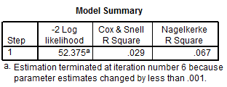
Beck Depression Inventory in Summary…
Binary Logistic Regressions
Total cholesterol predicting depression status
Pseudo-R² values range from 0.03 to 0.07

Slide 67
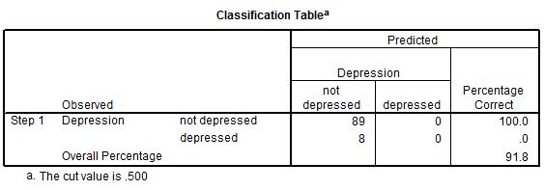
Beck Depression Inventory in Summary…
Binary Logistic Regressions
Total cholesterol predicting depression status

Slide 68
Beck Depression Inventory in Summary…
Binary Logistic Regressions
Total cholesterol predicting depression status
89 cases are correctly predicted to be not depressed

Slide 69
Beck Depression Inventory in Summary…
Binary Logistic Regressions
Total cholesterol predicting depression status
No cases are observed to be not depressed but predicted to be depressed

Slide 70
Beck Depression Inventory in Summary…
Binary Logistic Regressions
Total cholesterol predicting depression status
No cases are observed to be depressed and correctly predicted

Slide 71
Beck Depression Inventory in Summary…
Binary Logistic Regressions
Total cholesterol predicting depression status
8 cases are observed to be depressed, but predicted to be not depressed

Slide 72
Beck Depression Inventory in Summary…
Binary Logistic Regressions
Total cholesterol predicting depression status
While total cholesterol accurately predicts 91.8% of all cases,
it fails to predict 100% of all instances of depression

Slide 73
Beck Depression Inventory in Summary…
Binary Logistic Regressions
Total cholesterol predicting depression status
While total cholesterol accurately predicts 91.8% of all cases,
it fails to predict 100% of all instances of depression

Slide 74
Beck Depression Inventory in Summary…
Binary Logistic Regressions
Total cholesterol predicting BDI mean score

Slide 75
Beck Depression Inventory in Summary…
Binary Logistic Regressions
Total cholesterol predicting BDI mean score
No covariate (age, gender, WC, or BMI) is significant
Determining whether or not a variable
would be significant in the model: p=0.04

Slide 76
Beck Depression Inventory in Summary…
Binary Logistic Regressions
Total cholesterol predicting BDI mean score
Testing the null hypothesis that total cholesterol does not predict BDI mean; If significant, accept null hypothesis
Testing null hypothesis that the coefficient is 0;
If significant, reject null hypothesis

Slide 77
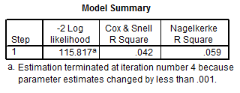
Beck Depression Inventory in Summary…
Binary Logistic Regressions
Total cholesterol predicting BDI mean score
Pseudo-R² values range from 0.04 to 0.06

Slide 78
Beck Depression Inventory in Summary…
Binary Logistic Regressions
Total cholesterol predicting BDI mean score
65 cases were correctly predicted to be under the mean

Slide 79
Beck Depression Inventory in Summary…
Binary Logistic Regressions
Total cholesterol predicting BDI mean score
2 cases were observed to be under the mean, but predicted to be over

Slide 80
Beck Depression Inventory in Summary…
Binary Logistic Regressions
Total cholesterol predicting BDI mean score
2 cases were correctly predicted to be over the mean

Slide 81
Beck Depression Inventory in Summary…
Binary Logistic Regressions
Total cholesterol predicting BDI mean score
28 cases were observed to be over the mean, but predicted to be under

Slide 82
Beck Depression Inventory in Summary…
Binary Logistic Regressions
Total cholesterol predicting BDI mean score
Total cholesterol accurately predicts 69.1% of all cases
It only predicted 2 “over the mean” cases correctly

Slide 83
Beck Depression Inventory in Summary…
Binary Logistic Regressions
Total cholesterol predicting BDI mean score
Total cholesterol accurately predicts 69.1% of all cases
It only predicted 2 “over the mean” cases correctly

Slide 84
Beck Depression Inventory in Summary…
Multinomial Logistic Regressions
There are two significant models:
Total cholesterol, gender, and waist circumference predict BDI Rating (p=0.035)
TC/HDL and BMI predict BDI rating (p=0.015)

Slide 85
Beck Depression Inventory in Summary…
Multinomial Logistic Regressions
In both models, “goodness-of-fit” is found in:
-2 Log Likelihood
Chi-Square test
Pseudo R2 values
The likelihood Ratio Tests show each predictor included to contribute significantly to the full effect

Slide 86
Beck Depression Inventory in Summary…
Multinomial Logistic Regressions
The problem is in the n:
89 subjects without depression
6 mildly depressed subjects
1 moderately depressed subject
1 severely depressed subject

Slide 87
Beck Depression Inventory in Summary…
Multinomial Logistic Regressions
Both models predicted 100% of the non-depressed subjects
by predicting every subject but 1 to be non-depressed
They failed to predict 100% of both mild and severe cases
Total cholesterol, gender,
and waist circumference
predict BDI Rating
TC/HDL and BMI predict
BDI rating

Slide 88
Beck Depression Inventory in Summary…
Multinomial Logistic Regressions
Both models predicted 100% of the non-depressed subjects
by predicting every subject but 1 to be non-depressed
They failed to predict 100% of both mild and severe cases
Total cholesterol, gender,
and waist circumference
predict BDI Rating
TC/HDL and BMI predict
BDI rating

Slide 89
Baseline Values (Men vs. Women)
Beck Depression Inventory
Psychological General Well Being Index

Slide 90
Psychological General Well Being Index (PGWBI)
1. Dupuy, 1984 2. Grossi et al., 2011; Sacco et al., 2009 3. Chassany et al., 2004

Slide 91
Psychological General Well Being Index (PGWBI)
22-question multiple choice assessment of one’s general well being¹
1. Dupuy, 1984 2. Grossi et al., 2011; Sacco et al., 2009 3. Chassany et al., 2004

Slide 92
Psychological General Well Being Index (PGWBI)
22-question multiple choice assessment of one’s general well being¹
Each question receives a score of 0-5
1. Dupuy, 1984 2. Grossi et al., 2011; Sacco et al., 2009 3. Chassany et al., 2004

Slide 93
Psychological General Well Being Index (PGWBI)
22-question multiple choice assessment of one’s general well being¹
Each question receives a score of 0-5
Scores summed to form a composite score of 0-110
1. Dupuy, 1984 2. Grossi et al., 2011; Sacco et al., 2009 3. Chassany et al., 2004

Slide 94
Psychological General Well Being Index (PGWBI)
22-question multiple choice assessment of one’s general well being¹
Each question receives a score of 0-5
Scores summed to form a composite score of 0-110
0-60: Severe psychological distress
61-72: Moderate psychological distress
73-110: Positive wellbeing
1. Dupuy, 1984 2. Grossi et al., 2011; Sacco et al., 2009 3. Chassany et al., 2004

Slide 95
Psychological General Well Being Index (PGWBI)
22-question multiple choice assessment of one’s general well being¹
Each question receives a score of 0-5
Scores summed to form a composite score of 0-110
0-60: Severe psychological distress
61-72: Moderate psychological distress
73-110: Positive wellbeing
Others² have used different cutoff points, but these appear to be selected arbitrarily while those listed above come from the PGWBI User Manual and result from intensive validation analyses³
1. Dupuy, 1984 2. Grossi et al., 2011; Sacco et al., 2009 3. Chassany et al., 2004

Slide 96
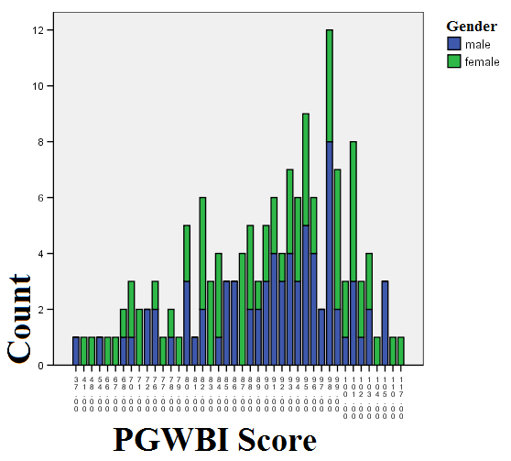
PGWBI data were collected on 147 subjects

Slide 97
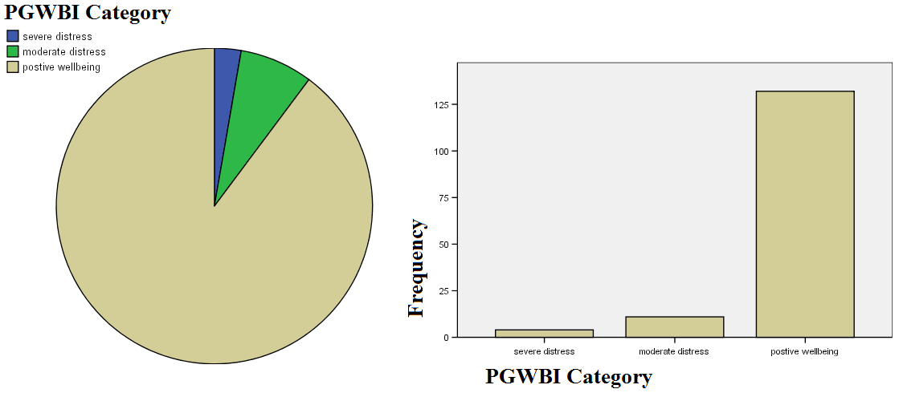
132 subjects had positive wellbeing (90%)
11 subjects were under moderate distress
4 subject was qualified as severely distressed

Slide 98
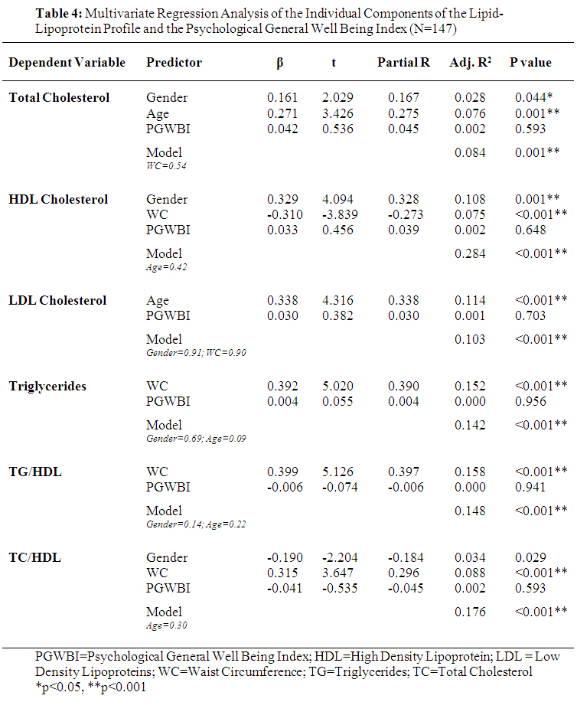

Slide 99
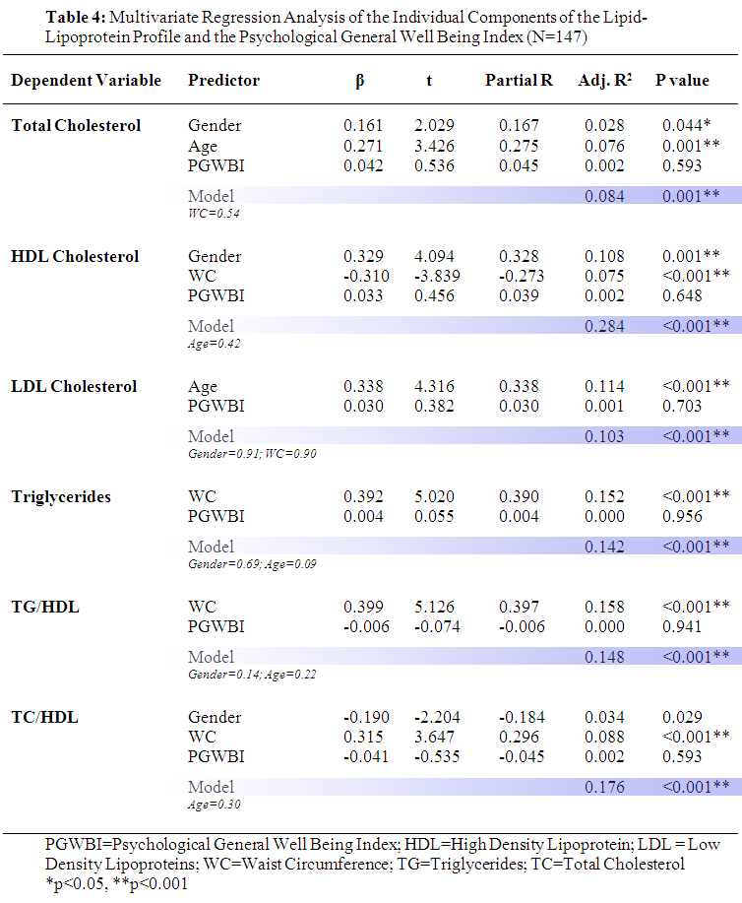

Slide 100
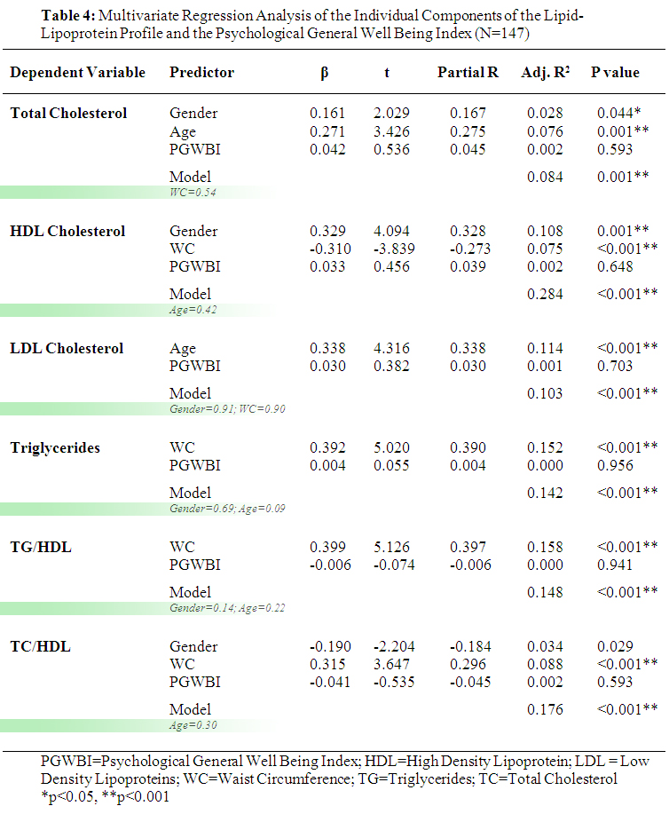

Slide 101
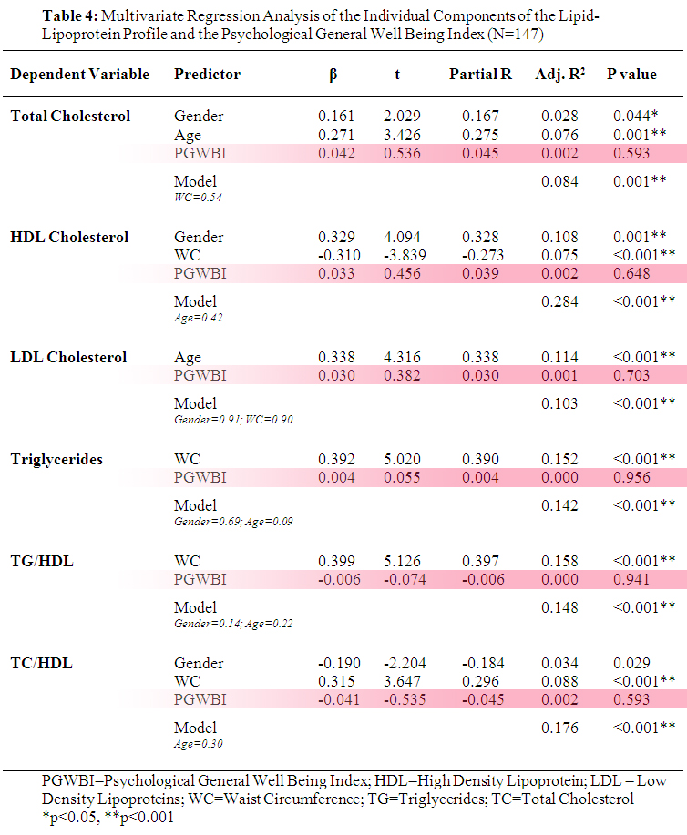

Slide 102
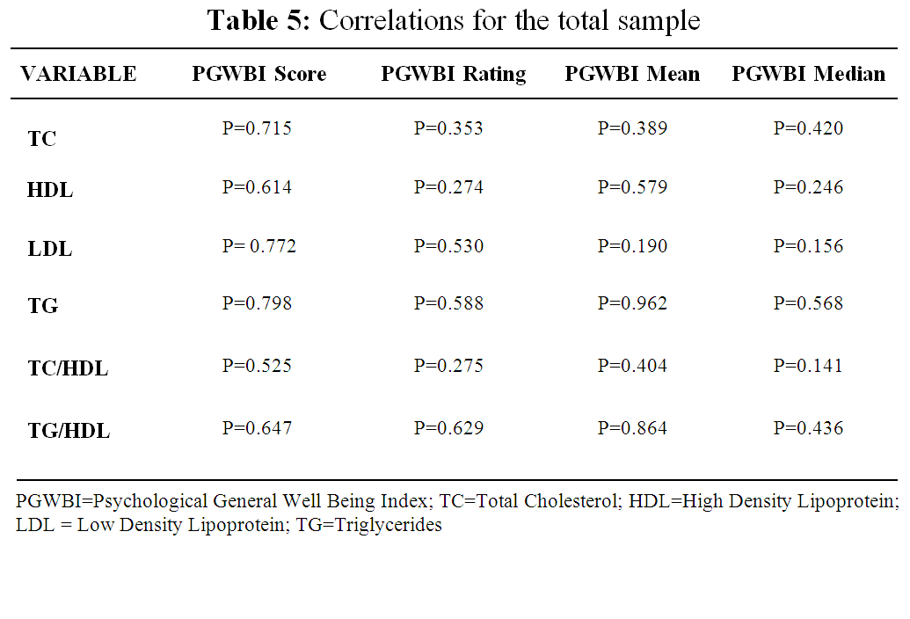

Slide 103
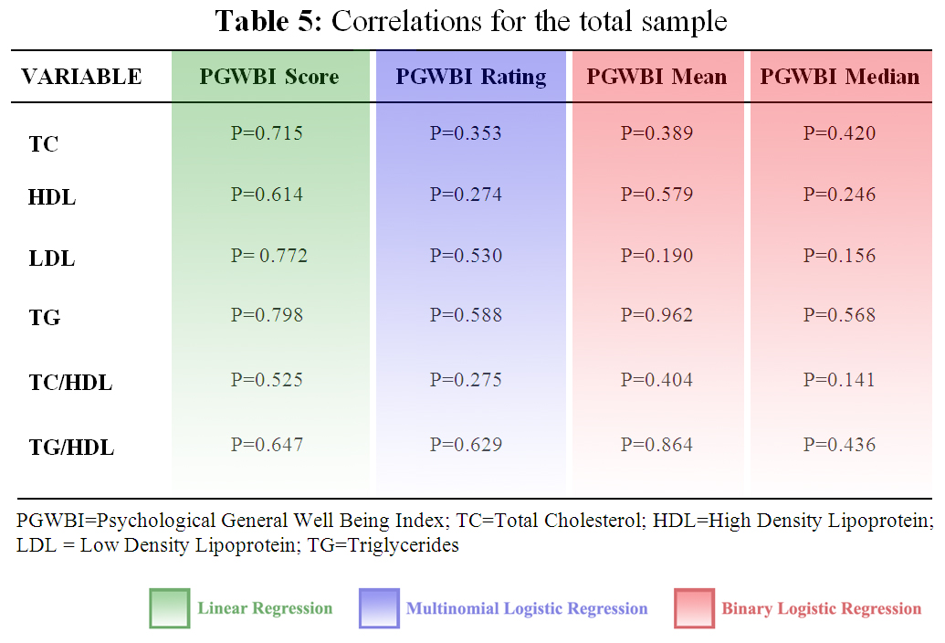

Slide 107
Whether or not the variable
Would be significant in the
model
Testing null hypothesis that the coefficient is 0;
If significant, reject null hypothesis

Slide 108
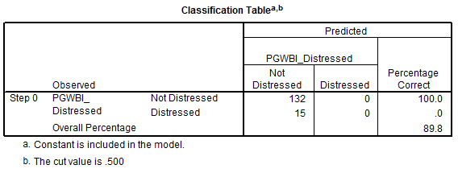
132 cases are correctly predicted to be not distressed
15 cases are observed to be distressed, but predicted to be not distressed
This model just predicts 0% of the subjects to be distressed

Slide 109
132 cases are correctly predicted to be not distressed
15 cases are observed to be distressed, but predicted to be not distressed
This model just predicts 0% of the subjects to be distressed

Slide 110
New Analyses
Based on Dr. P.’s suggestions
1. Metabolic Syndrome
Number of ATP III components
2. Rerun Table 4 with WC as the dependent variable
PGWBI and BDI as independent variables

Slide 111
New Analyses
Based on Dr. P.’s suggestions
1. Metabolic Syndrome
Number of ATP III components
2. Rerun Table 4 with WC as the dependent variable
PGWBI and BDI as independent variables

Slide 112
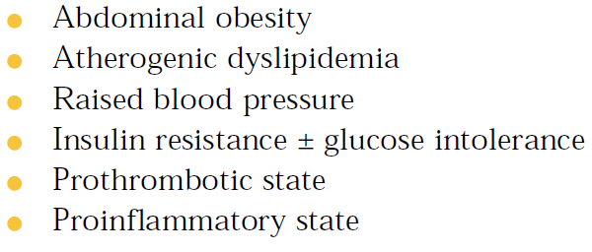
Third report of the National Cholesterol Education Program (NCEP) expert panel on detection, evaluation, and treatment of high blood cholesterol in adults (Adult Treatment Panel III). Final Report. Circulation, 2002; 106: 3143–3421

Slide 113
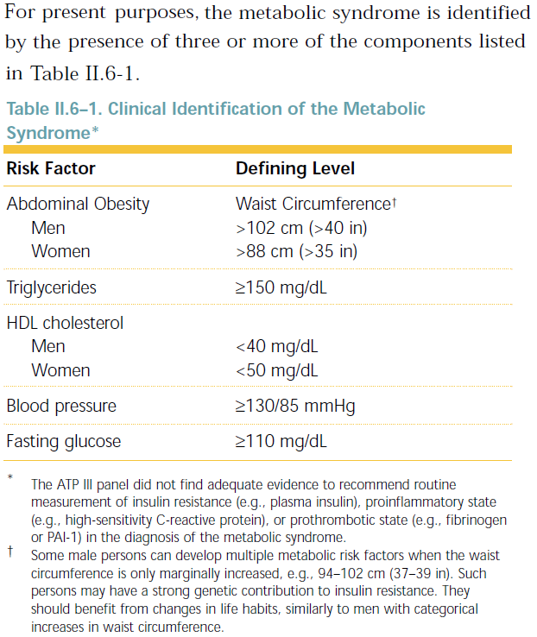

Slide 114
The STOMP database contains
data for 4 out of 5 variables
Metabolic Syndrome cannot be
diagnosed
All subjects were stratified into the
appropriate classes (yes or no) for
each variable that is available
The total number of risk variables
was summed for each subject

Slide 115
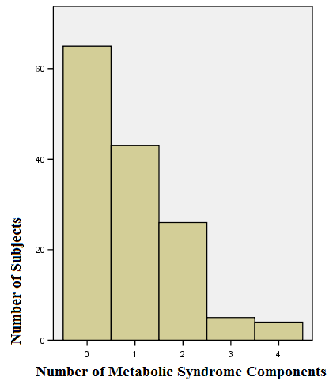
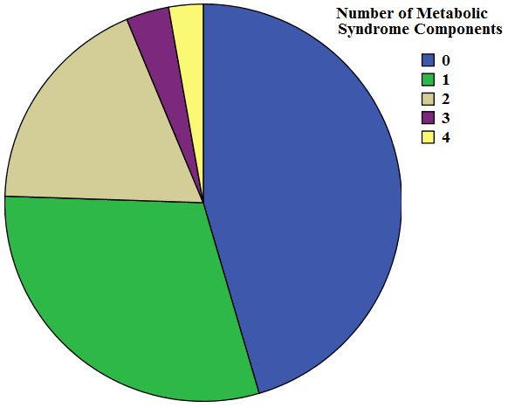
Summation of risk variables for Metabolic Syndrome

Slide 116
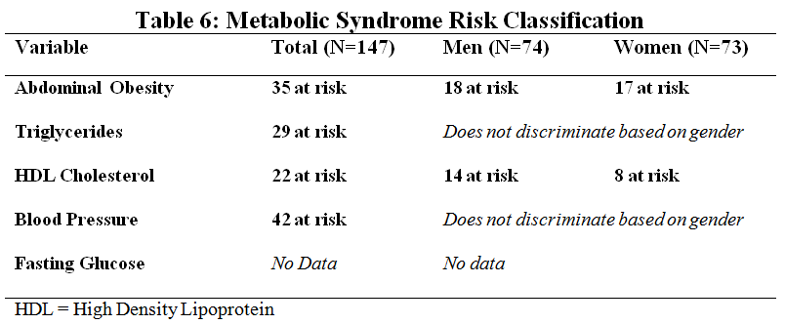
No significant differences between men and women. . .

Slide 118
No significance anywhere except Gender in BDI Mean score

Slide 119
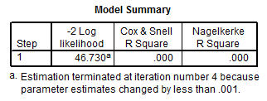
Binary Logistic Regression
Dependent variable: BDI mean score
Covariate: Number of Metabolic Syndrome risks
Sample: Men
Determines whether or not a variable would be significant
in the model: P=0.93
Number of MetS risks accounts for less than 0.1% of the explanation for BDI mean score

Slide 120
Binary Logistic Regression
Dependent variable: BDI mean score
Covariate: Number of Metabolic Syndrome risks
Sample: Men
Determines whether or not a variable would be significant
in the model: P=0.93
Number of MetS risks accounts for less than 0.1% of the explanation for BDI mean score

Slide 121
Binary Logistic Regression
Dependent variable: BDI mean score
Covariate: Number of Metabolic Syndrome risks
Sample: Women
Determines whether or not a variable would be significant
in the model: P=0.48
Number of MetS risks accounts for about 1% of the explanation for BDI mean score

Slide 122
Binary Logistic Regression
Dependent variable: BDI mean score
Covariate: Number of Metabolic Syndrome risks
Sample: Women
Determines whether or not a variable would be significant
in the model: P=0.48
Number of MetS risks accounts for about 1% of the explanation for BDI mean score

Slide 123
New Analyses
Based on Dr. P.’s suggestions
1. Metabolic Syndrome
Number of ATP III components
2. Rerun Table 4 with WC as the dependent variable
PGWBI and BDI as independent variables

Slide 124
New Analyses
Based on Dr. P.’s suggestions
1. Metabolic Syndrome
Number of ATP III components
2. Rerun Table 4 with WC as the dependent variable
PGWBI and BDI as independent variables

Slide 132
Conclusion and Direction . . .
I’ve put every cholesterol variable through every possible mode of statistical torture, and not one of them confessed significance. Or even hinted at a trend.
So I feel confident no relationship exists between the blood lipid-lipoprotein profile and psychological wellbeing within the STOMP population.
Being as I have 7 co-authors, I’d like to convert this finding into an abstract as early as possible. Do I have permission to move forward with it?
In regard to the waist circumference data, there appears to be relationships.
I’ve done some preliminary exploring (and some background reading), but the proposed mechanisms are completely different (cortisol rather than serotonin) and it’s a completely different set of researchers looking at this.
So if I were to pursue this subject instead of the cholesterol, I worry I’d be starting over much too late to make any abstract deadlines.

Slide 133
Conclusion and Direction . . .
What I’ve found in my background reading so far (ideally applied to a future abstract/paper):
Zaninotto et al. (2010). BMI and Waist Circumference as Predictors of Well-being in Older Adults: Findings From the English Longitudinal Study of Ageing. Obesity, 18(10): 1981–1987.
Among 8,688 older (late 60’s ± 15 yr) men (46%) and women (54%), increased WC is related to poorer quality of life and among women, depressive symptoms.
Vogelzangs et al. (2008). Depressive Symptoms and Change in Abdominal Obesity in Older Persons. Archives of General Psychiatry, 65(12): 1386-1393.
This study assesses the relationship in the reverse direction. Among 2,088 people in their 70’s (53% women), depressive symptoms at baseline result in increasing WC over five years independent of BMI. 36% of the subjects were black and race was a trending variable (p=0.06) in depression predicting waist circumference only in women.

Slide 134
Conclusion and Direction . . .
Weber-Hamann et al. (2006). Metabolic changes in elderly patients with major depression: evidence for increased accumulation of visceral fat at follow-up. Psychoneuroendocrinology, 31 (3): 347- 354.
29 depressed people (22 women and 7 men; 61.5 ± 11 yr) increased their WC more over time than 17 controls (12 women and 5 men; 61.8 ± 9 yr) despite similar amounts of weight gain. However, the depressed patients were reassessed after 14 months and the controls after 28 months.
Ahlberg et al. (2002). Depression and anxiety symptoms in relation to anthropometry and metabolism in men. Psychiatry Research, 112(2): 101-110.
This study used the Beck Depression Inventory (BDI) and waist-to-hip circumference ratio on 59 men (52.5±3.5 yr) and found ratios greater than 1.0 to associate with more depression (BDI) and anxiety (HAS) compared to the men with ratios lower than 1.0.

Slide 135
Conclusion and Direction . . .
Rosmond et al. (1996). Mental distress, obesity and body fat distribution in middle-aged men. Obesity Research, 4(3): 245-252.
Waist-to-hip ratio was compared to psychological wellbeing in 1040 men who were born in 1944. It was found to associate with depression, anxiety, and other measures of quality of life where BMI failed to find relationships.
Hachet al. (2006). Associations between waist circumference and depressive disorders. Journal of Affective Disorders, 92(2-3):305-308.
4181 German adults (49.7% women, mean age: 41.7 yr) showed no relationships between WC and depressive disorders. They also looked at other mental disorders (substance use, anxiety, etc) and found no relationships. Nothing changed when they controlled for gender, BMI, and different age groups.

Slide 136
Conclusion and Direction . . .
There appears to be a debate on the relationship between WC and wellbeing.
It’s just a different debate from the one concerning cholesterol and wellbeing.
Given the approaching deadline, can I start the cholesterol abstract now and save the other topic for after ACSM?

Slide 138
Cardiometabolic Risk Factors
and Their Associations with
Mental Health
C.D. Jensen, K.L. Darragh, B.A. Parker,
J.A. Capizzi, C.M. White, P.M. Clarkson,
P.D. Thompson, & L.S. Pescatello, FACSM
The Effects of Statins on Muscle Performance: NIH R01HL081893-01A2

Slide 139
Data Collected
Cardiometabolic Mental Health
Total Cholesterol
HDL Cholesterol
LDL Cholesterol
Triglycerides
Blood Pressure
Waist Circumference
Body Mass Index
VO₂max
Beck Depression Inventory
Psychological General
Well Being Index

Slide 140
Data Collected
Cardiometabolic Mental Health
Total Cholesterol
HDL Cholesterol
LDL Cholesterol
Triglycerides
Blood Pressure
Waist Circumference
Body Mass Index
VO₂max
Beck Depression Inventory
Psychological General
Well Being Index

Slide 141
Total Cholesterol
HDL Cholesterol
LDL Cholesterol
Triglycerides
Blood Pressure
Waist Circumference
Body Mass Index
VO₂max
Beck Depression Inventory

Slide 142
Total Cholesterol
HDL Cholesterol
LDL Cholesterol
Triglycerides
Blood Pressure
Waist Circumference
Body Mass Index
VO₂max
Beck Depression Inventory

Slide 143
Total Cholesterol
HDL Cholesterol
LDL Cholesterol
Triglycerides
Blood Pressure
Waist Circumference
Body Mass Index
VO₂max
Beck Depression Inventory
The only trending model (p=0.07) is TC predicting the categorical variable of Depression (yes or no). If any other variable enters the model, significance > 0.10. The reason this model trends is because of the small sample size (89 vs. 8). It predicts 100% of subjects to be asymptomatic, which means 92% correct, though failing to predict 100% of the cases of depression.

Slide 144
HDL Cholesterol
LDL Cholesterol
Triglycerides
Blood Pressure
Waist Circumference
Body Mass Index
VO₂max
Beck Depression Inventory

Slide 145
HDL Cholesterol
LDL Cholesterol
Triglycerides
Blood Pressure
Waist Circumference
Body Mass Index
VO₂max
Beck Depression Inventory
The model in which a BDI variable comes closest to significance is a multinomial logistic regression in which HDL cholesterol predicts the BDI category (4 different depression classes; p=0.11). No other predictors are significant in this model.

Slide 146
HDL Cholesterol
LDL Cholesterol
Triglycerides
Blood Pressure
Waist Circumference
Body Mass Index
VO₂max
Beck Depression Inventory
The model in which TC/HDL ratio is most significant is linear regression analysis in which BDI rating and waist circumference are the predictors. Although the model is significant (p<0.01), BDI rating (which only has an n of 1 in 2 of its 4 groups) is not significant (p=0.09).

Slide 147
LDL Cholesterol
Triglycerides
Blood Pressure
Waist Circumference
Body Mass Index
VO₂max
Beck Depression Inventory

Slide 148
LDL Cholesterol
Triglycerides
Blood Pressure
Waist Circumference
Body Mass Index
VO₂max
Beck Depression Inventory
The model closest to significance is a linear regression in which LDL cholesterol predicts BDI composite score (continuous variable; p=0.13). No other predictors are significant in this model.

Slide 149
Triglycerides
Blood Pressure
Waist Circumference
Body Mass Index
VO₂max
Beck Depression Inventory

Slide 150
Triglycerides
Blood Pressure
Waist Circumference
Body Mass Index
VO₂max
Beck Depression Inventory
The model in which triglycerides are closest to significance is a linear regression in which triglyceride levels predict BDI composite score (continuous variable; p=0.28). No other predictors are significant in this model.

Slide 151
Triglycerides
Blood Pressure
Waist Circumference
Body Mass Index
VO₂max
Beck Depression Inventory
The model in which TG/HDL ratio is most significant is a multinomial logistic regression with TG/HDL and gender as the predictors and BDI rating (4 categories) as the dependent variable. Neither the model (p=0.09) nor TG/HDL (p=0.18) is significant.

Slide 152
Blood Pressure
Waist Circumference
Body Mass Index
VO₂max
Beck Depression Inventory

Slide 153
Blood Pressure
Waist Circumference
Body Mass Index
VO₂max
Beck Depression Inventory
The best model for SBP is BDI rating (categorical) predicting SBP with age (p=0.03) and WC (p=0.01) included. While the overall model is significant (p=0.01), BDI rating is not significant (p=0.82).

Slide 154
Blood Pressure
Waist Circumference
Body Mass Index
VO₂max
Beck Depression Inventory
The best model for DBP is a linear regression in which DBP predicts BDI composite score (continuous) with no other predictors in the model (p=0.62).

Slide 155
Blood Pressure
Waist Circumference
Body Mass Index
VO₂max
Beck Depression Inventory
The best model for MAP is a linear regression in which WC and BDI composite score predict MAP. Neither the model (p=0.16) nor BDI score (p=0.64) is significant.

Slide 156
Waist Circumference
Body Mass Index
VO₂max
Beck Depression Inventory

Slide 157
Waist Circumference
Body Mass Index
VO₂max
Beck Depression Inventory
The models in which waist circumference is closest to significance are when BDI mean (categorical) is a predictor (p=0.19) or when BDI composite score (continuous) is a predictor (p=0.30). Age and gender are included in both models.

Slide 158
Body Mass Index
VO₂max
Beck Depression Inventory

Slide 159
Body Mass Index
VO₂max
Beck Depression Inventory
The most significant model is in a linear regression with BMI (p=0.55) and gender (p=0.06) as the predictors for the BDI composite score.

Slide 160
VO₂max
Beck Depression Inventory

Slide 161
VO₂max
Beck Depression Inventory
The model closest to significance (p=0.16) is VO₂max predicting BDI composite score with no other predictors. If VO₂max is the dependent variable, the best model is age (p<0.01), gender (p<0.01), and BDI composite score (p=0.21). VO2max is not related to any BDI measure in any model.

Slide 162
Beck Depression Inventory
NO FINDINGS WITH THE BDI

Slide 163
Total Cholesterol
HDL Cholesterol
LDL Cholesterol
Triglycerides
Blood Pressure
Waist Circumference
Body Mass Index
VO₂max
General Psychological
Well Being Index

Slide 164
Total Cholesterol
HDL Cholesterol
LDL Cholesterol
Triglycerides
Blood Pressure
Waist Circumference
Body Mass Index
VO₂max
General Psychological
Well Being Index

Slide 165
Total Cholesterol
HDL Cholesterol
LDL Cholesterol
Triglycerides
Blood Pressure
Waist Circumference
Body Mass Index
VO₂max
General Psychological
Well Being Index
The model in which any cholesterol variable comes closest to significance is a binary logistic regression in which TC/HDL is predicting distress, which is a categorical variable: yes (n=132) or no (n=15). No other predictors were significant and TC/HDL didn’t reach significance either (p=0.10). No other model can be thought of as a “near miss.”

Slide 166
Blood Pressure
Waist Circumference
Body Mass Index
VO₂max
General Psychological
Well Being Index

Slide 167
Blood Pressure
Waist Circumference
Body Mass Index
VO₂max
General Psychological
Well Being Index

Slide 168
Blood Pressure
Waist Circumference
Body Mass Index
VO₂max
General Psychological
Well Being Index

Slide 169
Blood Pressure
Waist Circumference
Body Mass Index
VO₂max
General Psychological
Well Being Index

Slide 170
Blood Pressure
Waist Circumference
Body Mass Index
VO₂max
General Psychological
Well Being Index

Slide 171
Blood Pressure
Waist Circumference
Body Mass Index
VO₂max
General Psychological
Well Being Index
Throughout the literature, WC has been found to be a much better predictor of psychological wellbeing than BMI. The STOMP data supports this finding. The best models are linear regressions in which BMI is the dependent variable and gender, age, and PGWBI composite score (p=0.16) or PGWBI distress category (p=0.12). Are the independents. WC in these models is p=0.09 and p=0.03 respectively.

Slide 172
Blood Pressure
Waist Circumference
VO₂max
General Psychological
Well Being Index

Slide 173
Blood Pressure
Waist Circumference
VO₂max
General Psychological
Well Being Index
Gender, age, and WC are significant predictors of VO₂max. PGWBI score is the wellbeing measure that comes closest to significance (p=0.49) in a legitimate model. The only way to accomplish a VO₂-related trend is to use no other covariates in a binary logistic regression with VO₂max predicting PGWBI distress category (yes or no). Here, p=0.06. However, that trend vanishes with the addition of any other covariates and the uneven n for the 2 groups (132 vs. 15) is what drives it. The model fails to predict all 15 “distress” cases. By predicting 100% of all cases to be non-distressed, it’s 90% accurate. But there are only 2 categories in the model and it fails to predict 100% of the cases in 1 of those 2. It would be cheating (or at least ridiculously misleading) if I used this trend.

Slide 174
Blood Pressure
Waist Circumference
General Psychological
Well Being Index

Slide 175
Cardiometabolic Mental Health
Blood Pressure
Waist Circumference
PGWBI
These are the only variables in the database with a relationship

Slide 178
Waist Circumference and PGWBI Score
Across the whole
sample, WC and
wellbeing appear to
have a weak reverse
linear relationship:
As WC increases,
wellbeing decreases
When controlling
for age and gender,
p=0.09
Without controlling
for age and gender,
p=0.22
Waist Circumference (cm)
PGWBI Score (higher is happier)

Slide 179
Waist Circumference and PGWBI Rating
Visually, the
categorical
relationship does
not appear very
strong.
Without controlling
for age and gender,
p=0.19
Controlling for age
and gender, p=0.07
Waist Circumference (cm)
PGWBI Category

Slide 180
Waist Circumference and Distress Rating
With two categories
the relationship
appears stronger
Without controlling
for age and gender,
p=0.12
Controlling for age
and gender, p=0.03
Waist Circumference (cm)
PGWBI Distress Category

Slide 187
Image source: http://themadcaplaughed.tumblr.com

Slide 188
Extra slides . . .

Slide 189
Beck Depression Inventory (BDI)
21-question multiple choice assessment of the severity of depression¹
Composite score categories based on clinical reports
by the Center for Cognitive Therapy²:
0-9: Minimal depression
10-18: Mild depression
19-29: Moderate depression
30-63: Severe depression
1. Beck et al., 1961; Beck et al., 1979 2. Beck et al., 1988

Slide 190
Beck Depression Inventory (BDI)
21-question multiple choice assessment of the severity of depression¹
Composite score categories based on clinical reports
by the Center for Cognitive Therapy²:
0-9: Minimal depression
10-18: Mild depression
19-29: Moderate depression
30-63: Severe depression
Lower numbers are more desirable
1. Beck et al., 1961; Beck et al., 1979 2. Beck et al., 1988

