Slide 1
The Influence of the
Blood Lipid-Lipoprotein Profile
on Psychological Well Being
07.02.2012 | Courtney

Slide 2
What I’ll be talking about
Why is this question worth asking?
How did the prior research answer it?
How is it answered by the present study?
What is the answer?
Title page image sources: waynecountyredcross.org and
depressionsymptomsguide.com . Current image source: tkmiller97.wordpress.com

Slide 3
Data come from STOMP¹
Why is this being studied?
Cholesterol is appropriated for use in a variety of biological systems but most concentrated in the central nervous system (CNS)²
When it was found to have such a robust presence in the CNS, it was arraigned by neuroscientists and physiologists alike for its potential role in phenomena beyond cardiovascular disease
One such line of questioning was cholesterol’s influence upon psychological well being in the mature brain²
1: STOMP: The Effects of Statins on Muscle Performance: (NIH R01HL081893-01A2)
2: Dietschy & Turley. (2004). Cholesterol metabolism in the central nervous system during
early development and in the mature animal. Journal of Lipid Research, 45(8): 1375–1397.

Slide 4
What the current research says
When assessing total cholesterol (TC):
Steegmans et al. (2000) found a positive relationship with
psychological well being
Ledochowski et al. (2003) found a negative relationship
Brown et al. (1994) found no correlation at all
In 1969, Jenkins et al. found elevated TC to be associated with positive personality traits whereas Oxenkrug et al. (1983) found no correlation between TC and emotional states

Slide 5
Why are there inconsistencies?
Partly because a proper definition of “psychological wellbeing” has not been established
While the sum of human flourishing clearly amounts to more than the mere absence of disease, mental health research doesn’t often take this into consideration
Psychological wellbeing is typically assessed through self report questionnaires assessing the severity of negative mood states such as depression, anxiety, aggression, etc¹⁻³
1. Steegmans, Hoes, Bak, van der Does, & Grobbee, 2000 2. Suls & Bunde, 2005 3. Virkkunen & Penttinen, 1984

Slide 6
Other than questionnaires, …?
TC and suicide attempts¹
TC and violent crime²
TC and predisposition for cognitive decline³
TC and intelligence (abstract reasoning,
concentration, etc)⁴
. . .Cholesterol’s role in each of these lacks a consistent verdict
1. Olié et al., 2011 2. Golomb, 1998 3. Anstey et al., 2008 4. Elias et al., 2005 Image source: aarons.org

Slide 7
Most researchers find low levels of TC to associate with elevated risk of suicide (Engelberg, 1992; Garland et al., 2000; Kunugia et al., 1995; Olié et al., 2011) but others have found no correlation (Pekkanen et al., 1989; Smith et al., 1990)
Much of the available research supports an association between low TC levels and increased participation in violent crime (Golomb et al., 2000; Jacobs et al., 1992) but other studies have found no correlation (Cummings & Psaty, 1994; New, et al., 1999)
Anstey et al. (2008) found high midlife TC to associate with an elevated risk of Alzheimer’s among 14,331 subjects, while Tan et al. (2003) found no associations among 5,209 subjects
The intelligence findings vary wildly depending on gender and the tests administered (Benton, 1995; Muldoon et al., 1997), but typically support a positive relationship between TC and cognitive performance (Elias et al., 2005)
. . . The most conflicted findings come from self-report questionnaires

Slide 8
STOMP uses two questionnaires
STOMP also examines
the whole lipid profile
Image sources: ztda-tourism.tj and phyzio.com

Slide 9
Other researchers have examined this too
High-density lipoprotein (HDL): Olusi & Fido (1996) reported a negative relationship between HDL levels and psychological wellbeing while Lehto et al. (2010) and Koponen et al. (2008) both reported positive relationships
Low-density lipoprotein (LDL): Strick et al. (2002) reported a positive relationship with psychological wellbeing while Muldoon et al. (2000) reported no relationship at all

Slide 10
Other researchers have examined this too
Plasma triglyceride levels appear to be the only variable unattached to a debate
Three studies¹ have found elevated triglycerides to correlate with reduced psychological well being
There appears to be no finding that suggests the opposite
1. Elovanio et al., 2010; Fowkes et al., 1992; Glueck et al., 1993

Slide 11
Methods of the present study
STOMP assessed whether there was an association between the blood lipid-lipoprotein profile and psychological well being among 74 men and 73 women between 20-76 yr

Slide 12
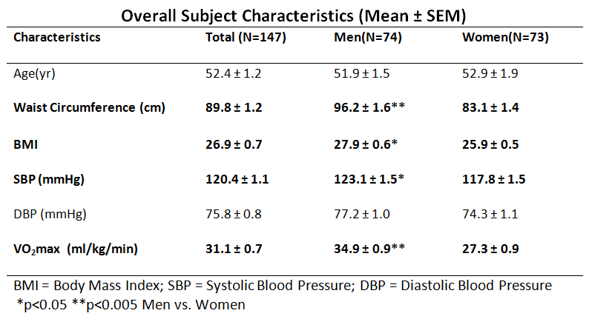

Slide 13
Methods of the present study
The entire blood lipid-lipoprotein profile was compared to a general measure of psychological well being as well as a specific assessment of depression
The measurements used are validated, widely used tools to assess depression¹ and general psychological well being²
1. Contreras et al., 2004 2. Wenger et al., 1984.

Slide 14
The two psychological tests
Beck Depression Inventory (BDI):
A 21-question multiple choice assessment of the severity of depression¹. Each question receives a score between 0 and 3. The composite score ranges between 0 and 63. High scores indicate more severe depression. The categories of total scores are as follows²:
0-9: minimal depression
10-18: mild depression
19-29: moderate depression
30-63: severe depression
1. Beck et al., 1961 2. Revicki et al., 1996

Slide 15
The two psychological tests
Psychological General Well Being Index (PGWBI):
A 22-question multiple choice assessment of one’s general well being¹. It encompasses 6 domains (freedom from bodily distress, life satisfaction, sense of vitality, cheerful verses distressed, relaxed verses anxious, and self-control). Each question receives a score of 0-5. The total score ranges from 0-110 with higher scores indicating greater psychological well being. Scores are categorically expressed as¹:
> 85 indicates general psychological well being
< 70 indicates psychological distress.
1. Dupuy, 1984

Slide 16
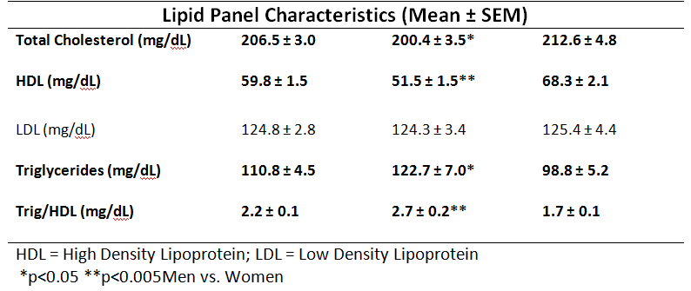

Slide 18
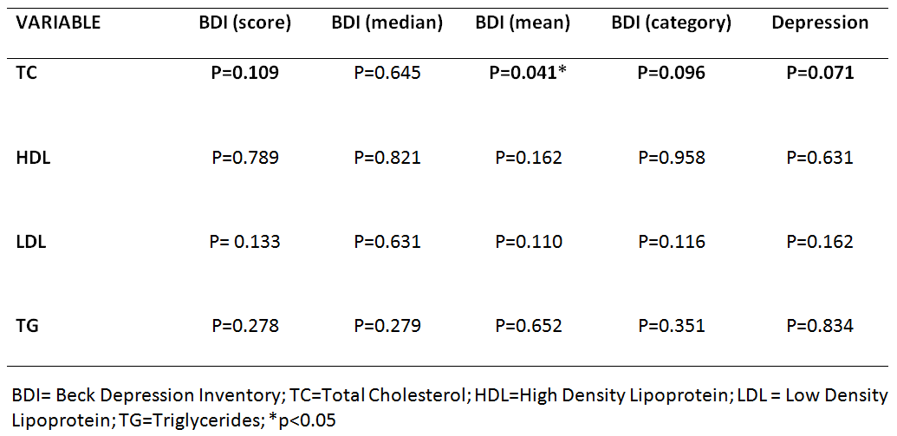
Bivariate correlations for BDI

Slide 19
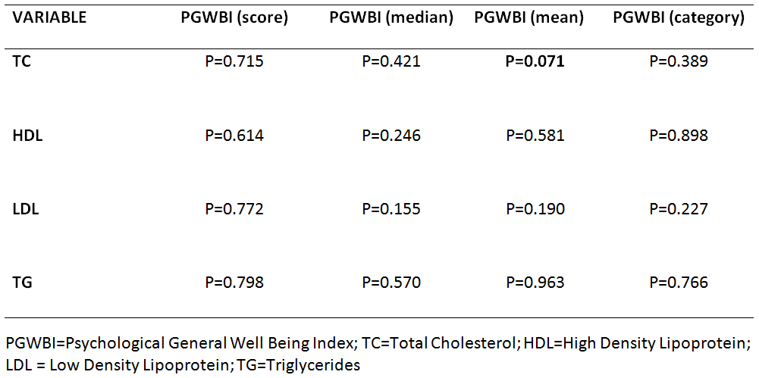
Bivariate correlations for PGWBI

Slide 20
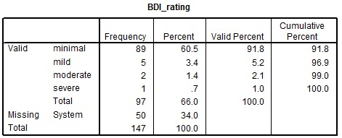
Exploring the BDI

Slide 21
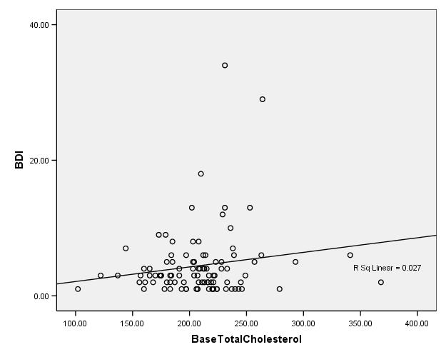
Total Sample

Slide 22
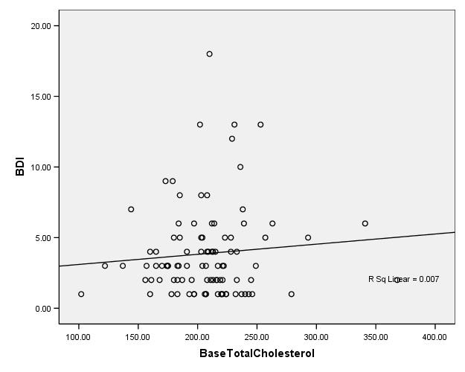
Excluded the outliers

Slide 23
Lipid Panel differences between Men and Women: Women had higher total cholesterol (p < 0.05) and HDL cholesterol (p < 0.001) than the men. Women also had lower triglyceride levels (p < 0.01) and TG/HDL ratio (p < 0.001) than the men.
Well Being differences between Men and Women: The mean BDI and PGWBI scores were not different between men and women.

Slide 24
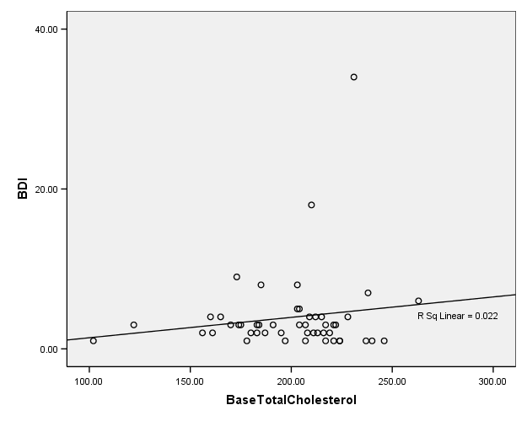
Men

Slide 25
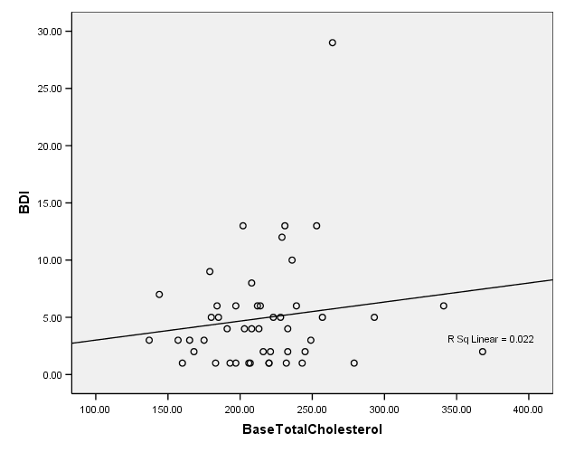
Women

Slide 26
Where should I go from here?

Slide 27
Between subjects factors: Gender, ethnicity, race, and season enrolled
Covariates: Age, waist circumference, and BMI

Slide 28
How do these results square with the existing literature?
STOMP is similar to the results of Brown et al. (1994) and Freedman et al. (1995)
Brown et al. reported no relationship between total cholesterol and depressive symptoms in an elderly population of men and women (≥71 yr)
Freedman et al., (1995) reported no relationships between depression or hostility and the entire lipid-lipoprotein panel among men, 34-45 yr, who suffer from generalized anxiety disorder
The STOMP study’s findings were the same, but among men and women, across a larger age range (20-76 yr), and using the entire lipid-lipoprotein panel

Slide 29
How do these results square with the existing literature?
The findings in STOMP contradict those of Ledchowski et al. (2003), Lehto et al. (2008), Steegmans et al. (2000), Strick et al. (2002), and Troisi et al. (2001), and Olusi & Fido (1996)

Slide 30
How do these results square with the existing literature?
The findings in STOMP contradict those of Ledchowski et al. (2003), Lehto et al. (2008), Steegmans et al. (2000), Strick et al. (2002), and Troisi et al. (2001), and Olusi & Fido (1996)
Ledchowski et al. reported a correlation between low TC and depressive symptoms among a large sample of men and women, 15-85 yr

Slide 31
How do these results square with the existing literature?
The findings in STOMP contradict those of Ledchowski et al. (2003), Lehto et al. (2008), Steegmans et al. (2000), Strick et al. (2002), and Troisi et al. (2001), and Olusi & Fido (1996)
Lehto et al. reported a positive correlation between low HDL cholesterol and long term depression in a population of men and women (25-64 yr)

Slide 32
How do these results square with the existing literature?
The findings in STOMP contradict those of Ledchowski et al. (2003), Lehto et al. (2008), Steegmans et al. (2000), Strick et al. (2002), and Troisi et al. (2001), and Olusi & Fido (1996)
Steegmans et al. found a positive relationship between low TC and incidence of depression in a population of men, 40-70 yr, with chronically low TC

Slide 33
How do these results square with the existing literature?
The findings in STOMP contradict those of Ledchowski et al. (2003), Lehto et al. (2008), Steegmans et al. (2000), Strick et al. (2002), and Troisi et al. (2001), and Olusi & Fido (1996)
Strick et al. found a positive association between low LDL cholesterol and depression in a sample of men and women who had suffered an acute myocardial infarction

Slide 34
How do these results square with the existing literature?
The findings in STOMP contradict those of Ledchowski et al. (2003), Lehto et al. (2008), Steegmans et al. (2000), Strick et al. (2002), and Troisi et al. (2001), and Olusi & Fido (1996)
Troisi et al. found reduced TC to associate with depression (BDI) among women, 23-39 yr, with postpartum declines in TC

Slide 35
How do these results square with the existing literature?
The findings in STOMP contradict those of Ledchowski et al. (2003), Lehto et al. (2008), Steegmans et al. (2000), Strick et al. (2002), and Troisi et al. (2001), and Olusi & Fido (1996)
Olusi & Fido found the opposite relationship between HDL cholesterol level and depression: that major depressive disorder associated with higher levels of HDL cholesterol among men and women, 20-79 yr

Slide 36
How could cholesterol influence well being?
A possible mechanism to explain associations between TC and psychological wellbeing is through alterations in the transmission of serotonin (Chattopadhyay et al., 2007), a mood-enhancing neurotransmitter (Young, 2007)
Low serum levels of TC appear to reduce the availability of free cholesterol surrounding the serotonin receptors, which would precipitate an increase in the fluidity of the lipid membranes, and in turn affect the brain's ability to metabolize the neurotransmitter (Engelberg, 1992)
The consequent reduction in serotonin levels would likely correspond to depression, aggressive tendencies, and an elevated risk of suicide (Steegmans et al., 2000)

Slide 37
How could cholesterol influence well being?
Strick et al., (2002) says low TC can decrease tryptophan availability in addition to increases serotonin membrane fluidity, but their findings were only with LDL and there’s no added explanation why LDL would be individually culpable
Elovanio et al. (2010), who found triglycerides that increase rapidly from childhood into adulthood increased the risk of adult depression proposed that increasing triglyceride trajectory may indicate poor lifestyle factors, such as increased dietary intake of fats that could contribute to the development of depression
Stoney et al. (2002) added that acute psychological distress to reduce plasma clearance of triglycerides

Slide 38
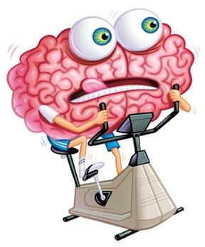
Or maybe…
People who are more physically active have better profiles. And that physical activity also enhances psychological well being.
Or people with depression eat a bunch of chocolate (or some such comfort food) while getting no exercise.
Image source: www.brainbasedbusiness.com

Slide 39
What is cholesterol?
Cholesterol is an organic steroid alcohol abundant in mammalian cell membranes (Saher et al., 2005). In addition to maintaining cell structures, cholesterol modulates the cell’s permeability (Yeagle, 1991), facilitates intracellular transport (Maxfield & Wüstner, 2002), has been implicated in cell signaling cascades (Ramprasad et al., 2007), is a biochemical precursor in the synthesis of compounds such as bile, vitamin D, and steroid hormones (Berg at al., 2002), and is critical to nerve conduction (Saher et al., 2005).

