Slide 1
Cardiometabolic Risk Factors
and Their Associations with
Mental Health
C.D. Jensen, K.L. Darragh, B.A. Parker,
J.A. Capizzi, C.M. White, P.M. Clarkson,
P.D. Thompson, and L.S. Pescatello, FACSM
The Effects of Statins on Muscle Performance: NIH R01HL081893-01A2

Slide 2
Introduction
Why is mental health important?

Slide 3
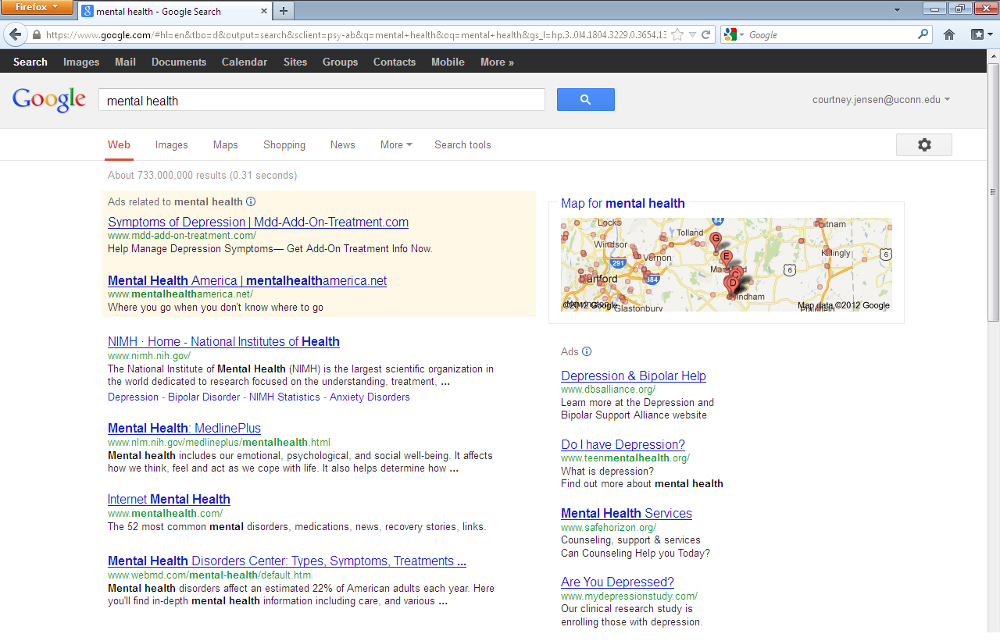

Slide 8
26.2%

Slide 11
Introduction
General mental health assessed through the
Psychological General Well-Being Index¹
1. Dupuy, 1984

Slide 12
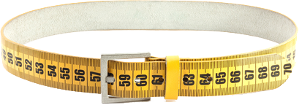
Introduction
Waist circumference
via cortisol¹
1. Vogelzangs et al. (2008)

Slide 13
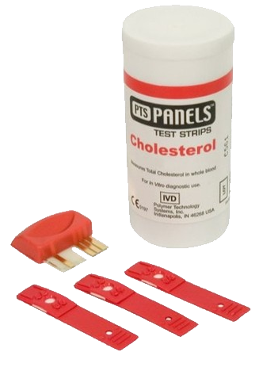
Introduction
Cholesterol via
serotonin¹
1. Chattopadhyay et al., 2007

Slide 14
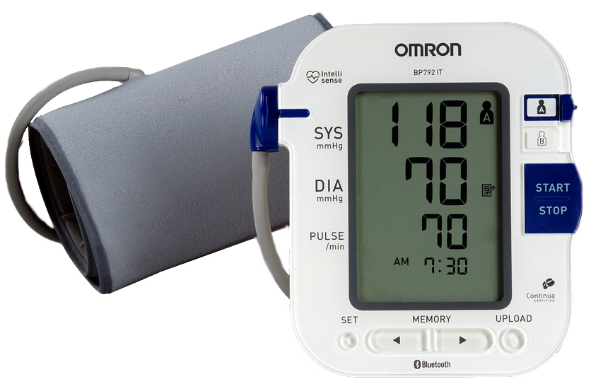
Introduction
Blood pressure via
stress response¹
1. Barrett-Connor, E. & Palinkas, L.A. (1994)

Slide 15
Introduction

Slide 16
Introduction

Slide 17
Introduction
Waist circumference associates with mental well-being:
Zaninotto et al. (2010)
Vogelzangs et al. (2008)
Weber-Hamann et al. (2006)
Waist circumference does not associate with mental well-being:
Hachet al. (2006)

Slide 18
Introduction
Blood pressure associates with mental well-being:
Rosengren et al. (1993)
Pilgrim et al. (1992)
Barrett-Connor et al. (1994)
Blood pressure does not associate with mental well-being:
Donner-Banzhoff et al. (1997)
Wright et al. (2009)

Slide 19
Introduction
The relationship between cholesterol and mental well-being:
Steegmans et al. (2000) found a positive relationship
Ledochowski et al. (2003) found a negative relationship
Brown et al. (1994) found no relationship at all

Slide 20
Introduction
HDL and mental well-being:
Negative relationship: Olusi & Fido (1996)
Positive relationship: Lehto et al. (2010) and Koponen et al. (2008)
LDL and mental well-being:
Positive relationship: Strick et al. (2002)
No relationship: Muldoon et al. (2000)

Slide 21
Introduction

Slide 22
Purpose
Examine the associations between
cardiometabolic risk factors and
mental health among men and
women across the life span

Slide 23
Subject Profile

Slide 24
Subject Profile
N = 147

Slide 25
Subject Profile
♂ = 74 ♀ = 73

Slide 26
Subject Profile
Ages 20 – 76

Slide 28
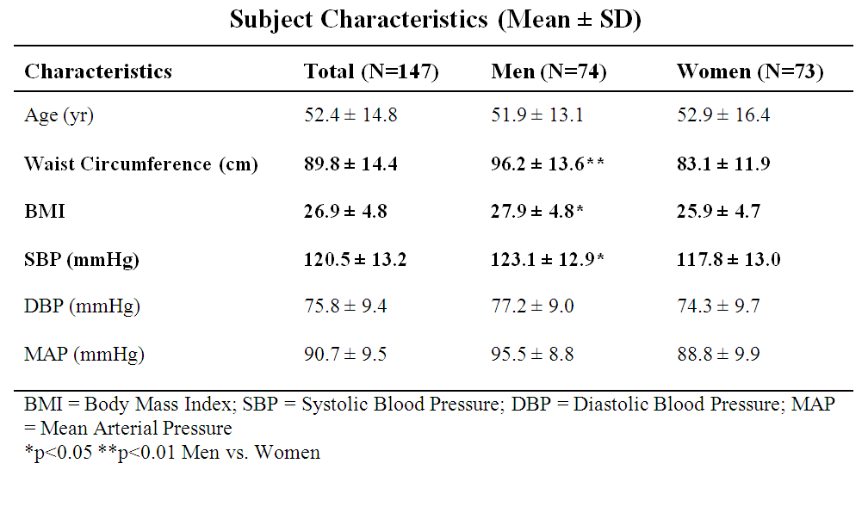

Slide 29
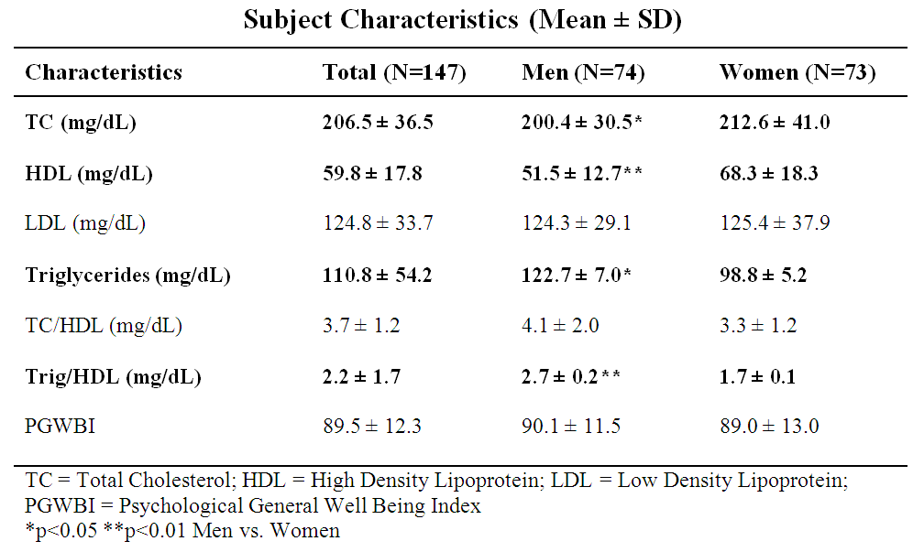

Slide 30
Data Collected
Cardiometabolic Mental Health
Total Cholesterol
HDL Cholesterol
LDL Cholesterol
Triglycerides
Blood Pressure
Waist Circumference
Body Mass Index
Psychological General
Well Being Index

Slide 31
Data Collected
Cardiometabolic Mental Health
Total Cholesterol
HDL Cholesterol
LDL Cholesterol
Triglycerides
Blood Pressure
Waist Circumference
Body Mass Index
Psychological General
Well Being Index

Slide 32
Data Collected
Cardiometabolic Mental Health
Total Cholesterol
HDL Cholesterol
LDL Cholesterol
Triglycerides
Blood Pressure
Waist Circumference
Body Mass Index
Psychological General
Well Being Index

Slide 33
Data Collected
Cardiometabolic Mental Health
Blood Pressure
Waist Circumference
Psychological General
Well Being Index

Slide 34
Data Collected
Cardiometabolic Mental Health
Blood Pressure
Waist Circumference
Psychological General
Well Being Index

Slide 35
Methods
BP (mmHg) was measured by auscultation
following 10-15 minutes of seated rest

Slide 36
Methods
Waist Circumference (cm) was measured
at the narrowest point of the subject’s torso
with a non-distensible tape measure

Slide 37
Methods
Cholesterol and triglycerides were measured with an automated clinical laboratory instrument (Model P Module, Roche Diagnostics)
Total cholesterol was determined by enzymatic colorimetric assay using cholesterol esterase and cholesterol oxidase
Cholesterol measured at Clinical Lab Partners in Hartford, CT

Slide 38
Methods
High density lipoprotein (HDL) cholesterol was determined by homogeneous enzymatic colorimetric assay
Triglycerides determined by coupled enzymatic reaction
Low density lipoprotein (LDL) cholesterol calculated using the Friedwald equation
Cholesterol measured at Clinical Lab Partners in Hartford, CT

Slide 39
Methods
Psychological General
Well Being Index
22-question multiple choice assessment of one’s general wellbeing¹
Composite score categories based on PGWBI User Manual²:
0-60: Severe psychological distress
61-72: Moderate psychological distress
73-110: Positive wellbeing
1. Dupuy, 1984 2. Chassany et al., 2004

Slide 40
Methods
Psychological General
Well Being Index
22-question multiple choice assessment of one’s general wellbeing¹
Composite score categories based on PGWBI User Manual²:
0-60: Severe psychological distress
61-72: Moderate psychological distress
73-110: Positive wellbeing
Higher numbers are more desirable
1. Dupuy, 1984 2. Chassany et al., 2004

Slide 41
Statistical Analyses
Multivariate regression analyses tested the relationships among cardiometabolic risk factors and PGWBI
Due to significant gender effects, the results
are presented by gender

Slide 42
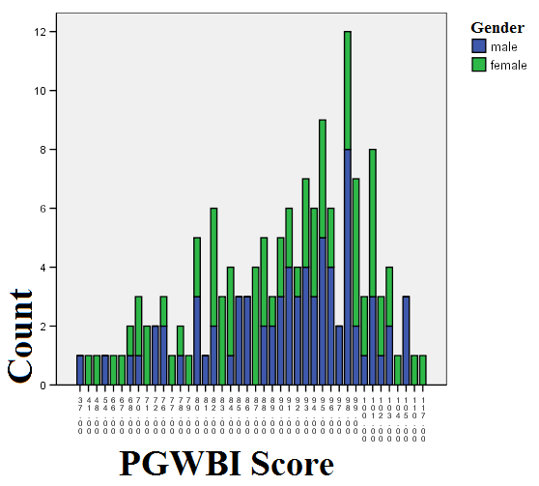
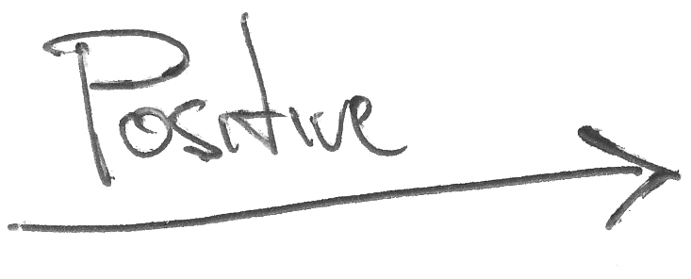
Results

Slide 43
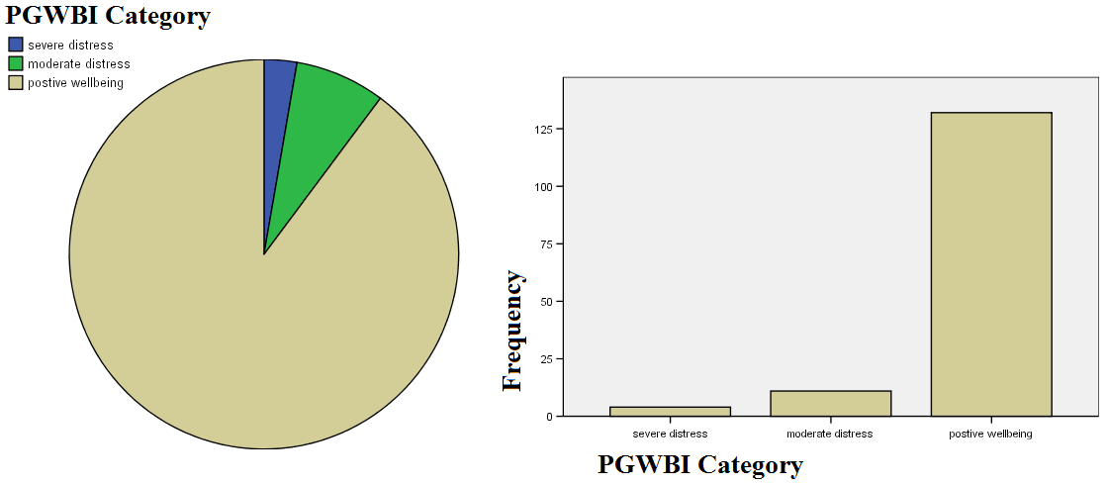
Results
132 subjects had positive wellbeing (90%)
11 subjects were under moderate distress
4 subjects qualified as severely distressed

Slide 44
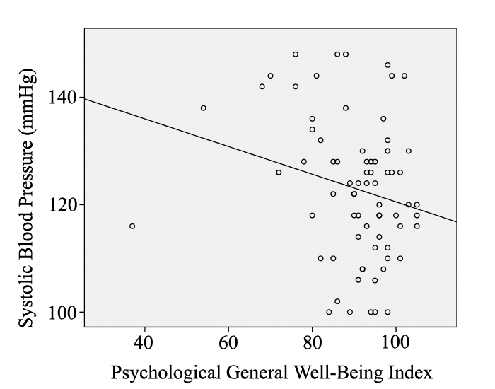
Among men, PGWBI (β=-0.249, r2=0.065, p=0.030) and age (β=0.243, r2=0.062, p=0.034) explained 8.6% of the variance in SBP

Slide 45
Among women, age (β=0.433, r2=0.176, p<0.001) was the only significant correlate of SBP

Slide 46
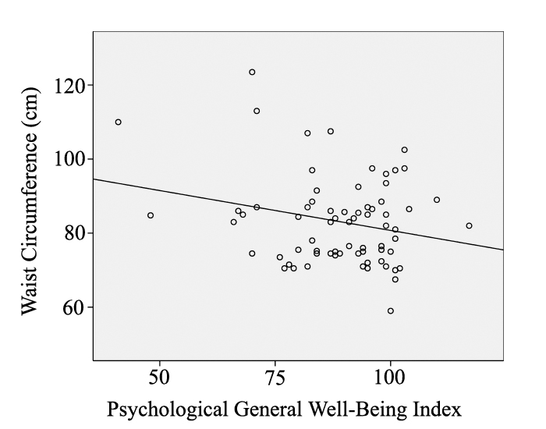
Among women, PGWBI (β=-0.212, r²=0.055, p=0.053) and age (β=0.409, r²=0.176, p<0.001) explained 20% of the variance in WC

Slide 47
Among men, neither age nor PGWBI was a significant correlate of WC (p>0.05)

Slide 48
Major Findings
Among men, mental well-being was negatively correlated with SBP
Among women, mental well-being was negatively correlated with WC
Further research is needed to establish the relationships among cardiometabolic disease risk factors and mental well-being and what mechanisms may account for the sex-dependent findings observed

Slide 49
Strengths & Limitations

Slide 50
Strengths & Limitations
Data were part of a larger study not designed to answer this question
Mental health outcomes among the sample were very homogenous

Slide 51
Strengths & Limitations
Data were collected through a rigorous multi-site randomized controlled trial
Assessed men and women across the lifespan

Slide 52
Thank You
Support provided by: NHLBI ⁄ NIH grant RO1 HL081893A2

