Slide 1
Cardiometabolic Risk Factors
and Their Associations with
Mental Health
C.D. Jensen, K.L. Darragh, B.A. Parker,
J.A. Capizzi, C.M. White, P.M. Clarkson,
P.D. Thompson, and L.S. Pescatello, FACSM
The Effects of Statins on Muscle Performance: NIH R01HL081893-01A2

Slide 2
Introduction
Why is mental health important?

Slide 3
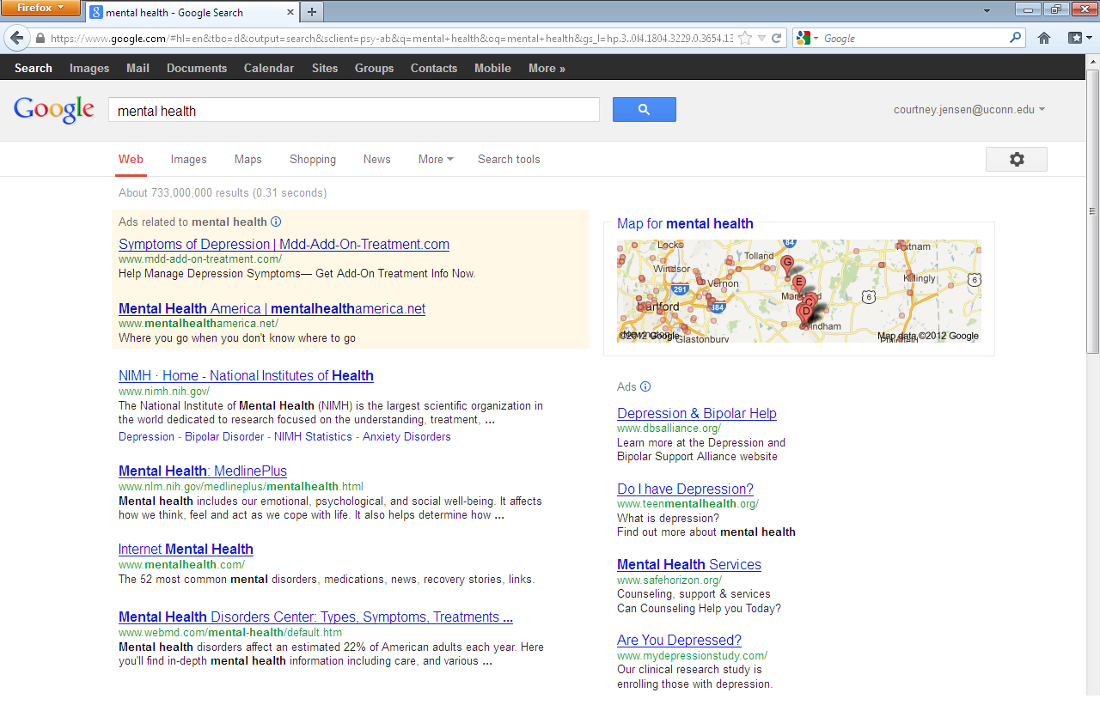

Slide 4
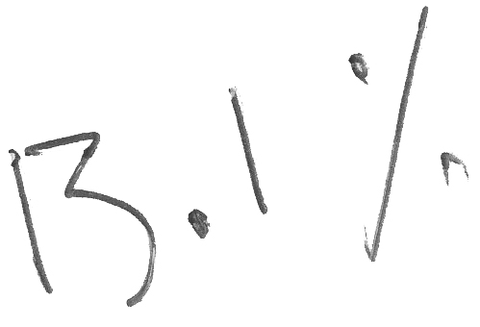

Slide 5
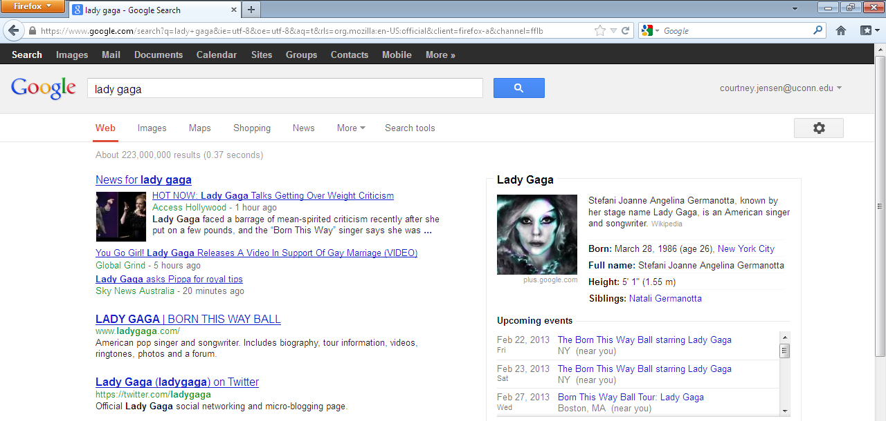
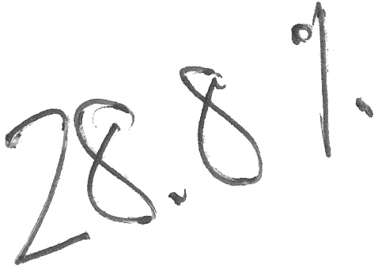

Slide 9
26.2%

Slide 12
Introduction
General mental health assessed through the
Psychological General Well-Being Index¹
1. Dupuy, 1984

Slide 13
Introduction

Slide 14
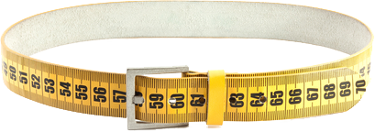
Introduction
Zaninotto et al. (2010)
Vogelzangs et al. (2008)
Weber-Hamann et al. (2006)
Hachet al. (2006)

Slide 15
Introduction
Zaninotto et al. (2010)
Vogelzangs et al. (2008)
Weber-Hamann et al. (2006)
Hachet al. (2006)

Slide 16
Introduction
Zaninotto et al. (2010)
Vogelzangs et al. (2008)
Weber-Hamann et al. (2006)
Hachet al. (2006)

Slide 17
Introduction
Zaninotto et al. (2010)
Vogelzangs et al. (2008)
Weber-Hamann et al. (2006)
Hachet al. (2006)

Slide 18
Introduction
Zaninotto et al. (2010)
Vogelzangs et al. (2008)
Weber-Hamann et al. (2006)
Hachet al. (2006)

Slide 19
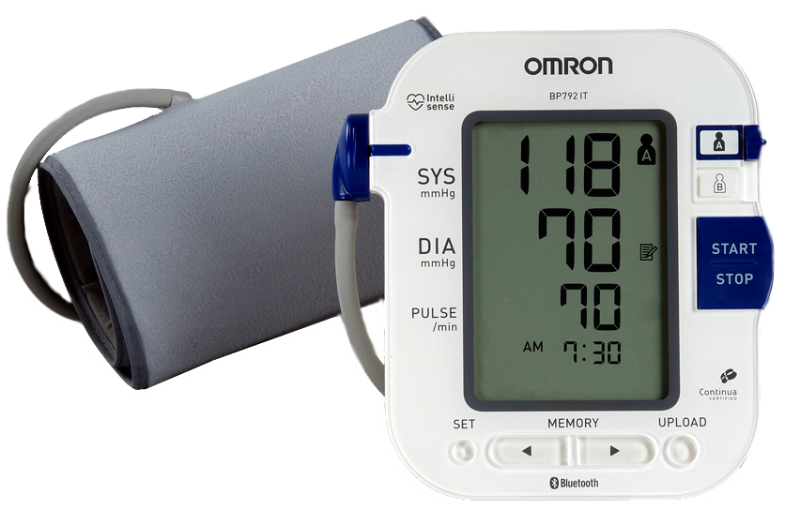
Introduction
Rosengren et al. (1993)
Pilgrim et al. (1992)
Barrett-Connor et al. (1994)
Donner-Banzhoff et al. (1997)
Wright et al. (2009)

Slide 20
Introduction
Rosengren et al. (1993)
Pilgrim et al. (1992)
Barrett-Connor et al. (1994)
Donner-Banzhoff et al. (1997)
Wright et al. (2009)

Slide 21
Introduction
Rosengren et al. (1993)
Pilgrim et al. (1992)
Barrett-Connor et al. (1994)
Donner-Banzhoff et al. (1997)
Wright et al. (2009)

Slide 22
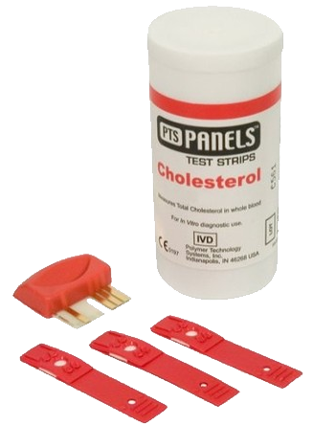
Introduction
Steegmans et al. (2000) found a positive relationship
Ledochowski et al. (2003) found a negative relationship
Brown et al. (1994) found no relationship at all

Slide 23
Introduction
HDL and mental well-being:
Negative relationship: Olusi & Fido (1996)
Positive relationship: Lehto et al. (2010) and Koponen et al. (2008)
LDL and mental well-being:
Positive relationship: Strick et al. (2002)
No relationship: Muldoon et al. (2000)

Slide 24
Introduction

Slide 25
Purpose
Examine the associations between
cardiometabolic risk factors and
mental health among men and
women across the life span

Slide 26
Subject Profile

Slide 27
Subject Profile
N = 147

Slide 28
Subject Profile
♂ = 74 ♀ = 73

Slide 29
Subject Profile
Ages 20 – 76

Slide 31
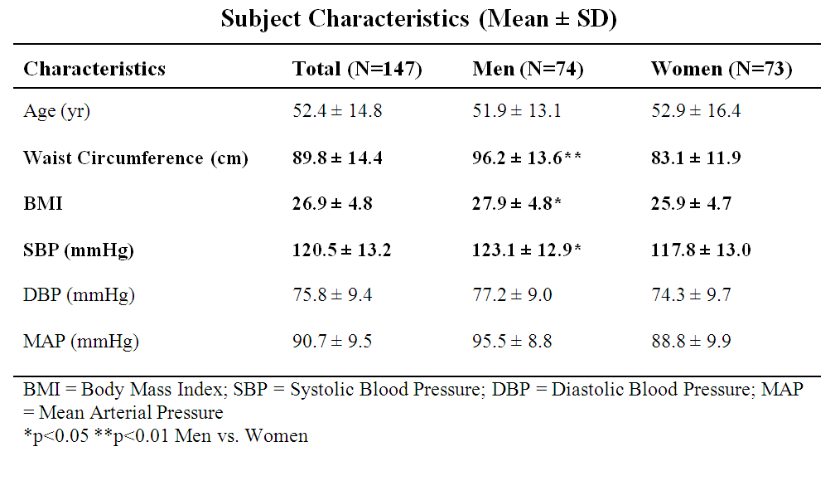

Slide 32
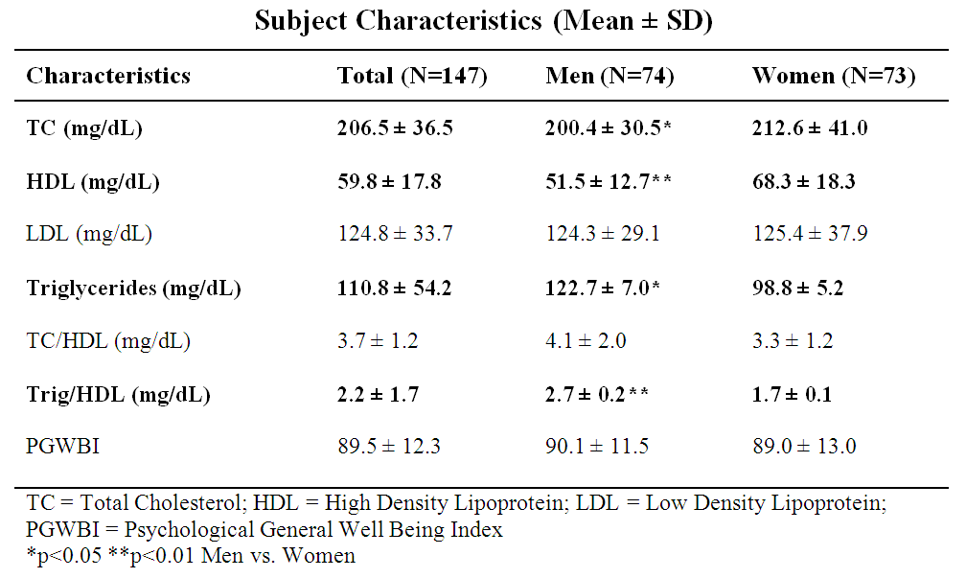

Slide 33
Data Collected
Cardiometabolic Mental Health
Total Cholesterol
HDL Cholesterol
LDL Cholesterol
Triglycerides
Blood Pressure
Waist Circumference
Body Mass Index
Psychological General
Well Being Index

Slide 34
Data Collected
Cardiometabolic Mental Health
Total Cholesterol
HDL Cholesterol
LDL Cholesterol
Triglycerides
Blood Pressure
Waist Circumference
Body Mass Index
Psychological General
Well Being Index

Slide 35
Data Collected
Cardiometabolic Mental Health
Total Cholesterol
HDL Cholesterol
LDL Cholesterol
Triglycerides
Blood Pressure
Waist Circumference
Body Mass Index
Psychological General
Well Being Index

Slide 36
Data Collected
Cardiometabolic Mental Health
Blood Pressure
Waist Circumference
Psychological General
Well Being Index

Slide 37
Data Collected
Cardiometabolic Mental Health
Blood Pressure
Waist Circumference
Psychological General
Well Being Index

Slide 38
Methods
BP (mmHg) was measured by auscultation
following 10-15 minutes of seated rest

Slide 39
Methods
Waist Circumference (cm) was measured
at the narrowest point of the subject’s torso
with a non-distensible tape measure

Slide 40
Methods
Cholesterol and triglycerides were measured with an automated clinical laboratory instrument (Model P Module, Roche Diagnostics)
Total cholesterol was determined by enzymatic colorimetric assay using cholesterol esterase and cholesterol oxidase
Cholesterol measured at Clinical Lab Partners in Hartford, CT

Slide 41
Methods
High density lipoprotein (HDL) cholesterol was determined by homogeneous enzymatic colorimetric assay
Triglycerides determined by coupled enzymatic reaction
Low density lipoprotein (LDL) cholesterol calculated using the Friedwald equation
Cholesterol measured at Clinical Lab Partners in Hartford, CT

Slide 42
Methods
Psychological General
Well Being Index
22-question multiple choice assessment of one’s general wellbeing¹
Composite score categories based on PGWBI User Manual²:
0-60: Severe psychological distress
61-72: Moderate psychological distress
73-110: Positive wellbeing
1. Dupuy, 1984 2. Chassany et al., 2004

Slide 43
Methods
Psychological General
Well Being Index
22-question multiple choice assessment of one’s general wellbeing¹
Composite score categories based on PGWBI User Manual²:
0-60: Severe psychological distress
61-72: Moderate psychological distress
73-110: Positive wellbeing
Higher numbers are more desirable
1. Dupuy, 1984 2. Chassany et al., 2004

Slide 44
Statistical Analyses
Multivariate regression analyses tested the relationships among cardiometabolic risk factors and PGWBI
Due to significant gender effects, the results
are presented by gender

Slide 45
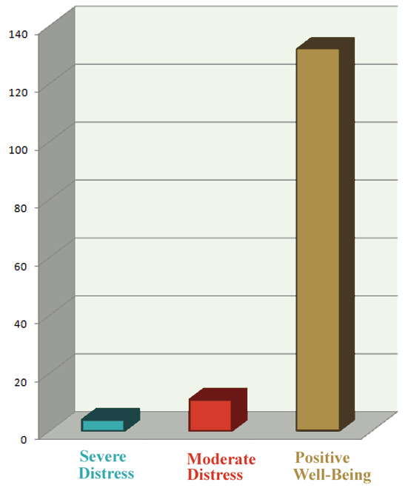
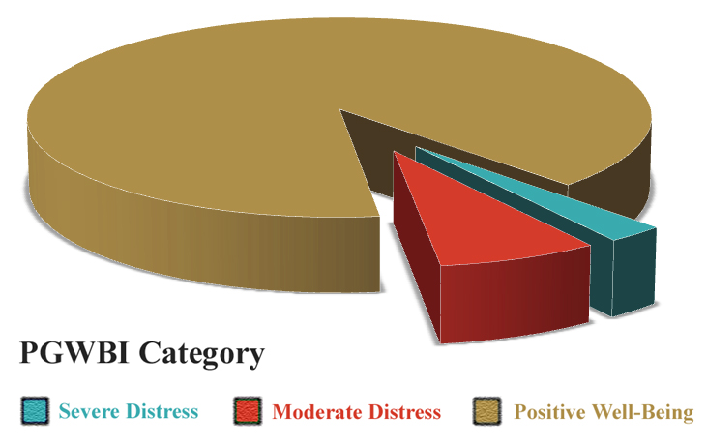
Results
132 subjects had positive wellbeing (90%)
11 subjects were under moderate distress
4 subjects qualified as severely distressed

Slide 46
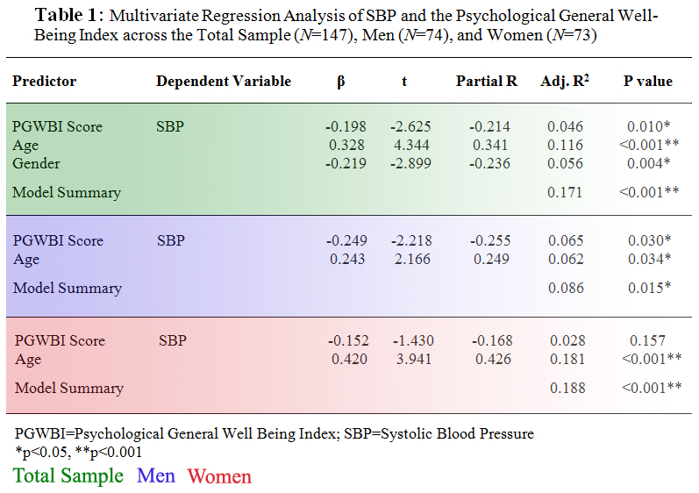

Slide 47
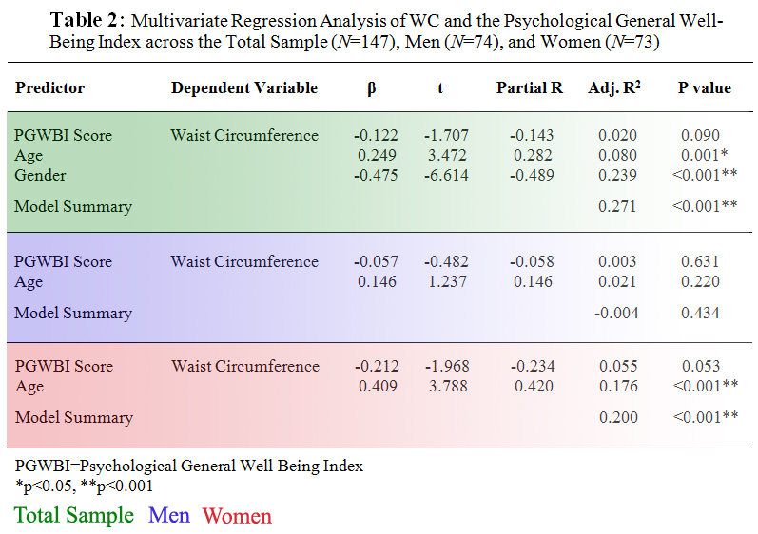

Slide 48
Major Findings
Among men, mental well-being was negatively correlated with SBP
Among women, mental well-being was negatively correlated with WC
No findings with blood lipid lipoprotein profile
Further research is needed to establish the relationships among cardiometabolic disease risk factors and mental well-being and what mechanisms may account for the sex-dependent findings observed

Slide 49
Strengths & Limitations

Slide 50
Strengths & Limitations
Data were part of a larger study not designed to answer this question
Mental health outcomes among the sample were very homogenous

Slide 51
Strengths & Limitations
Data were collected through a rigorous multi-site randomized controlled trial
Assessed men and women across the lifespan

Slide 52
Thank You
Support provided by: NHLBI ⁄ NIH grant RO1 HL081893A2

Slide 53
Extra Slides
Sources, graphs, and additional information

Slide 54
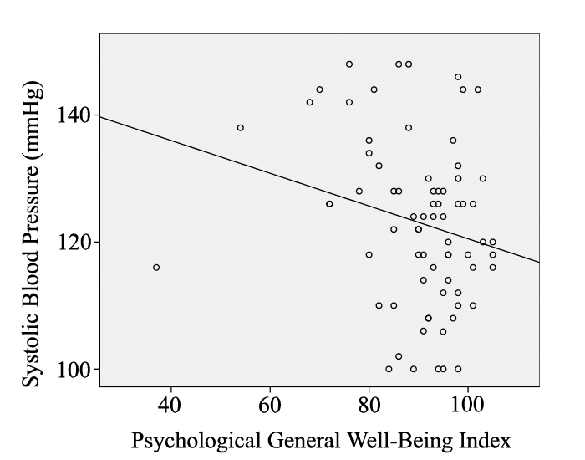
Among men, PGWBI (β=-0.249, r2=0.065, p=0.030) and age (β=0.243, r2=0.062, p=0.034) explained 8.6% of the variance in SBP

Slide 55
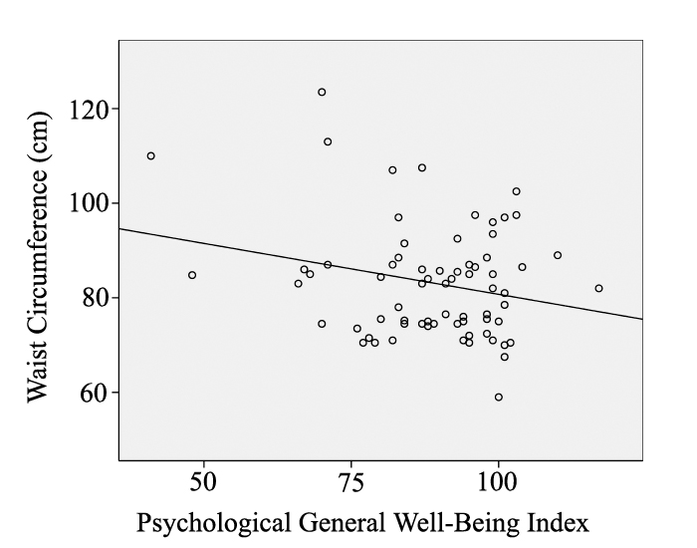
Among women, PGWBI (β=-0.212, r²=0.055, p=0.053) and age (β=0.409, r²=0.176, p<0.001) explained 20% of the variance in WC

Slide 56
Other data on WC and PGWBI

Slide 57
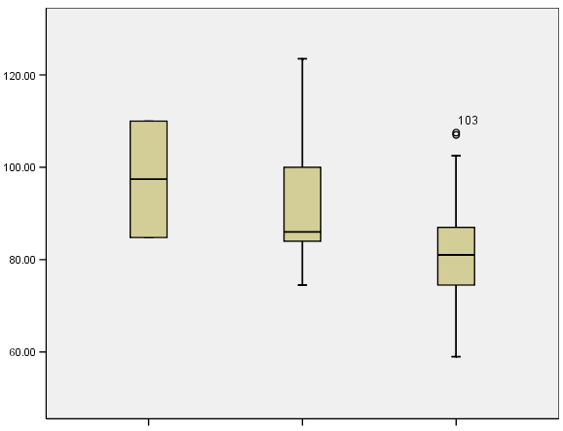
WC and PGWBI among Women
As waist circumference decreases, so does distress (categorically)
P = 0.004 when controlling for age in a linear regression with WC as the dependent variable
P=0.003 with no other variables in the model (linear regression with WC as the dependent variable)
P=0.020 in a multinomial regression with distress category as the dependent variable
Waist Circumference (cm)
Severe Distress Moderate Distress Positive Wellbeing

Slide 58
WC and PGWBI among Women
As waist circumference decreases, so does distress
β = -0.239
t = -2.029
Partial R = -0.239
Adj. R² = 0.057
P = 0.046

Slide 59
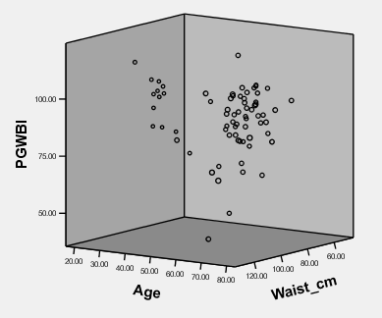
Among women, PGWBI (β=-0.212, r²=0.055, p=0.053) and age (β=0.409, r²=0.176, p<0.001) explained 20% of the variance in WC; but neither was a significant correlate of WC among men (p>0.05).

Slide 60
Split the sample by Gender . . .
WC Predicting PGWBI Total Sample Men Women
PGWBI Score 0.218 0.694 0.046
PGWBI Category 0.301 0.427 0.020
PGWBI Distress 0.117 0.869 0.003
PGWBI Mean 0.699 0.730 0.219
PGWBI Median 0.546 0.759 0.255
PGWBI Predicting WC Total Sample Men Women
PGWBI Score 0.090 0.694 0.046
PGWBI Category 0.070 0.799 0.003
PGWBI Distress 0.030 0.871 0.003
PGWBI Mean 0.331 0.734 0.225
PGWBI Median 0.388 0.763 0.261

Slide 61
Split the sample by Gender . . .
WC Predicting PGWBI Total Sample Men Women
PGWBI Score 0.218 0.694 0.046
PGWBI Category 0.301 0.427 0.020
PGWBI Distress 0.117 0.869 0.003
PGWBI Mean 0.699 0.730 0.219
PGWBI Median 0.546 0.759 0.255
PGWBI Predicting WC Total Sample Men Women
PGWBI Score 0.090 0.694 0.046
PGWBI Category 0.070 0.799 0.003
PGWBI Distress 0.030 0.871 0.003
PGWBI Mean 0.331 0.734 0.225
PGWBI Median 0.388 0.763 0.261

Slide 62
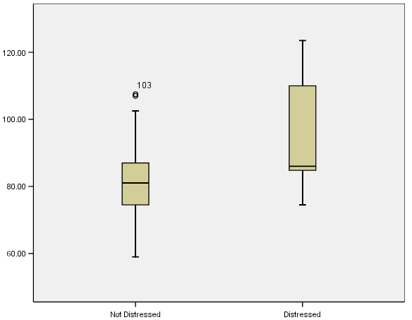
WC and PGWBI among Women
As waist circumference increases so does distress (categorically)
P = 0.004 when controlling for age in a linear regression with WC as the dependent variable
P=0.003 with no other variables in the model (linear regression with WC as the dependent variable)
P=0.003 in a multinomial regression with distress category as the dependent variable
Waist Circumference (cm)
Not Distressed Distressed

Slide 63
Other data on BP and PGWBI

Slide 64
High BP with mental health (higher bp results in cognitive impairment) Tsvigoulis G. Association of higher diastolic blood pressure levels with cognitive impairment. Neurology 2009; 73:589-595 "10 mm Hg in diastolic blood pressure was associated with a 7% increased risk of cognitive impairment." 8. Cacciatore F, Abete P, Ferrara N, et al. The role of blood pressure in cognitive impairment in an elderly population. J Hypertens 1997;15:135–142. 9. Kilander L, Nyman H, Boberg M, Hansson L, Lithell H. Hypertension is related to cognitive impairment: a 20-year follow-up of 999 men. Hypertension 1998;31:780 –786.

Slide 65
Causes: High blood pressure - AMA - coping strategies to a stressful life include eating and drinking and smoking. As well as catecholamines and cortisol. 7 Jun 2012 http://www.heart.org/HEARTORG/Conditions/HighBloodPressure/PreventionTreatmentofHighBloodPressure/Stress-and-Blood-Pressure_UCM_301883_Article.jsp Dr. Sheldon G. Sheps wrote on the Mayo Clinic website Mood disorders; chronic anxiety; summation of acute spikes influene lifestyle Sheps, Sheldon G. Mayo Clinic. High blood pressure (hypertension). Can anxiety cause high blood pressure? Web. May 16, 2012. medications to treat mood disorders (e.g. anxiety) may have an effect on bp

Slide 66
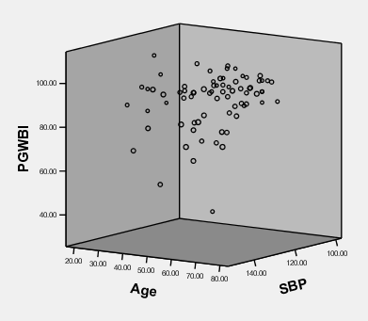
Among men, PGWBI (β=-0.249, r²=0.065, p=0.030) and age (β=0.243, r²=0.062, p=0.034) explained 8.6% of the variance in SBP

Slide 67
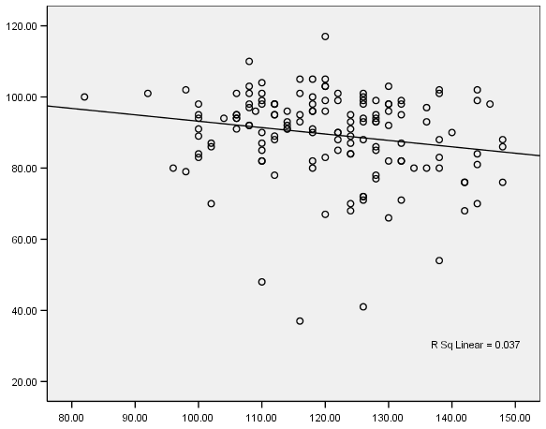
Distribution of PGWBI Scores
As SBP decreases,
so does distress
β = -0.194
t = -2.376
Partial R = -0.194
Adj. R² = 0.038
P = 0.019
PGWBI Composite Score
Systolic Blood Pressure

Slide 68
Cholesterol and PGWBI

Slide 69
Several researchers have jettisoned the subjective approach entirely, attempting to link TC with objective outcomes such as suicide attempts (Olié et al., 2011) and incidence of violent crime (Golomb, 1998). Others have investigated the relationship between TC and a predisposition for cognitive decline (Anstey et al., 2008) as well as various measures of intelligence such as abstract reasoning and concentration (Elias et al., 2005).
Although cholesterol’s role in each of these lacks a consistent verdict, the data do show apparent trends. Numerous researchers have found low levels of TC to associate with elevated risk of suicide (Engelberg, 1992; Garland et al., 2000; Kunugia et al., 1995; Olié et al., 2011) while fewer have found no correlation (Pekkanen et al., 1989; Smith et al., 1990). Most studies support the association between low TC levels and increased participation in violent crime (Golomb et al., 2000; Jacobs et al., 1992) while fewer have found no correlation (Cummings & Psaty, 1994; New, et al., 1999). Anstey et al. (2008) found high midlife TC to associate with an elevated risk of Alzheimer’s among 14,331 subjects, while Tan et al. (2003) found no associations among 5,209 subjects. And the findings among measures of intelligence vary wildly depending on gender and the tests administered (Benton, 1995; Muldoon et al., 1997), but typically support a positive relationship between TC and cognitive performance (Elias et al., 2005).

Slide 70
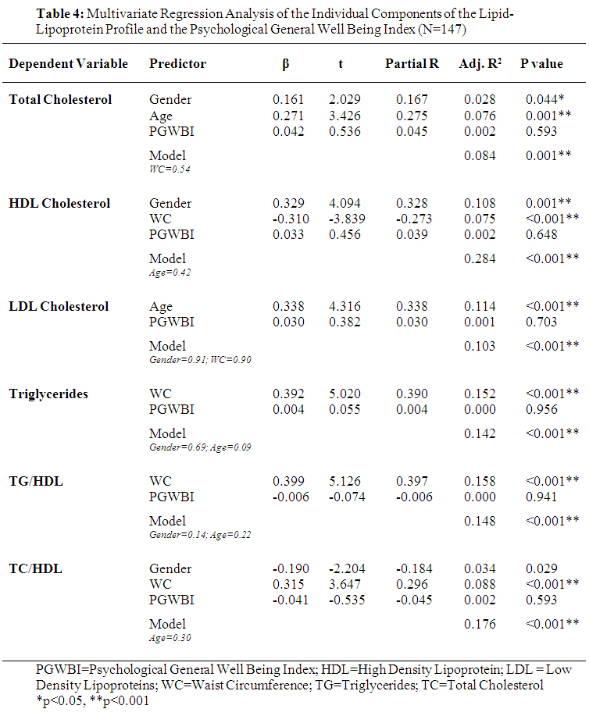

Slide 71
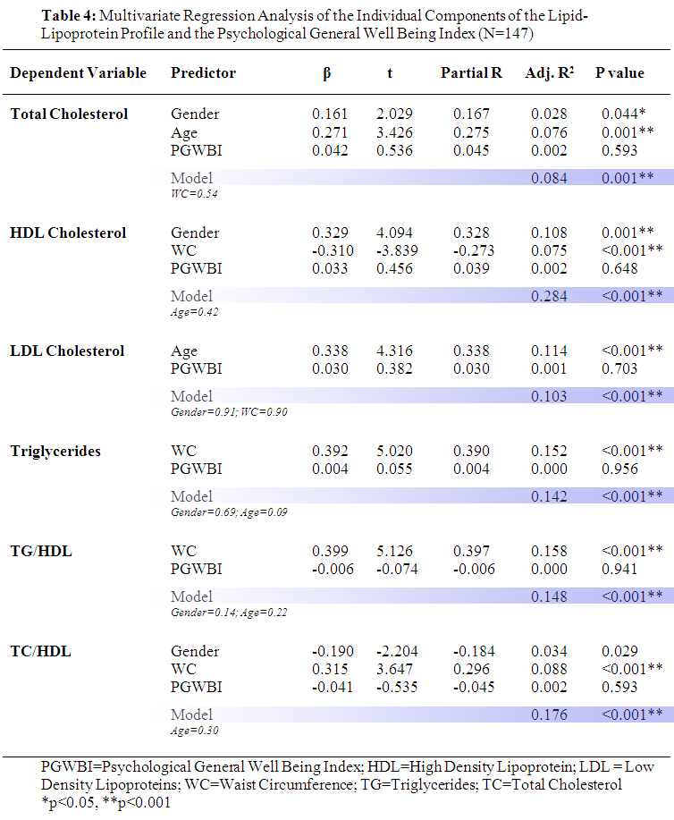

Slide 72
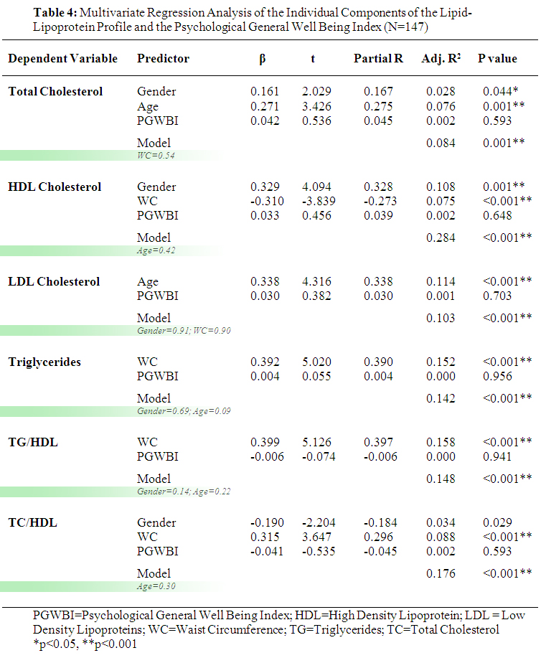

Slide 73
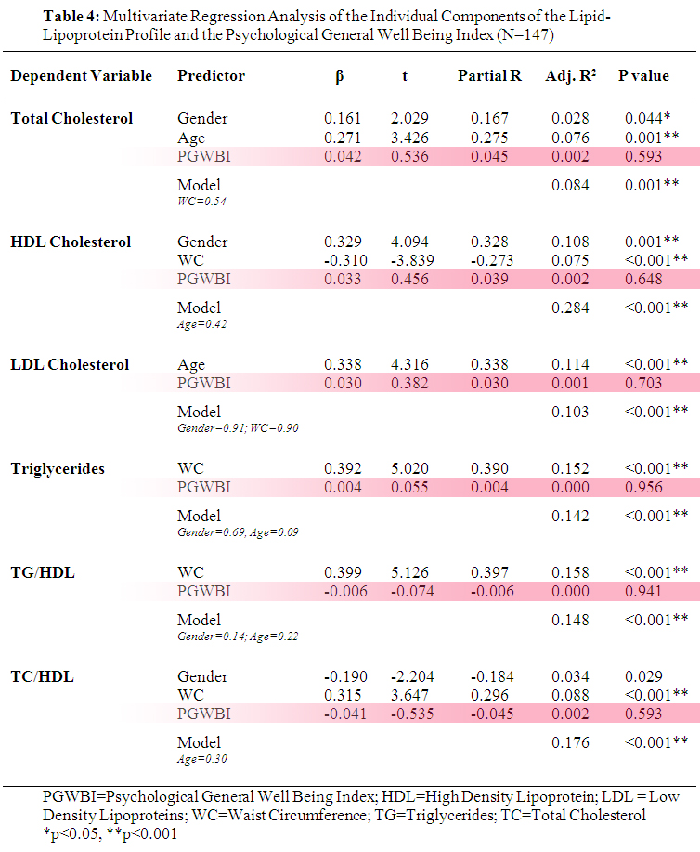

Slide 74
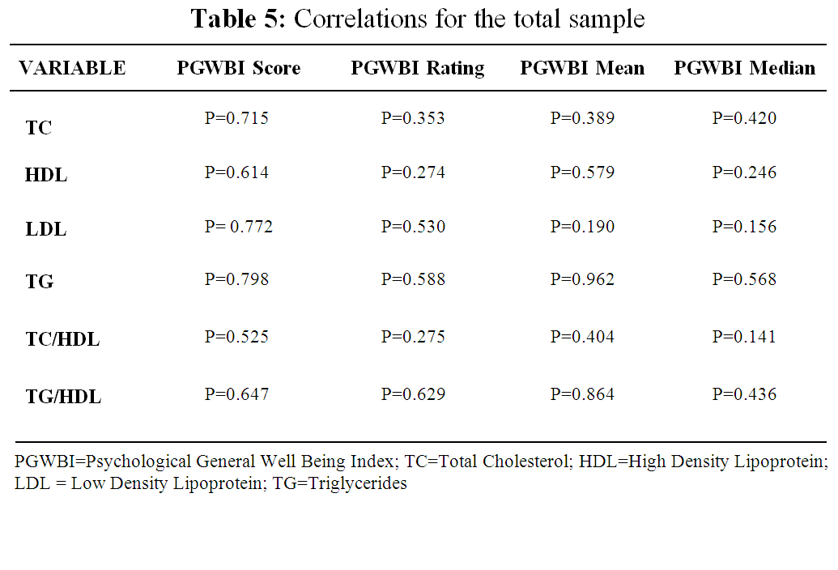

Slide 75
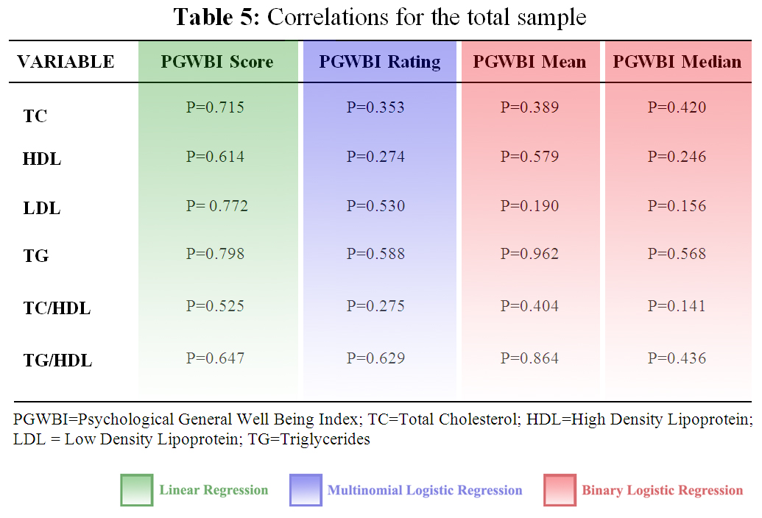

Slide 77
The Metabolic Syndrome

Slide 78
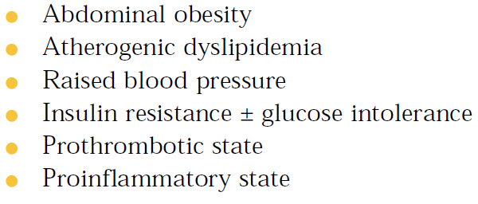
Third report of the National Cholesterol Education Program (NCEP) expert panel on detection, evaluation, and treatment of high blood cholesterol in adults (Adult Treatment Panel III). Final Report. Circulation, 2002; 106: 3143–3421

Slide 79
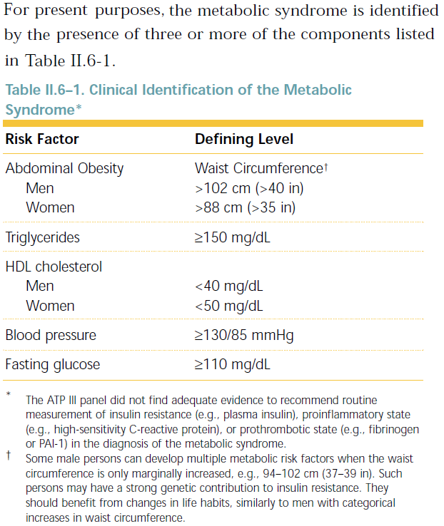

Slide 80
The STOMP database contains
data for 4 out of 5 variables
Metabolic Syndrome cannot be
diagnosed
All subjects were stratified into the
appropriate classes (yes or no) for
each variable that is available
The total number of risk variables
was summed for each subject

Slide 81
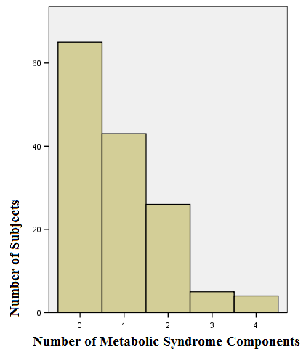
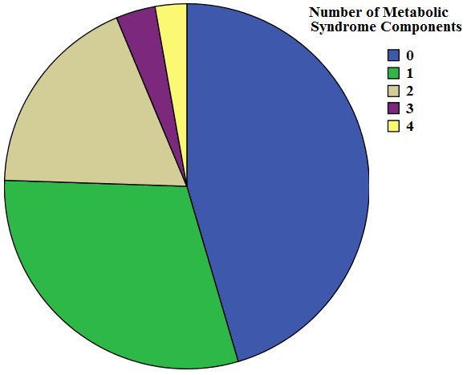
Summation of risk variables for Metabolic Syndrome

Slide 82
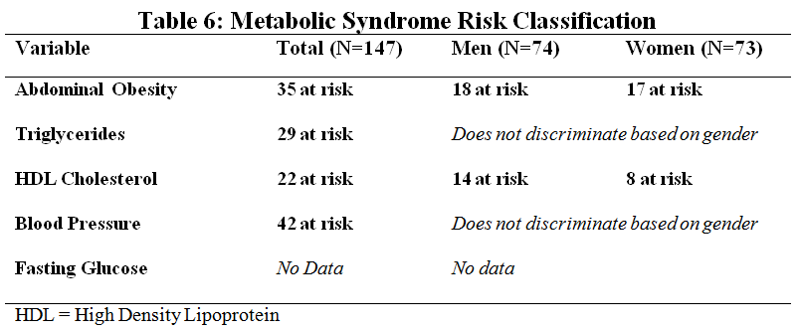
No significant differences between men and women. . .

