Slide 1
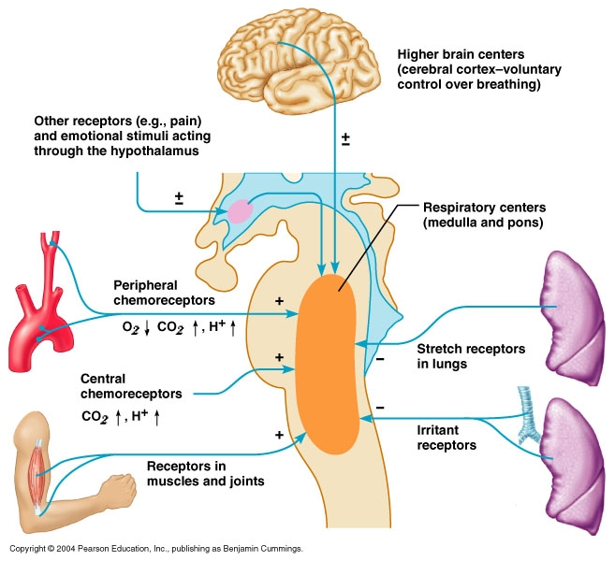
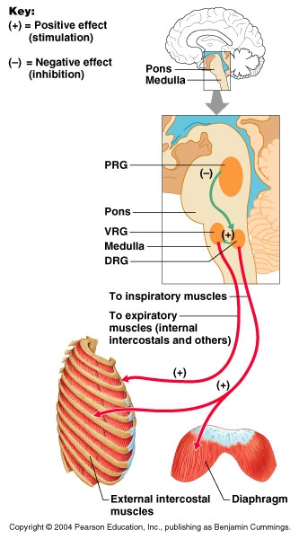
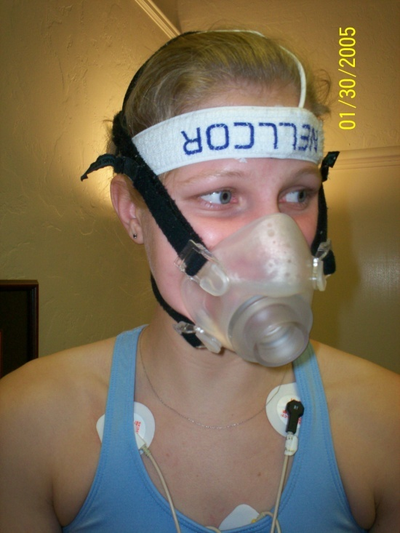
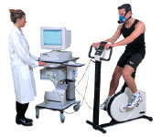
Diminished Ventilatory Responses During Post-Exertional Malaise Contributes to Exercise Intolerance in Myalgic Encephalomyelitis/Chronic Fatigue Syndrome
Francisco H. Guiao, Staci Stevens, Todd Davenport, Christopher R. Snell, Jared Stevens, J. Mark VanNess
Department of Health and Exercise Science, University of the Pacific, Stockton, CA
ABSTRACT
Reduced functional capacity and post-exertional malaise following physical activity are hallmark symptoms of Myalgic Encephalomyelitis/Chronic Fatigue Syndrome (ME/CFS). The mechanisms producing exercise intolerance in the post-exertional state have not been adequately described.
PURPOSE: To compare the ventilatory response to repeated exercise stress in control and ME/CFS subjects.
METHODS: 69 female subjects were recruited for the study, 51 ME/CFS patients and 18 age and weight matched controls. All underwent two maximal exercise tests 24 hours apart. Oxygen consumption, minute ventilation (V_{E}), tidal volume (TV), respiratory rate (RR), end-tidal oxygen and carbon dioxide (ET0₂/ETCO₂) were measured at rest, at the anaerobic threshold, and at maximal exercise. Multivariate analyses were performed for group (ME/CFS vs control), test (exercise test 1 vs test 2), and condition (rest vs anaerobic threshold vs maximal exertion) with univariate follow up.
RESULTS: 51 ME/CFS subjects and 18 control subjects reached criteria for maximal effort. The overall multivariate analysis was significant for group and condition. Follow-up univariate and post-hoc showed VO₂, V_{E}, ETO₂, and ETCO₂ were lower in the ME/CFS group only on exercise test 2. Post hoc for condition was significant for ventilation at maximal exercise only. Respiratory rate and TV were not different between tests or groups.
CONCLUSION: In the absence of a second exercise test, the lack of any significant differences for the first test would appear to suggest no exercise intolerance in ME/CFS patients. However, the results from the second test indicate the presence of exercise intolerance and post-exertional malaise. Diminished ventilatory responses accompany reductions in work output and oxygen consumption during post exertional malaise in ME/CFS patients.
SINGLE GRADED EXERCISE TEST
40 females – 21 CFS, 19 Control (age and weight matched)
Bicycle Ergometer (15 W/min increase)
Record cardiopulmonary variables
VO₂: oxygen consumption
V_{E}: Ventilation
WL: work output
Values shown below are taken at the anaerobic threshold and at maximal effort
*indicates p>0.05 versus control
Blunted ventilatory responses in ME/CFS versus control
Is this an example of skeletal muscle fatigue, diminished ventilatory drive, or simply due to deconditioning?
EXERCISE TEST-RETEST
69 females – 57 CFS, 12 Control (age and weight matched)
Bicycle Ergometer (15 W/min increase)
Record ventilation
V_{E}: Ventilation
peak and anaerobic threshold for test 1 and test 2
*Repeat the test 24 hours later!
*indicates p>0.05 versus control
Similar reductions in ventilation at peak exercise and at the anaerobic threshold
Greater reduction in ventilation on test 2, especially at the anaerobic threshold
 | Peak VE-Test 1 (L/min) | Peak VE-Test 2 (L/min) | VE@AT-Test 1 (L/min) | VE@AT-Test 2 (L/min)
CFS (n=57) | 67.5 + 2.7* | 63.8 + 2.3* | 25.6 + 1.1 | 23.1 + 1.0*
Control (n=12) | 86.6 + 9.0 | 91.9 + 10.4 | 26.1 + 1.8 | 30.6 + 2.6
 | Peak VE (L/min) | Peak WL (Watts) | Peak VO2 (mL/kg/min) | VE @ AT (L/min)
CFS (n=21) | 71.9 + 4.4* | 119.3 + 4.5* | 24.3 + 5.4* | 32.3 + 1.9*
Control (n=19) | 101.1 + 3.37 | 173.7 + 24.9 | 31.4 + 4.9 | 46.5 + 5.8*
CONCLUSIONS
The mechanisms producing the diminished ventilatory activity or “drive” are not known:
Possible ventilatory anomalies in ME/CFS
Oxidative deficiency at the skeletal muscle may be causing fatigue
Reduced ventilatory “drive” from limited sensory feedback
Graded Exercise to Examine Pulmonary Ventilation
“Blunted” or diminished ventilatory response to exercise may represent skeletal muscle fatigue, but it is difficulty to separate confounding effects of deconditioning
Test retest paradigm shows post-exertional effects
Test-Retest Effects
2 exercise tests 24 hours apart
Adjusts for the effects of deconditioning
Examines the post-exertional response more clearly
Subjects
Seventy-eight (n=78) patients with ME/CFS and thirty-one (n=31) sedentary control subjects that were age and weight matched. All subjects performed graded exercise tests to maximal exertion. Only subjects that reached RER > 1.09 are included in the analysis.
Subject Characteristics:
Test 1 Test 2
 | Age (yrs.) | Height (in) | Body wt. (lbs.)
CFS | 32+9 | 66.2+2.8 | 143.8+22.5
Control | 28+7 | 65.5+2.2 | 143.8+23.2
Acknowledgments
Special thanks to all the patients and subjects that volunteered for this study. This study was supported by a grant from the CFIDS Association of America.

